Slide 1
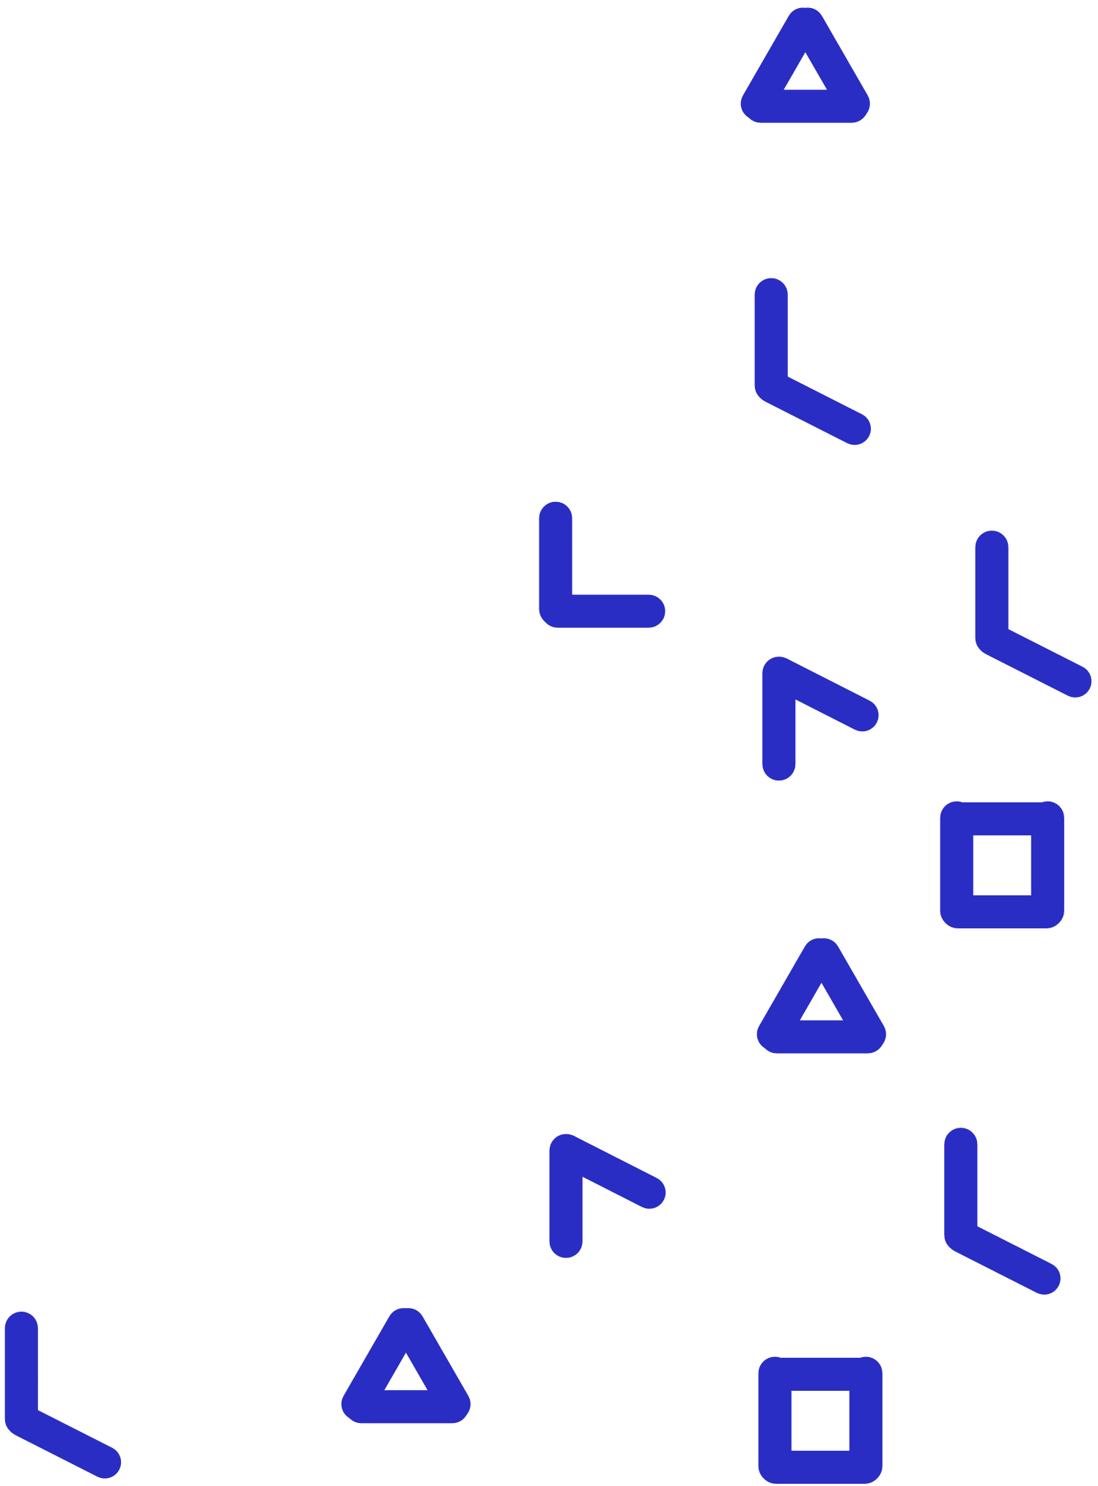
Karel the Turtle
Teacher’s Guide

Slide 2
Overview of Sections
1. What is Karel the Turtle?
2. What are the elements of the digital environment of Karel?
3. How can I use and customise Karel?
4. How can I view student progress on Karel?
Notes:
Link these as well

Slide 3
1
What is Karel the Turtle?
BACK TO MAIN MENU

Slide 4
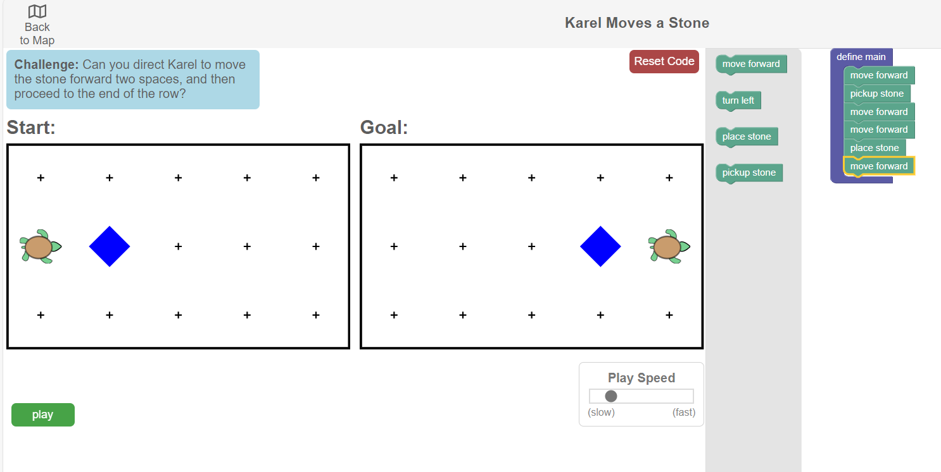
Introduction to Karel the Turtle
What is Karel the Turtle?
Karel the Turtle is a PILA application that develops and assesses students’ ability to build computational solutions to problems using a block-based programming language.
Students must program a virtual turtle-shaped agent (named ‘Karel’) to do certain actions in a grid-like world.

Slide 5
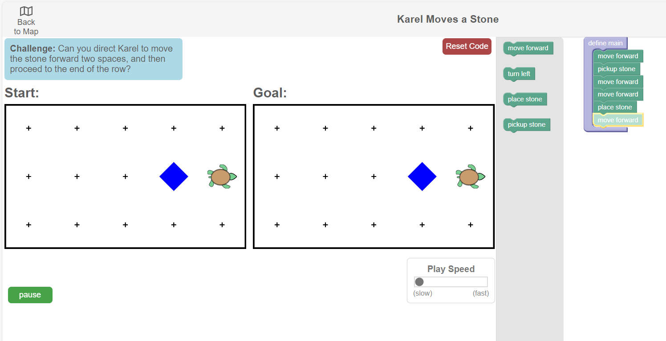
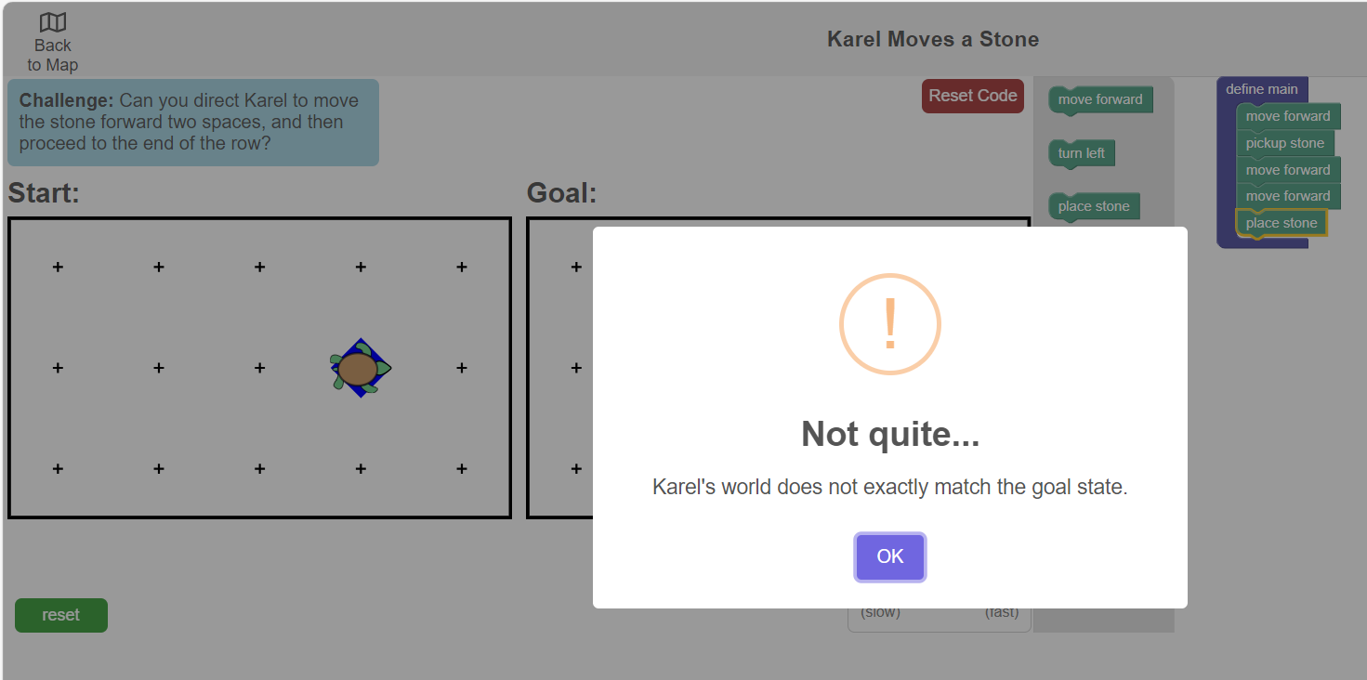
Introduction to Karel the Turtle
How does it work?
Students can use visual code blocks to create a program that instructs Karel to perform actions. The aim is to make the ‘start’ state match the ‘goal’ state.
Students can watch Karel follow their instructions in the simulated start world by using the ‘play’ button. They receive visual and pop-up feedback on their program.

Slide 6
Introduction to Karel the Turtle
What are the target skills?
Karel aims for students to learn and demonstrate…
Computational problem solving
Self-regulated learning
…how to manage and make decisions about one’s own learning processes. This includes setting goals, planning strategies, and monitoring progress.
…how to develop solutions to problems that can be executed by a computer. This involves breaking problems down into smaller, more manageable parts, recognizing patterns and other skills.

Slide 7
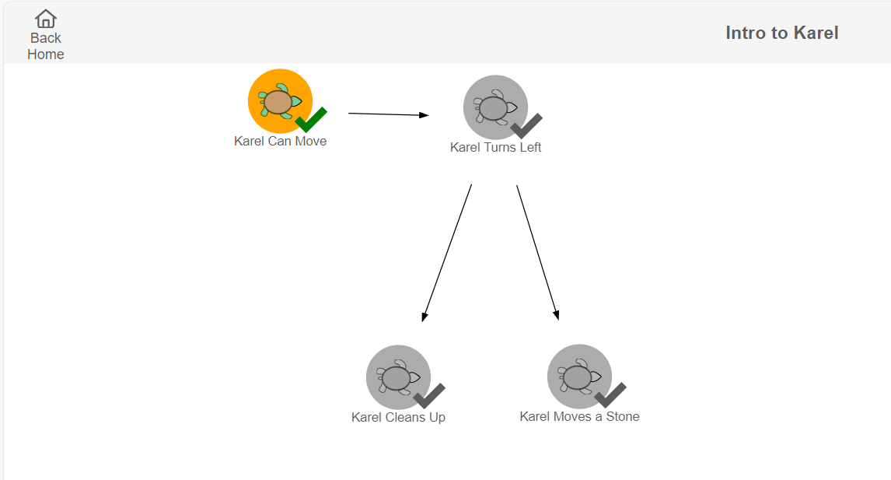
Introduction to Karel the Turtle
How is content organised in Karel?
In Karel, there are individual tasks and maps.
Maps contain sequences of individual tasks that students must complete.
Maps can be designed to meet different needs. For example, a map could focus on one concept (e.g., repetition) with increasingly difficult tasks to scaffold student learning.
Task
Map

Slide 8
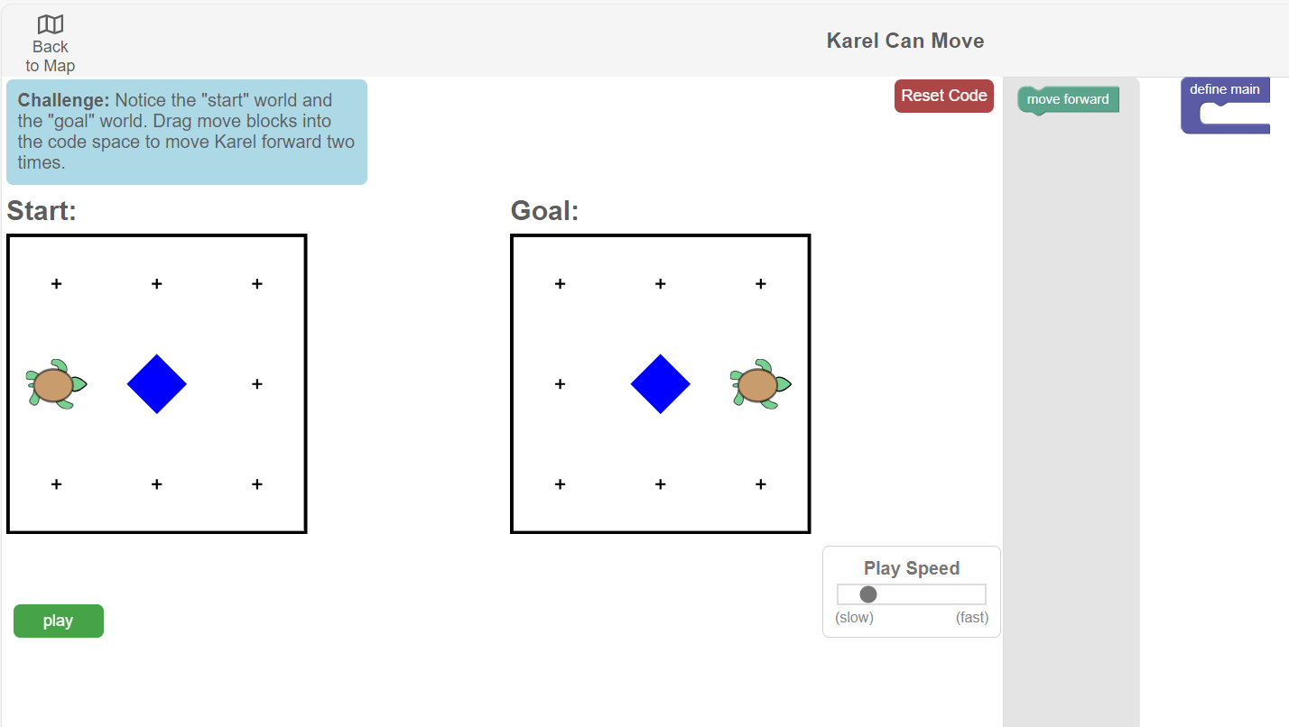
Introduction to Karel the Turtle
How is content organised in Karel?
When you click on a specific task in the map, it takes you to a block-based programming tool and a simulation.
This is where students build their program to achieve the goal world.
Task

Slide 9
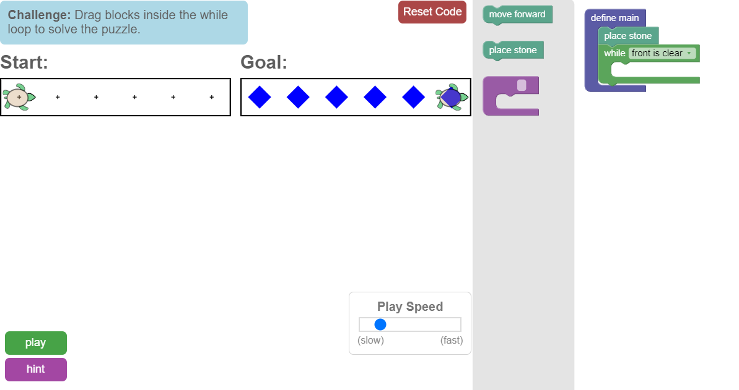
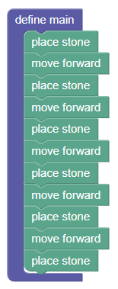
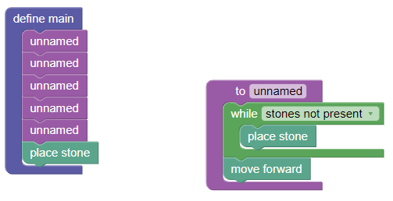
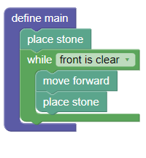
Introduction to Karel the Turtle
‘Low Floor, High Ceiling’
Karel tasks are ‘low floor, high ceiling.’
This means students with no experience in programming can learn quickly how to use the tool and make progress, while students who do have programming experience can still be challenged.
The tasks are open-ended to allow students flexibility in how they build their program. A student’s program (even if unfinished) can provide evidence of where they are at in their learning and where they need help.
Student A: Solved the task, but using linear code
Student B: Solved the task using more complex code blocks, but not the best use of functions and while loops
Student C: Solved the task with most optimal solution

Slide 10
Quiz: Section 1
Which of the following skills does Karel the Turtle aim at improving among learners?
Computational Problem Solving
Systems Thinking
Creative Thinking
Game Design

Slide 11
Quiz: Section 1
Which of the following skills does Karel the Turtle aim at improving among learners?
Computational Problem Solving
Systems Thinking
Creative Thinking
Game Design

Slide 12
Quiz: Section 1
Karel is based on a ‘low-floor, high-ceiling’ approach. Can students who already come with programming experience still learn from Karel?
Yes
No

Slide 13
Quiz: Section 1
Karel is based on a ‘low-floor, high-ceiling’ approach. Can students who already come with programming experience still learn from Karel?
Yes
No

Slide 14
Congrats, you have finished Section 1!
Time for a quick break.

Slide 15
2
What are the elements of Karel’s task interface?
BACK TO MAIN MENU

Slide 16
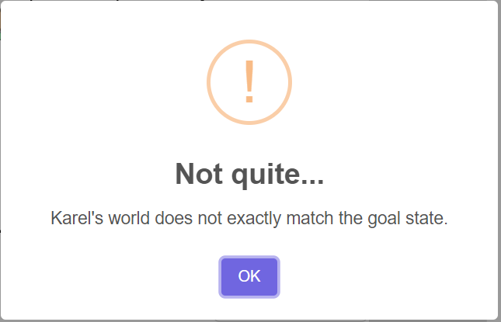
Key Elements
Each task in Karel’s interface has 8 key elements.
Look at the labels in this picture carefully. Then click on the numbers to know more.

Slide 17
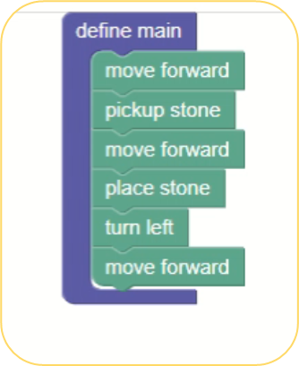
Virtual Programmable Agent
Karel
Karel is the virtual ‘turtle’ that students can instruct with their program. Karel can understand four basic instructions (available in the form of code blocks on the right):
Move forward
Pickup stone
Place stone
Turn left
Play the video on the right to see how it works!
This is a stone

Slide 18
Karel’s Grid World
This is the grid-like world that Karel inhabits and performs actions in, when instructed.
Each cell in the grid can be empty or contain a finite number of stones
Cells can be separated by a wall that limits Karel’s movement

Slide 19
Karel’s Grid World
There are two grid states in Karel. The ‘Start State’ represents Karel’s current state, and the ‘Goal State’ represents the state that students must instruct Karel to achieve.
To reach the goal in this scenario, students must build a program that instructs Karel to move forward two times and pick up a stone.

Slide 20
Block-based program builder
The toolbox contains pre-defined code blocks which can be used to build a program
Students can drag and drop the instructions from the toolbox to the workspace.
Students must place the code blocks inside the ‘define main’ block for the program to play correctly.
Toolbox
Workspace

Slide 21
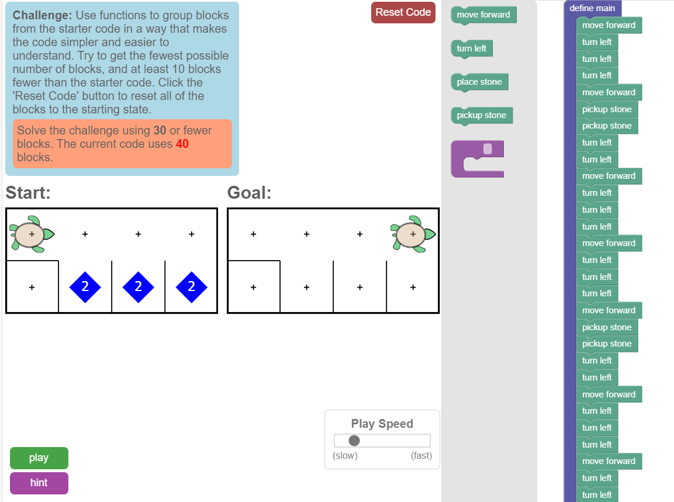
Task Instructions
Task instructions state what students must do in the task and what the desired goal(s) are.
Instructions can reinforce the desired goal state or provide further criteria by which the solution will be assessed (e.g. using a maximum number of code blocks in the program).

Slide 22
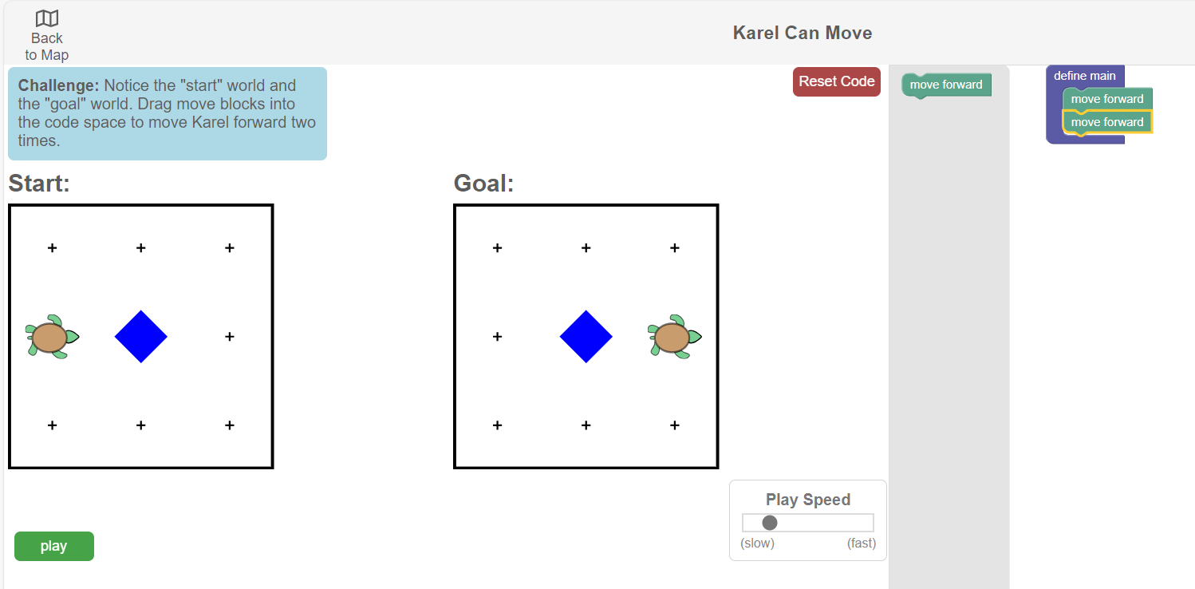
Play Button
The play button allows the student to run and test their code.
At any point in the building process, students can click on play to test their code. Karel will move in the ‘Start’ world according to the instructions in the program.

Slide 23
Play Speed Slider
This slider allows students to adjust the speed at which the program runs.
The play speed slider lets students adjust the speed at which the program plays (make it faster or slower) to help identify where an error is located, or what to do next.

Slide 24
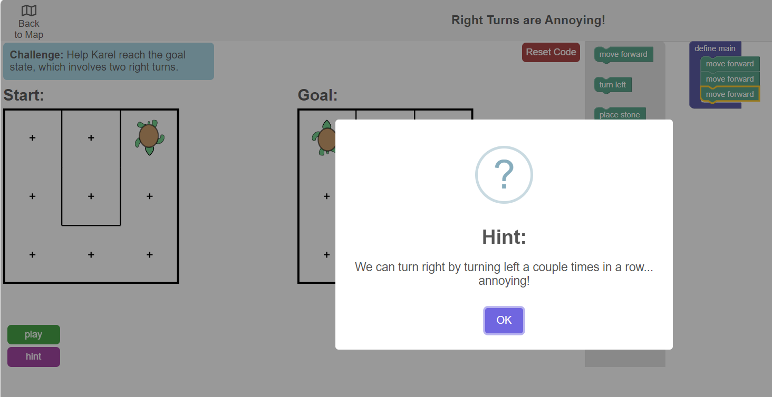
Hint Button
The hint button offers extra feedback in case students are stuck.

Slide 25
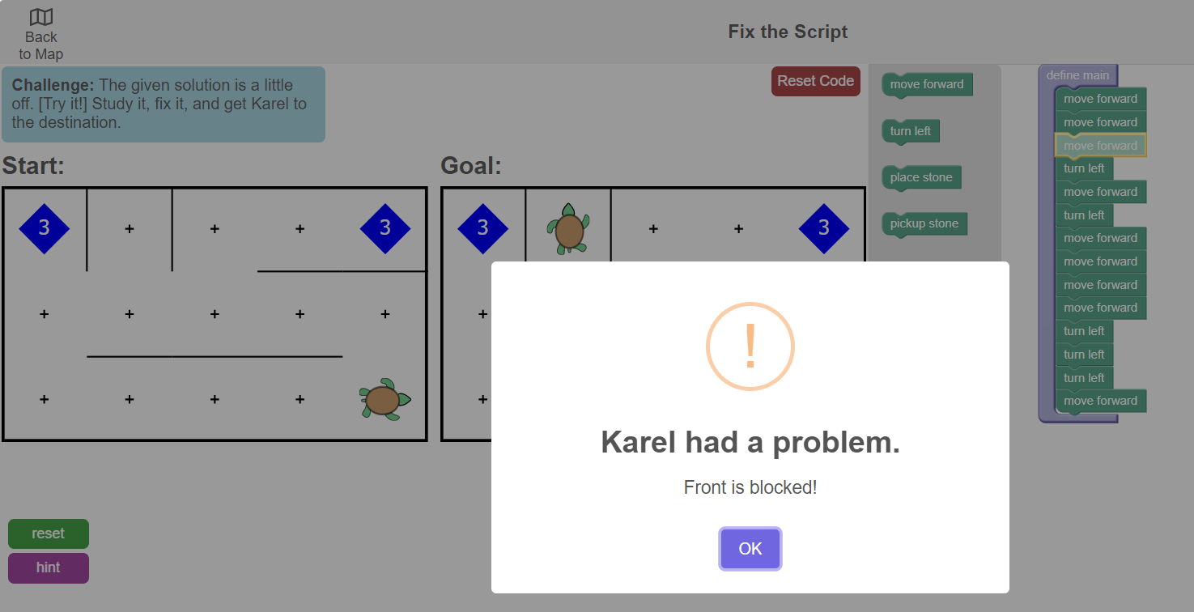
Pop-Up Messages
Pop-up messages offer feedback on the student’s code after they run it.
When students play their program, they receive feedback via pop-up messages on whether they achieved the goal or if there are any errors.
Move to quiz

Slide 26
Quiz: Section 2
Which of the following elements in Karel facilitates the diagnosis of errors in the code? Multiple options can be correct.
Play
Hint
Play Speed Slider
Timer

Slide 27
Quiz: Section 2
Which of the following elements in Karel facilitates the diagnosis of errors in the code? Multiple options can be correct.
Play
Hint
Play Speed Slider
Timer

Slide 28
Quiz: Section 2
Which of the following are Karel task interface elements that can offer feedback to the student on their code? Multiple options can be correct.
Hint button
Pop-up notifications
Play button
Karel the virtual agent

Slide 29
Quiz: Section 2
Which of the following are Karel task interface elements that can offer feedback to the student on their code? Multiple options can be correct.
Hint button
Pop-up notifications
Play button
Karel the virtual agent

Slide 30
Congrats, you have finished Section 2!
Time for a quick break.

Slide 31
3
How can I use Karel?
BACK TO MAIN MENU

Slide 32
How can I use Karel?
The content in Karel is organised into maps and tasks, as explained in Section 1. You have access to maps and tasks designed by PILA experts for immediate use. If you want to modify expert tasks or create your own from scratch, in addition to combining them together to create a custom map, you can do so using the customiser tool.
Karel content
Expert Maps
Custom Maps
Expert Tasks
Custom Tasks

Slide 33
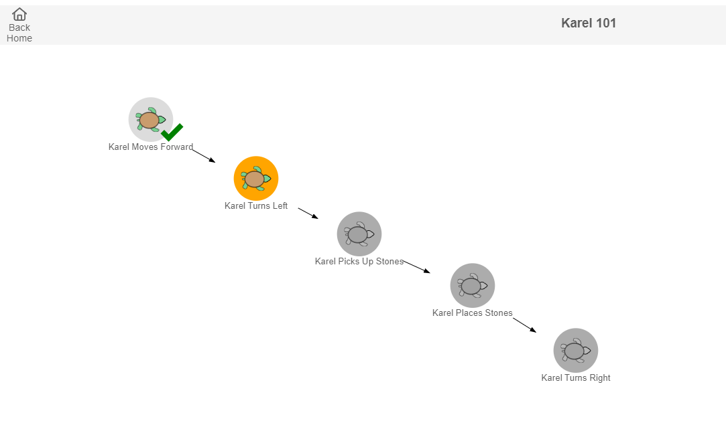
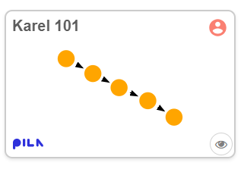
Expert maps
Expert maps are designed by PILA experts according to evidence-based learning progressions. In your teacher account, you can find maps that meet your needs by filtering by concepts (e.g. repetition), difficulty level, etc. You can immediately assign an expert map as classwork or homework.
Expert maps are tagged with the PILA logo.

Slide 34
Expert tasks
Expert tasks available in Karel can be of different types and can ask students to do different things: choose from different program options to solve the given instruction, debug an existing program, complete a partially-built program, or build a program from scratch. You can also create similar task types using the customiser tool.
Task Types
Building Tasks
Multi-scenario Tasks
Multiple Choice Tasks
Parson’s Problem Tasks
Debugging Tasks

Slide 35
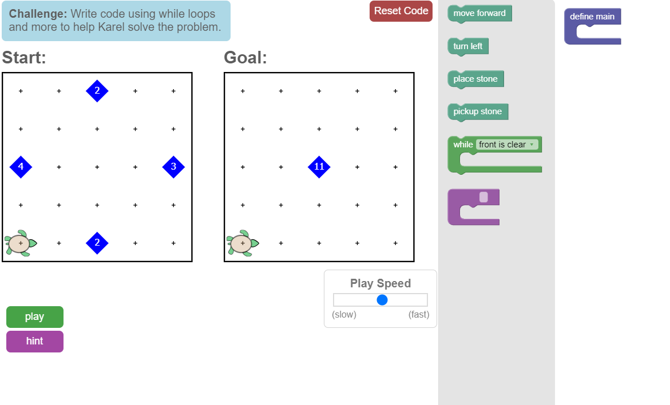
Expert tasks
Building Tasks
In a building task, students are asked to build a code from scratch that helps them achieve the goal state.

Slide 36
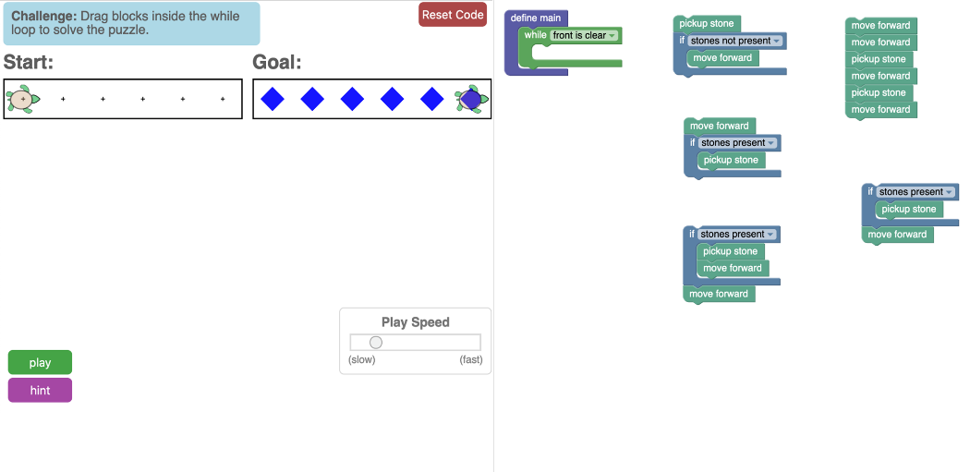
Expert tasks
Multiple Choice Tasks
In a multiple-choice task, there is no toolbox, but only a list of non-modifiable blocks in the workspace, from which students must choose the right ‘answer’ block.

Slide 37
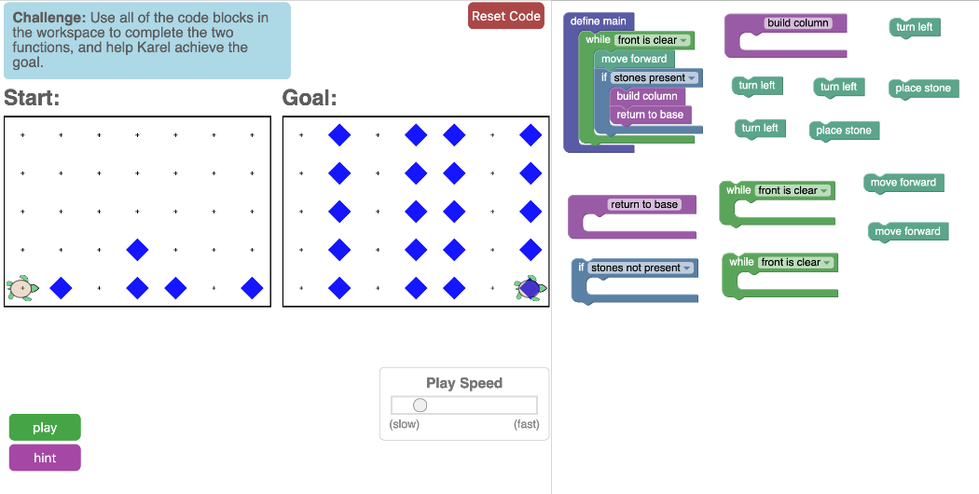
Expert tasks
Parson’s Problem Tasks
In a Parson’s problem task, students are asked to assemble the right solution using short code blocks that are already available.
This scaffolds students to solve the problem using specific concepts, and often presents an additional challenge.

Slide 38
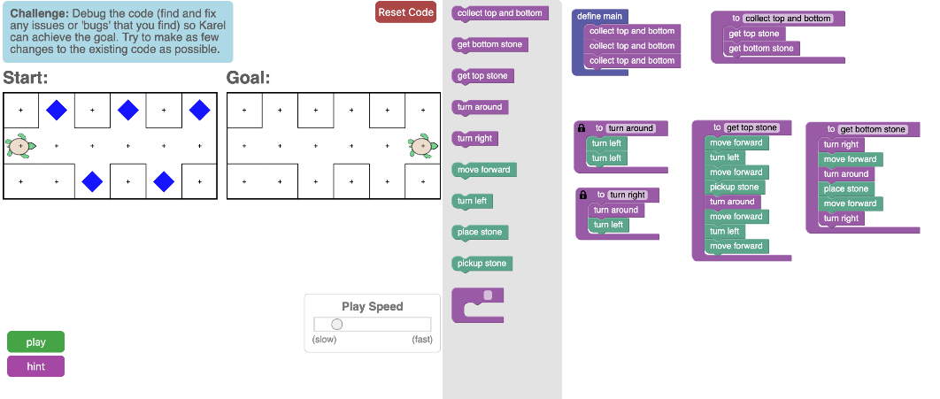
Expert tasks
Debugging Tasks
In a debugging task, the student is asked to detect the source of an error and identify a solution to the error by modifying the code.

Slide 39
Expert tasks
Multi-scenario Tasks
In a multi-scenario task, students are asked to build/modify a program that can solve two goal states in two different scenarios.
This gets them to develop single solutions for multiple problems, by identifying repeated patterns across problems.
Play the video to see how it works!

Slide 40
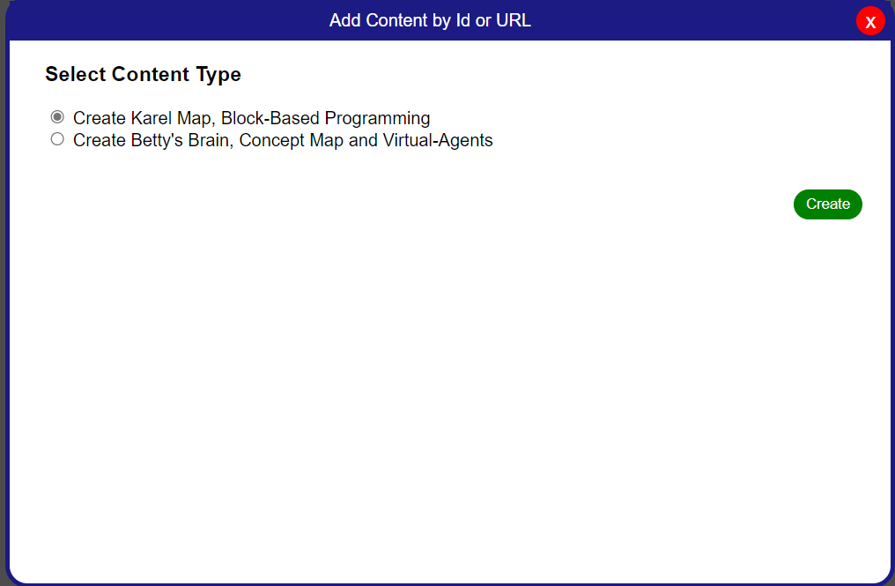
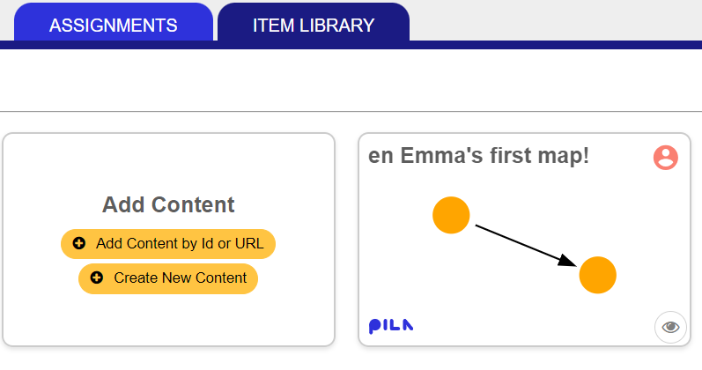
Custom Tasks
In the following four sections, you will learn how you can create a custom task using the Karel customiser tool. The PILA item library offers two options – to create new content, or to add expert or custom content created by others to your item library.
Then, choose ‘Karel Map’
To get started, click on ‘Create New Content’ in the Item Library to enter the content creation space.

Slide 41
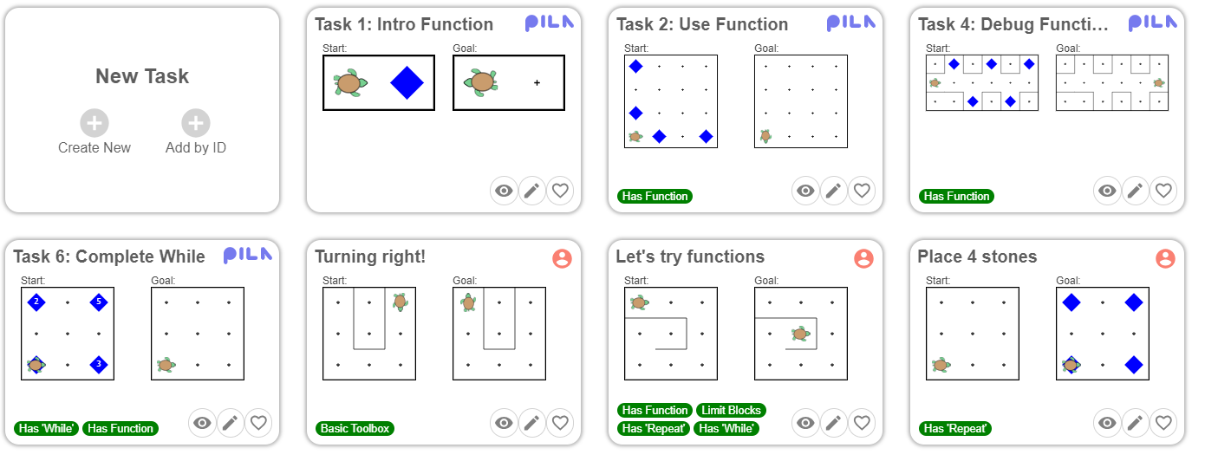
Custom Tasks
Once you are in the Karel customiser tool, click on ‘Create New’ to enter the Karel task interface editor.

Slide 42
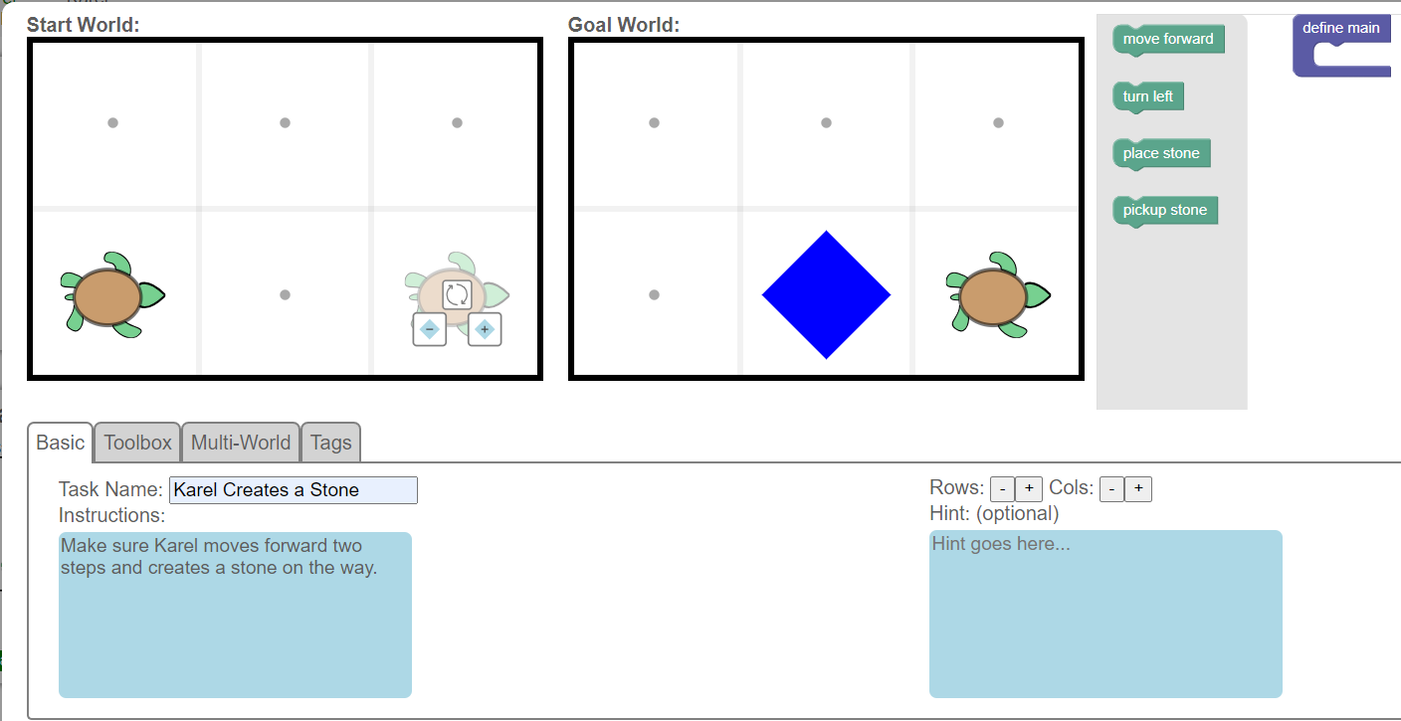
Custom Tasks I: Customise the start/goal grid and its elements
In the task interface editor, you can change the position of Karel in the start and the goal grids by clicking on any cell.

Slide 43
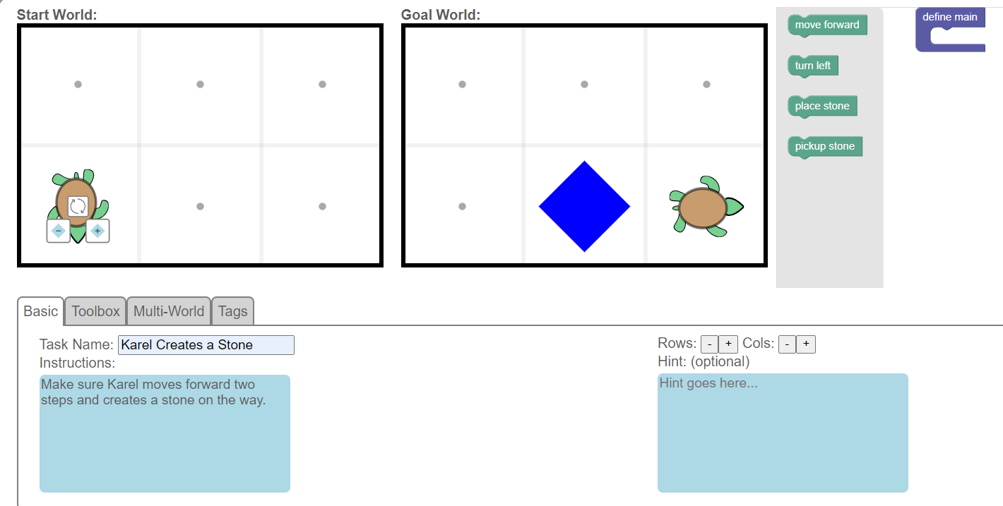
Custom Tasks I: Customise the start/goal grid and its elements
You can also change Karel’s orientation by hovering over it and clicking on the icon.

Slide 44
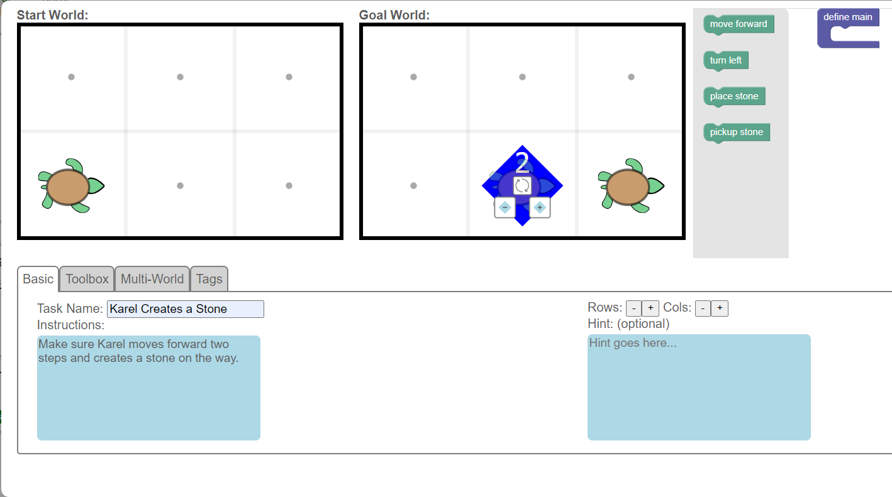
Custom Tasks I: Customise the start/goal grid and its elements
You can increase or decrease the number of stones in a cell by clicking on the or icons that appear when you hover over any cell.

Slide 45
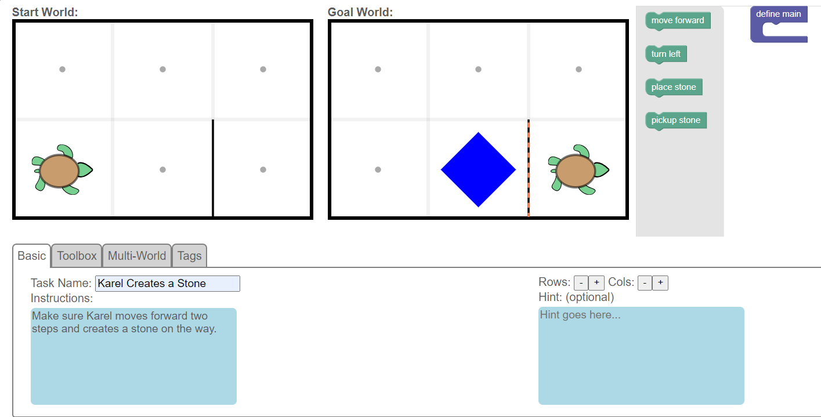
Custom Tasks I: Customise the start/goal grid and its elements
Optionally, you can add walls wherever you choose by clicking on the edge of the cell.

Slide 46
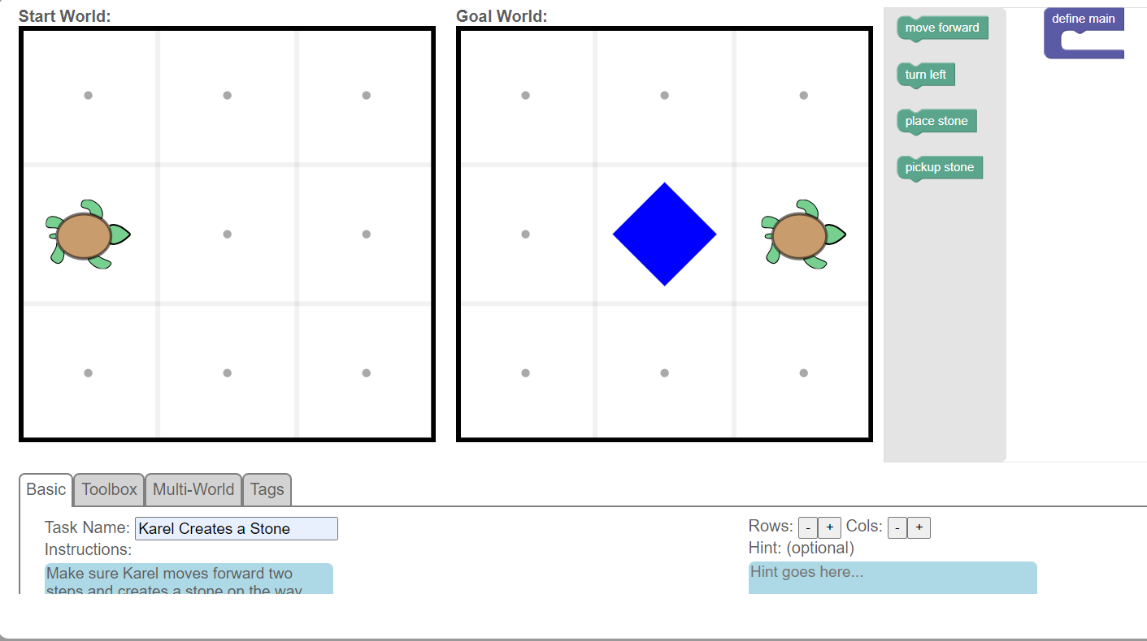
Custom Tasks I: Customise the start/goal grid and its elements
You can also adjust the number of rows and columns in the grid. This will change the size of both worlds.

Slide 47
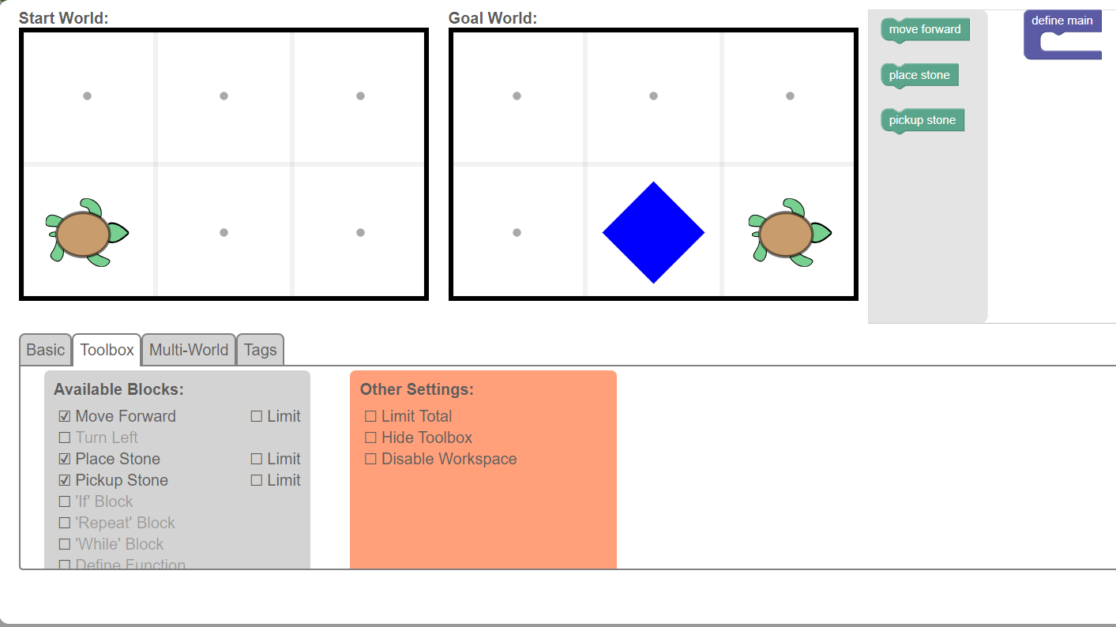
Custom Tasks II: Customise the toolbox and the workspace
You can restrict or expand the code blocks students can use to build their program, by using the toolbox tab. Click on the box next to the block to add or remove it.

Slide 48
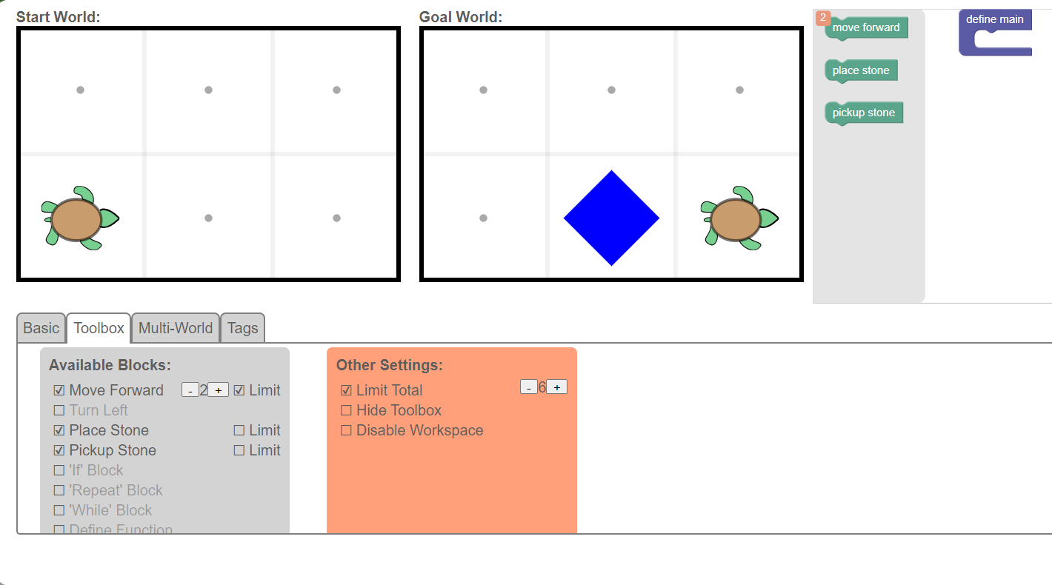
Custom Tasks II: Customise the toolbox and the workspace
To encourage students to use more advanced concepts to create generalisable and organised solutions, you can limit the number of specific blocks, and the number of total blocks they can use.
Use this to limit the total number of blocks the student can use in their program.
Use this option to limit the number of specific blocks (e.g. ‘move forward’) the student can use in their solution.

Slide 49
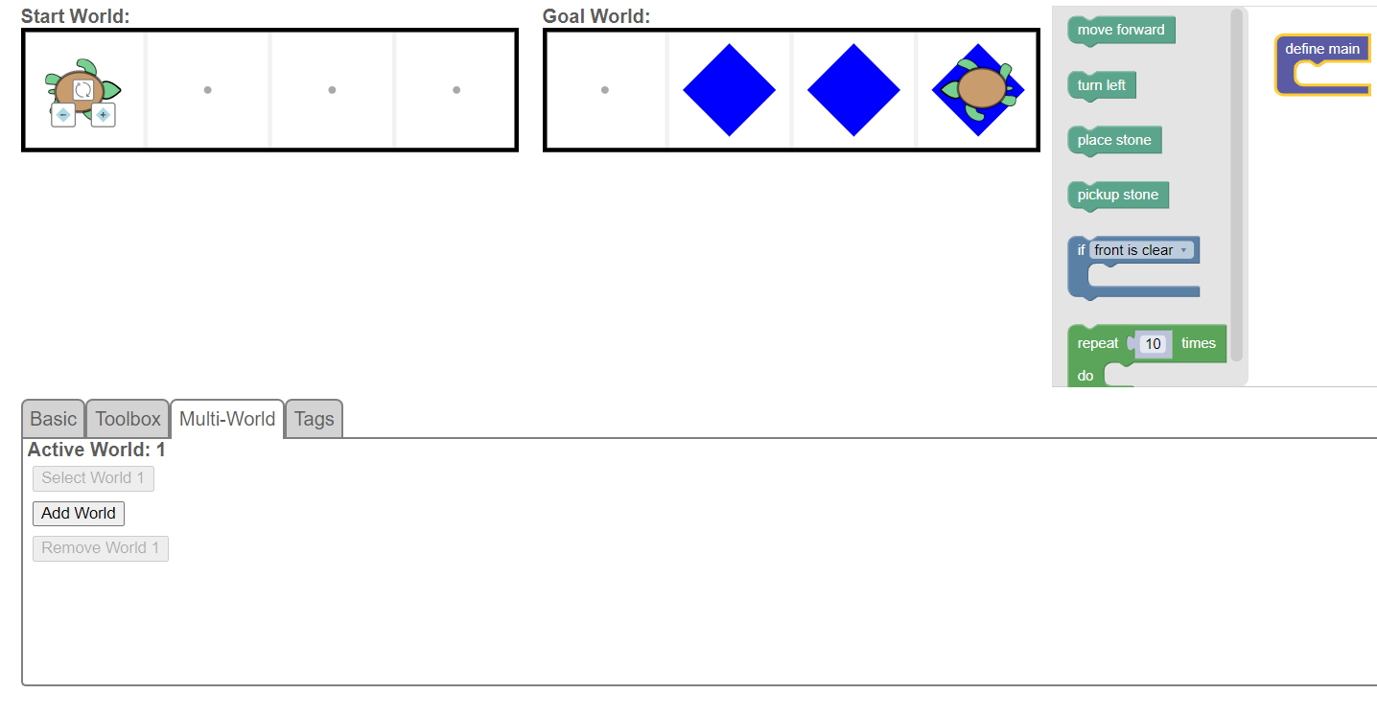
Custom Tasks II: Customise the toolbox and the workspace
You can use the multi-world option to add another grid-world to the task. This means students will need to build one program that achieves the goal states in both worlds. A program that is “generalisable” to multiple problems!

Slide 50
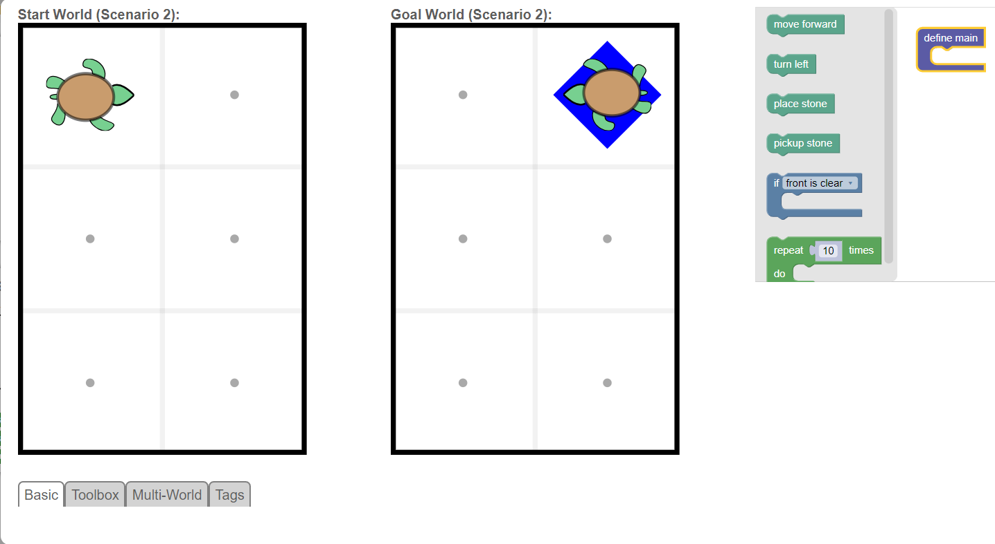
Custom Tasks II: Customise the toolbox and the workspace
Click on ‘Add World’ and you will be directed to a ‘Scenario 2’ which you can edit to reflect a different start and goal state.

Slide 51
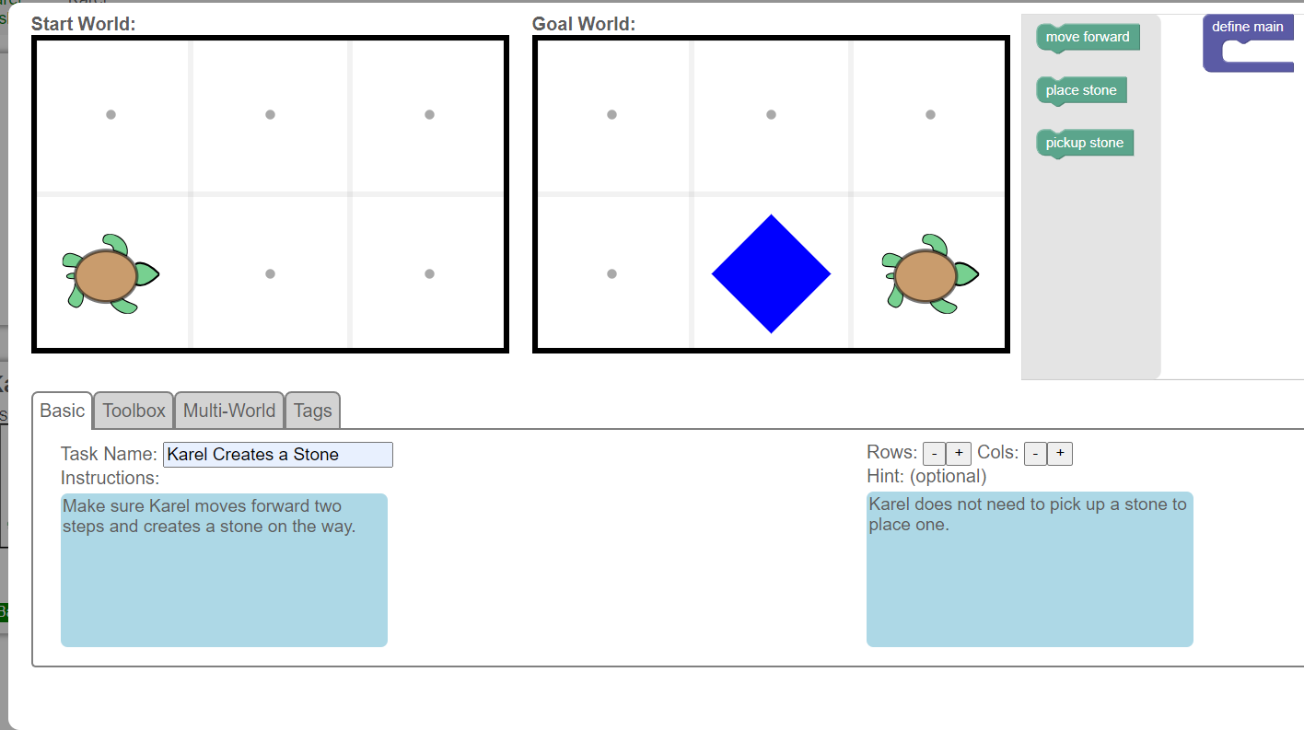
Custom Tasks III: Customise the instructional resources
Add clear instructions on what the student is expected to do to achieve the task.
Add a hint if you would like to give additional support during the task.

Slide 52
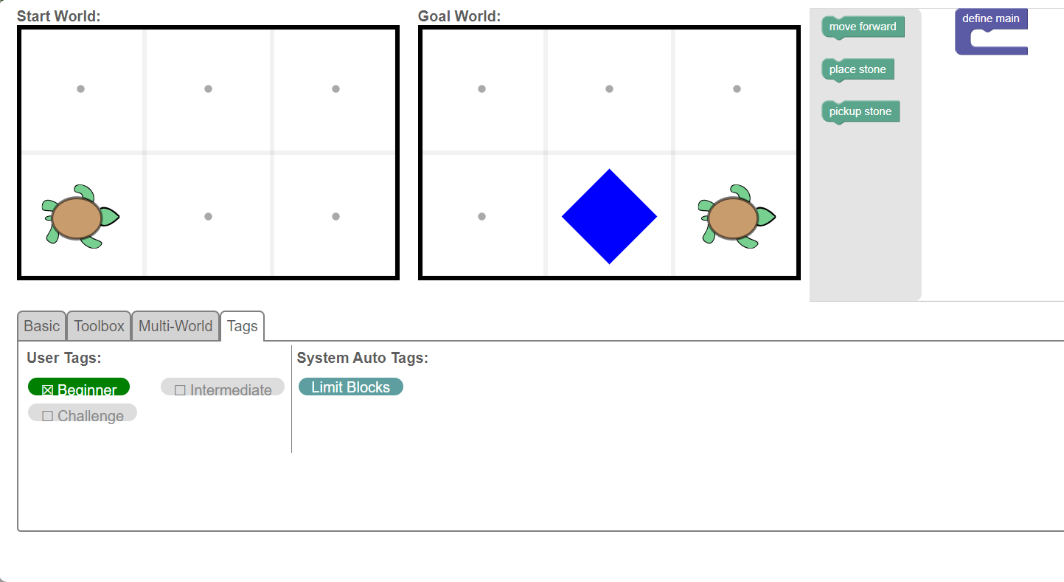
Custom Tasks IV: Customise the identifiers of the task
You can tag the task with certain attributes, such as difficulty level, school level, relevant curriculum standard and more.
Some tags get assigned automatically, if you select certain code blocks (e.g. repeat blocks) or settings (such as ‘limit blocks’)

Slide 53
Custom Tasks IV: Customise the identifiers of the task
Before you save the task, don’t forget to give it a name!

Slide 54
Congrats, you have finished Custom Tasks! Time to move on to custom maps.

Slide 55
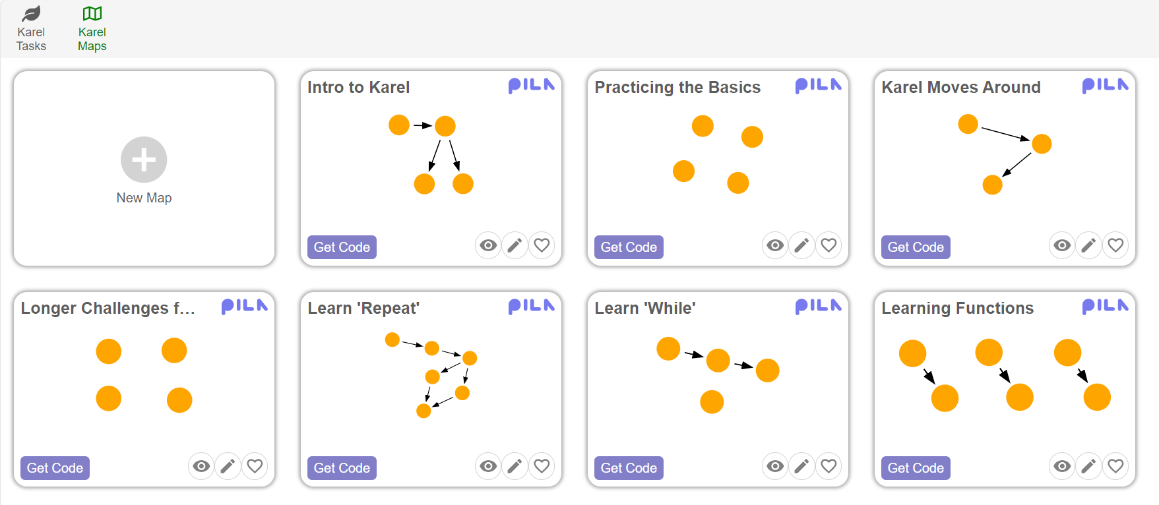
Custom Maps
The second part of the customiser tool is the Map Customiser. Custom maps can be created by ordering various tasks in a sequence of your choice.
To enter the map customiser tool, click on ‘New Map’

Slide 56
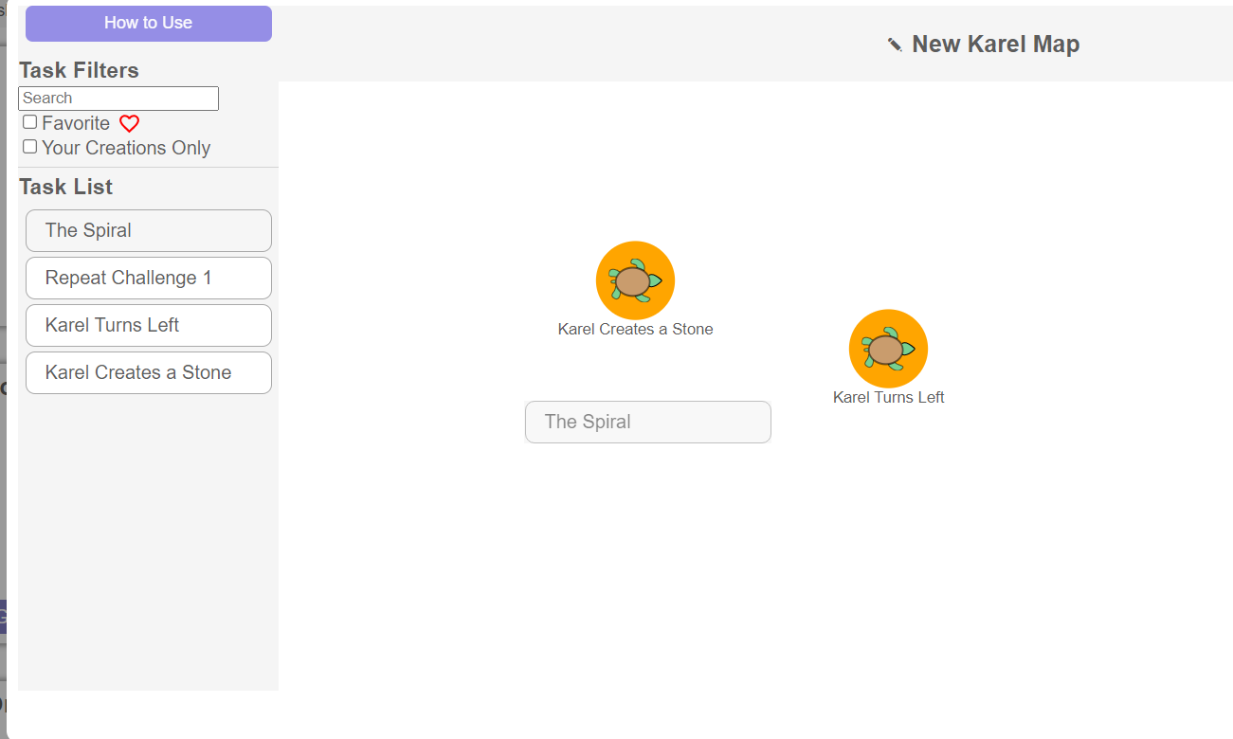
Custom Maps
To create a custom map, first drag and drop your desired tasks from the task list into the map builder space. You can use filters to identify the tasks you want.

Slide 57
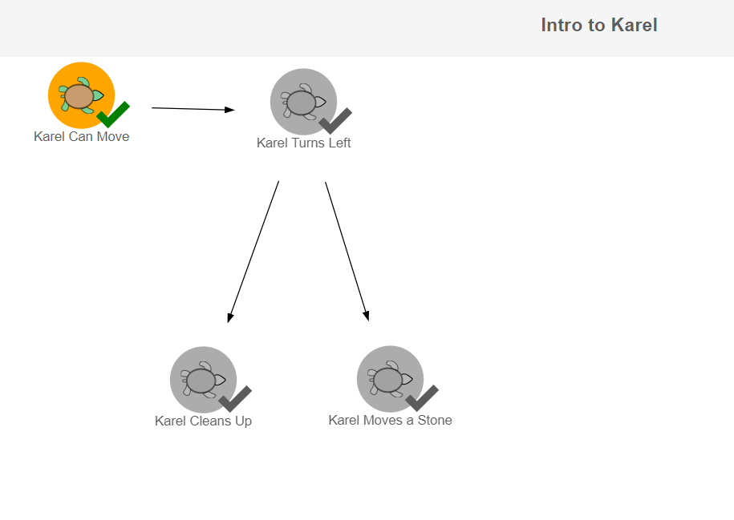
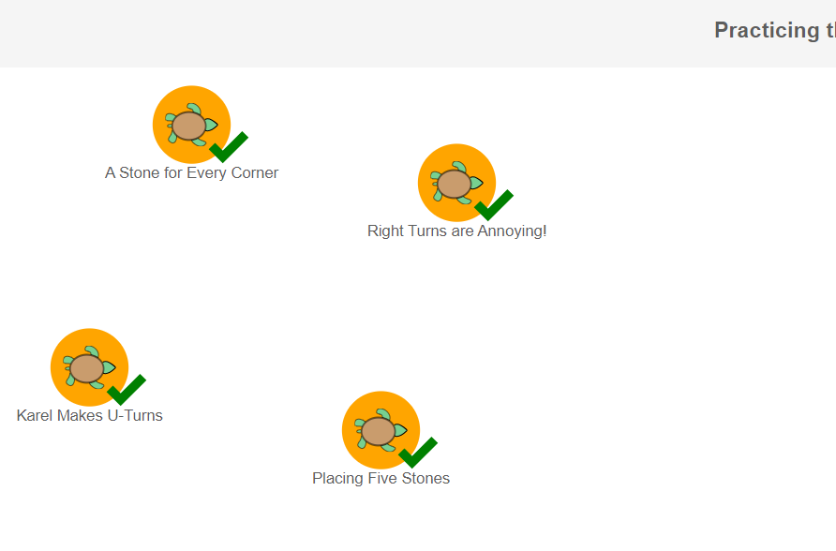
Custom Maps
Some maps can have tasks that are causally dependent (the second task can be unlocked only when the first task is done).
Other maps can have tasks that are independent, and the student can choose the order in which they work through them.

Slide 58
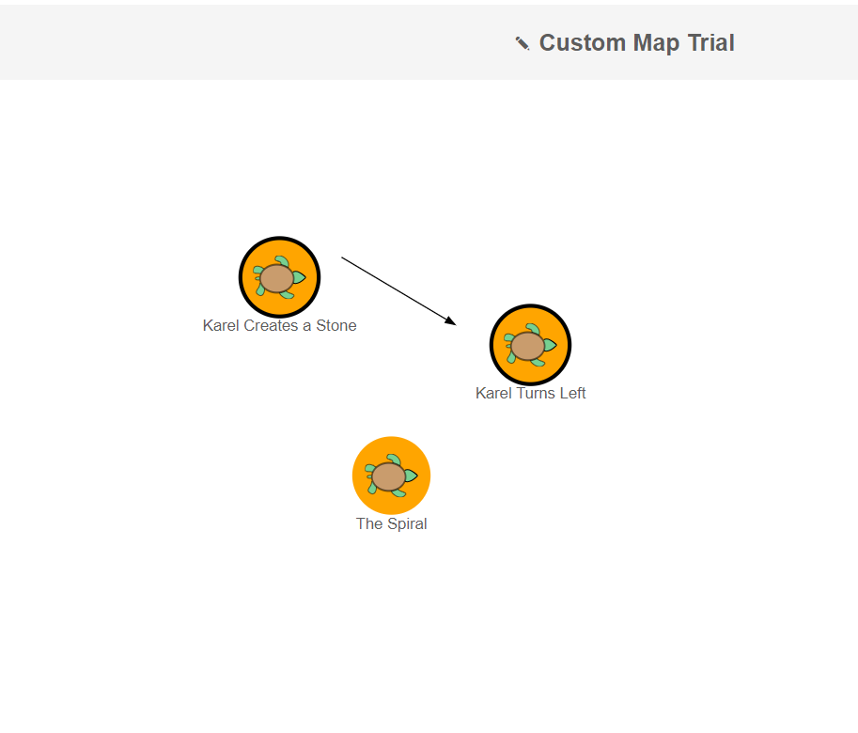
Custom Maps
To push students to take a specific sequence of tasks, click next to a task and start dragging to the next task in the sequence. This will create a dependency arrow.

Slide 59
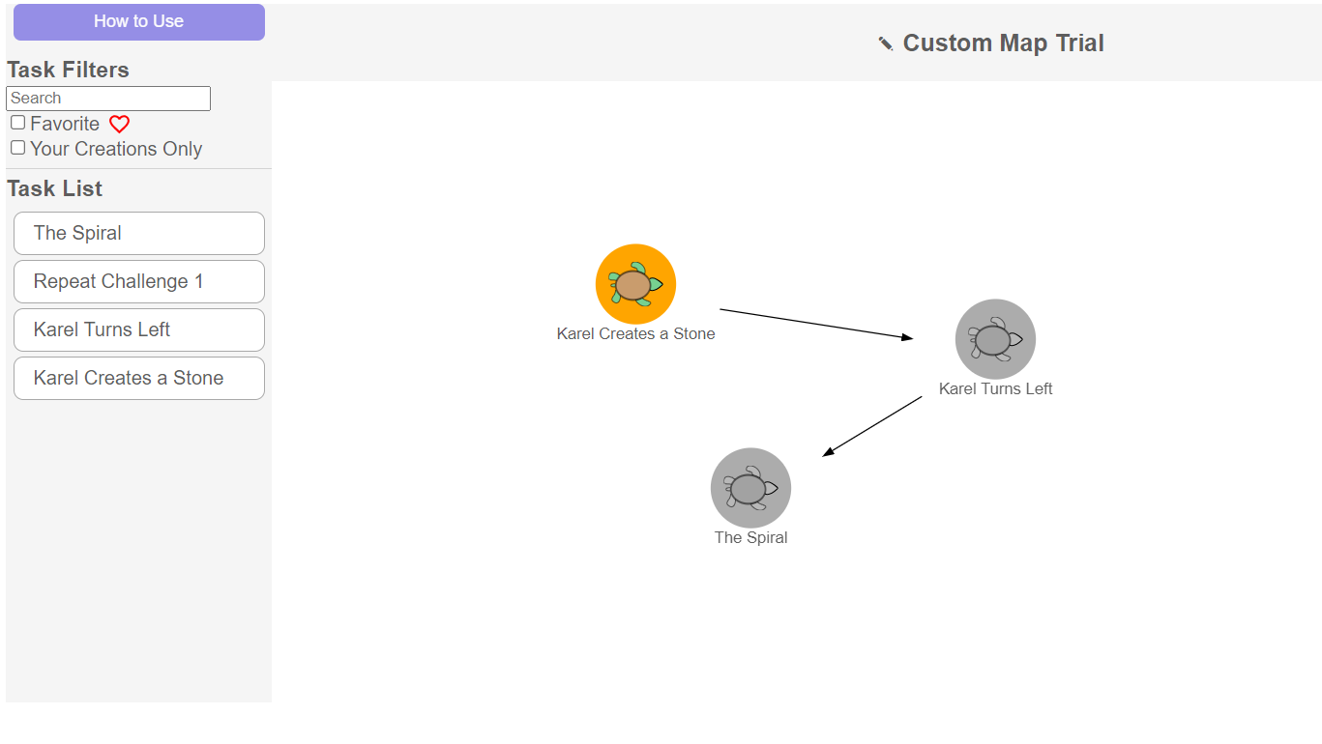
Custom Maps
Before saving your custom map, don’t forget to give it a name!
Tasks that are dependent on a previous task are greyed-out till the previous task is completed.

Slide 60
Quiz: Section 3
Using the Karel Customiser Tool, which of the following can you NOT do as a teacher?
Build a new task
Build a new map
Adjust the complexity of a custom task
Remove an expert task

Slide 61
Quiz: Section 3
Using the Karel Customiser Tool, which of the following can you NOT do as a teacher?
Build a new task
Build a new map
Adjust the complexity of a custom task
Remove an expert task

Slide 62
Quiz: Section 3
You have created two custom tasks A and B and you want to create a Karel Map in which task B can be unlocked only after task A is successfully completed. Which of the following would you use?
Grey-out feature
Arrow feature
Create different levels for A & B
None of the above

Slide 63
Quiz: Section 3
You have created two custom tasks A and B and you want to create a Karel Map in which task B can be unlocked only after task A is successfully completed. Which of the following would you use?
Grey-out feature
Arrow feature
Create different levels for A & B
None of the above

Slide 64
Congrats, you have finished Section 3!
Time for a quick break.

Slide 65
4
How can I view students’ progress?
BACK TO MAIN MENU

Slide 66
Live Monitoring View
Karel Moves Forward
Karel Turns Left
Karel Picks Up Stones
Karel Places Stones
Karel Turns Right
Emma
Marta
Sruthi
Theo
Ava
Tiago
Shir
The live-monitoring view shows the performance of all students across the different tasks within a map. You can quickly evaluate students timing and engagement.

Slide 67
Live Monitoring View
A green cell signifies that the task was completed successfully. The time spent on the task is also shown.
Karel Moves Forward
Karel Turns Left
Karel Picks Up Stones
Karel Places Stones
Karel Turns Right
Emma
Marta
Sruthi
Theo
Ava
Tiago
Shir

Slide 68
Live Monitoring View
A grey cell with a time stamp indicates that the student spent some time on the task, but could not complete it.
Karel Moves Forward
Karel Turns Left
Karel Picks Up Stones
Karel Places Stones
Karel Turns Right
Emma
Marta
Sruthi
Theo
Ava
Tiago
Shir

Slide 69
Live Monitoring View
A grey cell or row with no time stamp indicates that the student has not accessed or started it.
Karel Moves Forward
Karel Turns Left
Karel Picks Up Stones
Karel Places Stones
Karel Turns Right
Emma
Marta
Sruthi
Theo
Ava
Tiago
Shir

Slide 70
Live Monitoring View
A green dot signals that the student is actively working on the task.
A grey dot signals that the student has not done anything in the task for more than 30 seconds.
Karel Moves Forward
Karel Turns Left
Karel Picks Up Stones
Karel Places Stones
Karel Turns Right
Emma
Marta
Sruthi
Theo
Ava
Tiago
Shir

Slide 71
Live Monitoring View
A question mark in a cell signals a hint is available in that task.
A green question mark indicates that the student has used a hint in the task.
Karel Moves Forward
Karel Turns Left
Karel Picks Up Stones
Karel Places Stones
Karel Turns Right
Emma
Marta
Sruthi
Theo
Ava
Tiago
Shir

Slide 72
Live Monitoring View
A grey question mark indicates that the student has NOT used a hint in the task.
Karel Moves Forward
Karel Turns Left
Karel Picks Up Stones
Karel Places Stones
Karel Turns Right
Emma
Marta
Sruthi
Theo
Ava
Tiago
Shir

Slide 73
Quiz: Section 4
You are viewing the dashboard for a Karel map that you have assigned your students. Which of the following is an indication of a student having tried out a task but not completing it?
A grey cell with a time stamp
An empty grey cell
A cell with a question mark icon
A green cell with a time stamp

Slide 74
Quiz: Section 4
You are viewing the dashboard for a Karel map that you have assigned your students. Which of the following is an indication of a student having tried out a task but not completing it?
A grey cell with a time stamp
An empty grey cell
A cell with a question mark icon
A green cell with a time stamp

Slide 75
Congratulations, you’re all done! Take a few moments to look at a quick recap in the next slide.
Notes:
One dense slide here

Slide 76
Introduction to Karel the Turtle
Block-based programming
Elements of the Task Interface
Virtual Agent – Karel
Using and Customising Karel
Expert maps
Viewing student progress
Learning levels: Low-floor, high ceiling
Content elements: maps and tasks
Grid world – start and goal states
Task Instructions
Feedback: Hints and pop-ups
Program builder: Toolbox and workspace
Back to the map
Live-monitoring view
Cells, stones, and walls
Diagnosis: Play and play speed slider
Expert tasks
Multiple choice tasks
Parson’s problems
Building tasks
Debugging tasks
Multi-world tasks
Custom tasks
Start-goal grids
Toolbox and workspace
Instructions
Tags
Custom maps
Skills: Computational thinking and self-regulated learning

Slide 77
Well-done! You’re ready to use Karel the Turtle with your students.

