Slide 1
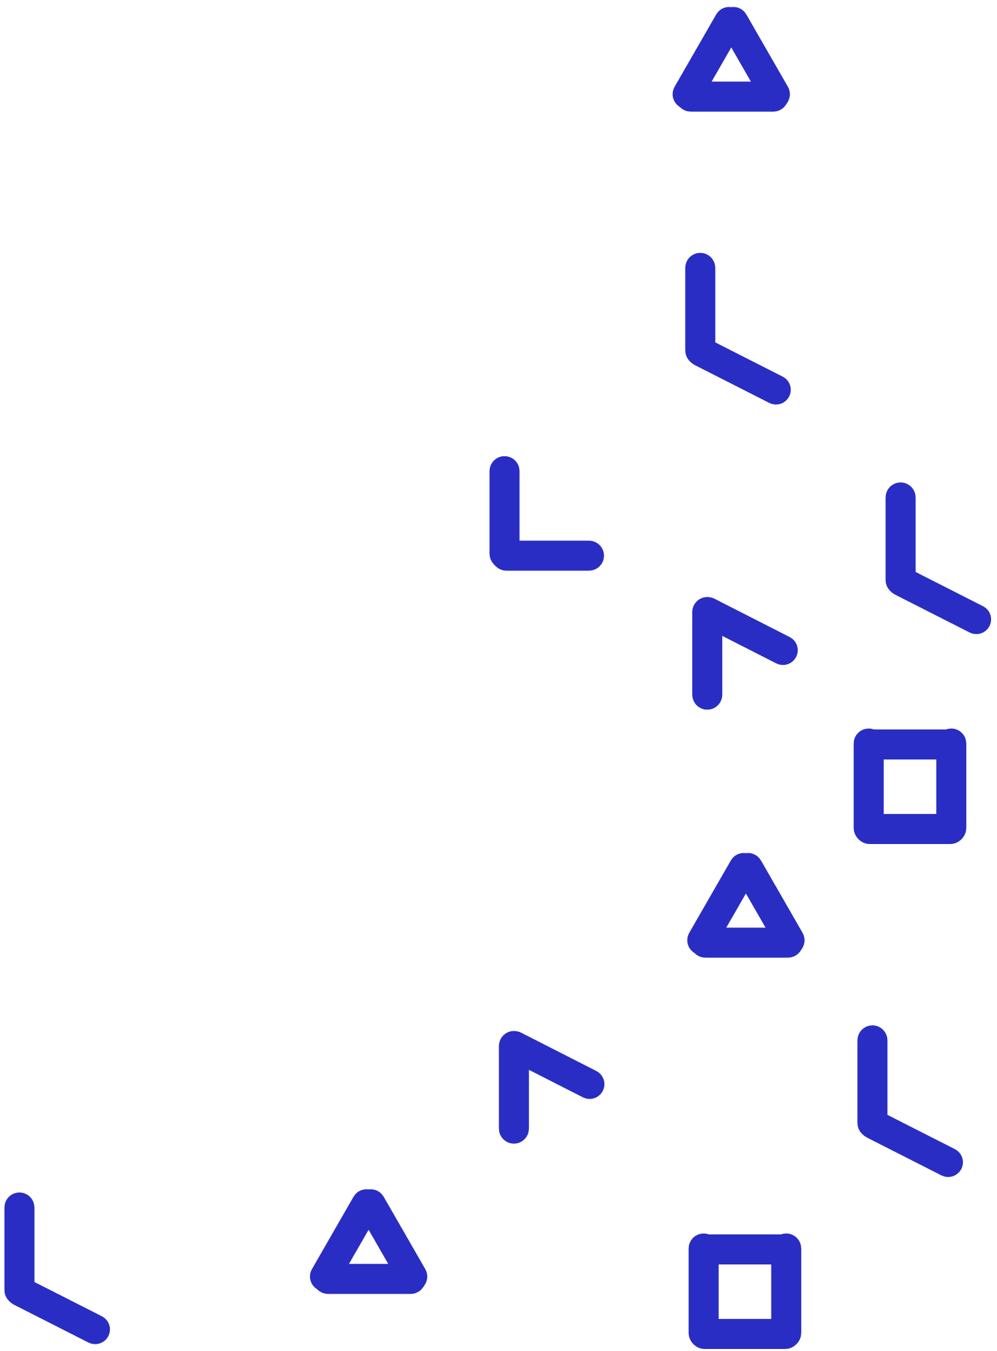
Betty’s Brain
Teacher’s Guide

Slide 2
Overview of Sections
1. What is Betty’s Brain?
2. What are the elements of the digital environment of Betty’s Brain?
3. How can I use Betty’s Brain?
4. How can I view students’ progress?
Notes:
Link these as well

Slide 3
1
What is Betty’s Brain?
BACK TO MAIN MENU

Slide 4
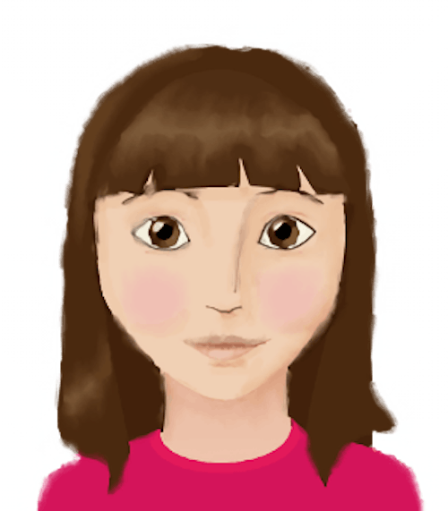
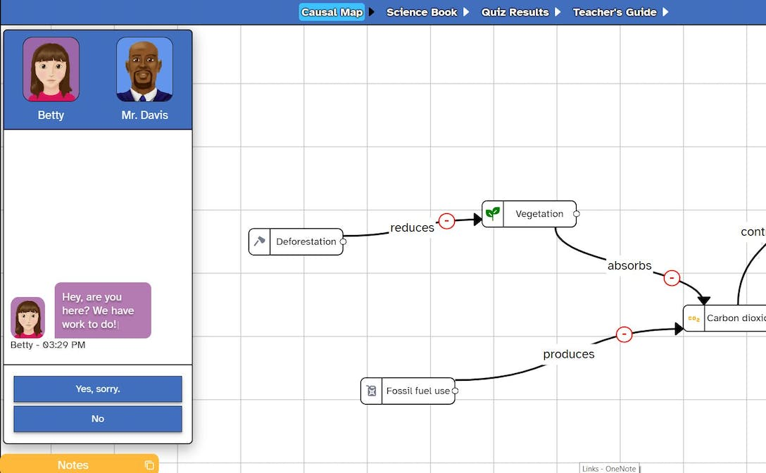
Introduction to Betty’s Brain
What is Betty’s Brain?
Betty’s Brain is a PILA application, created by the Teachable Agents Group at Vanderbilt University, which develops and assesses students’ understanding of a topic by getting them to build and teach causal maps on a specific topic to a virtual student named ‘Betty’.

Slide 5
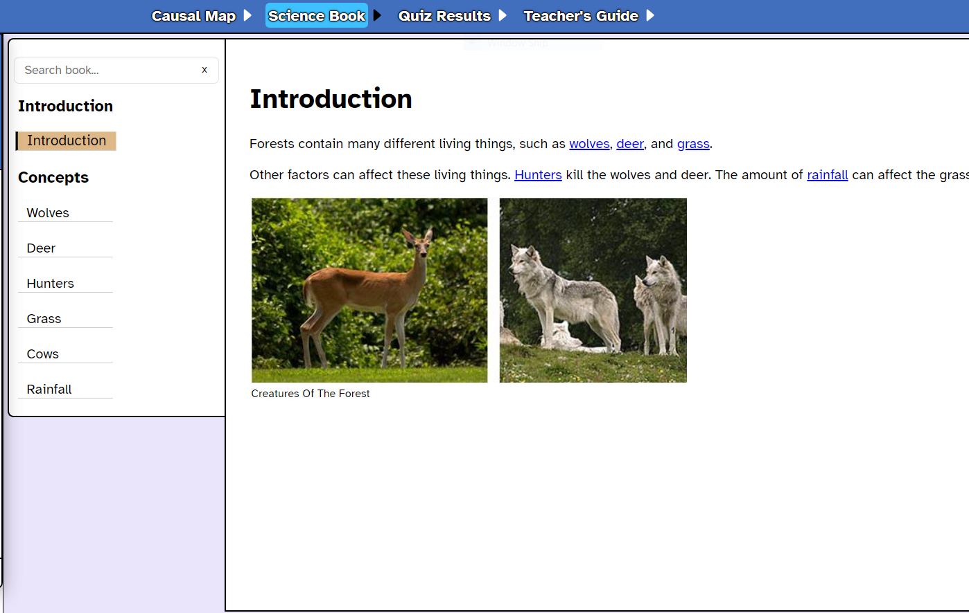
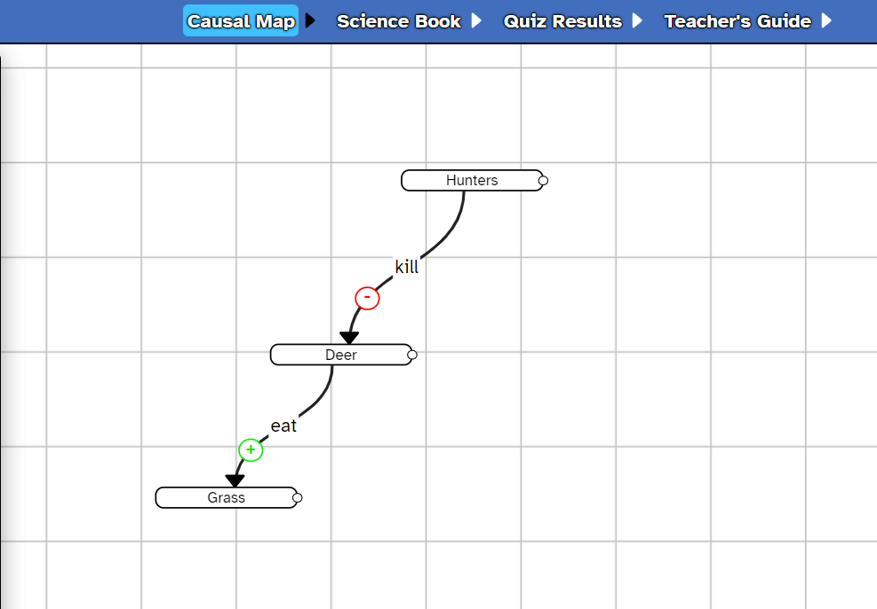
Introduction to Betty’s Brain
How does it work?
Students read about cause-and-effect relationships in a system (e.g., predator-prey ecosystem)
They build a causal map on how different variables in the system are related

Slide 6
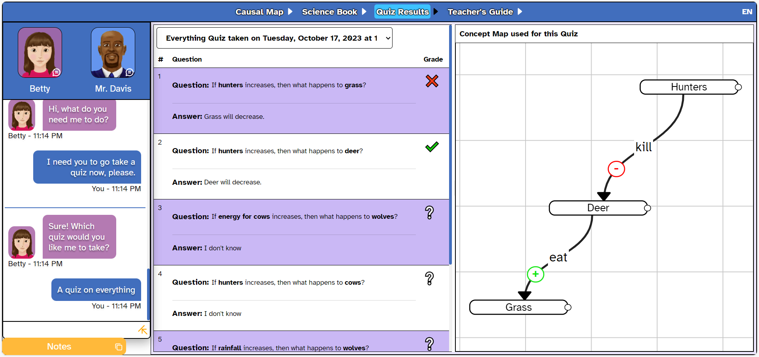
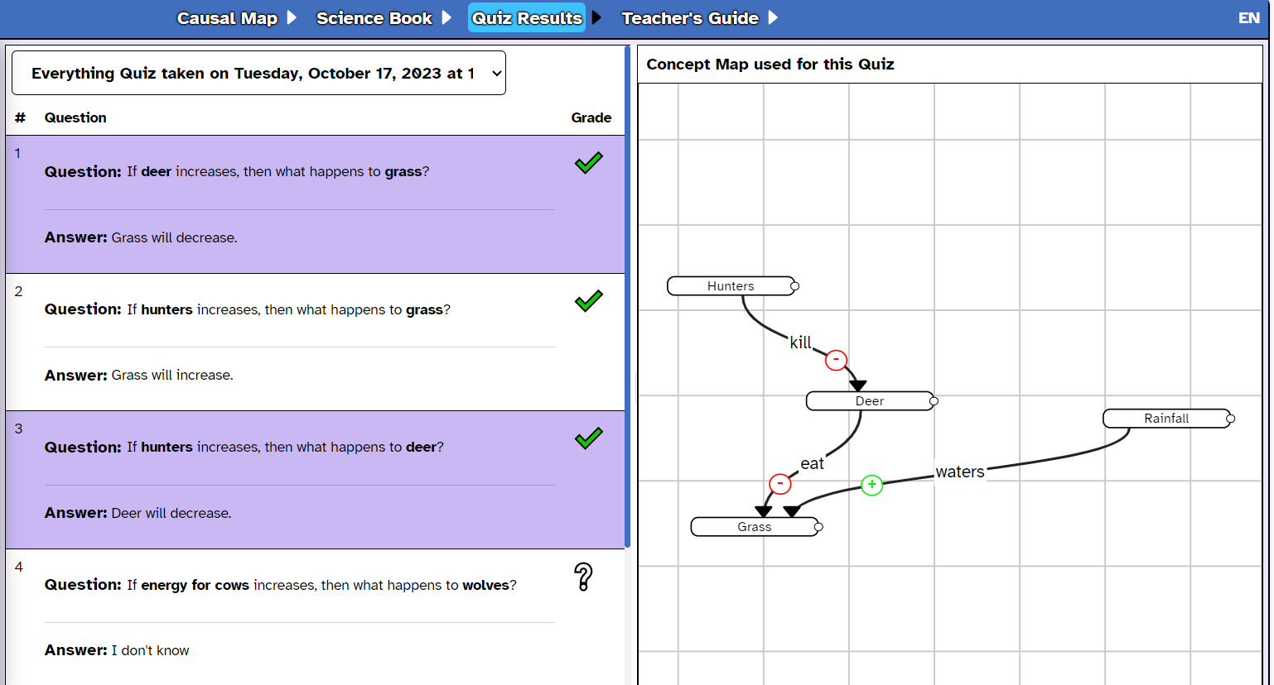
Introduction to Betty’s Brain
Students ask Betty to take an (auto-generated) quiz on the map they have built
How does it work?
Students ask Betty to take an (auto-generated) quiz on the map they have built
Betty, the virtual “teachable” agent, learns about the topic through the student’s causal map
If Betty gets questions wrong or doesn’t know how to answer, students can look for information and edit their map

Slide 7
Introduction to Betty’s Brain
What are the target skills?
Causal reasoning
Systems thinking
Self-regulated learning
…how to understand a phenomenon as a system of interrelated elements that are causally related.
…how to manage and make decisions about one’s own learning processes.
…how to identify the nature of relationships between concepts that are causally linked.
Students learn and demonstrate…

Slide 8
Quiz: Section 1
Which pedagogical approach is Betty’s Brain based on?
Learning by teaching
Learning by doing
Experiential learning
Project-based learning

Slide 9
Quiz: Section 1
Which pedagogical approach is Betty’s Brain based on?
Learning by teaching
Learning by doing
Experiential learning
Project-based learning

Slide 10
Quiz: Section 1
Which of the following skills does Betty’s Brain aim at improving among learners?
Computational Thinking
Systems Thinking
Creative Thinking
Game Design

Slide 11
Quiz: Section 1
Which of the following skills does Betty’s Brain aim at improving among learners?
Computational Thinking
Systems Thinking
Creative Thinking
Game Design

Slide 12
Congrats, you have finished Section 1!
Time for a quick break.

Slide 13
2
What are the elements of the Bettys Brain digital environment?
BACK TO MAIN MENU

Slide 14
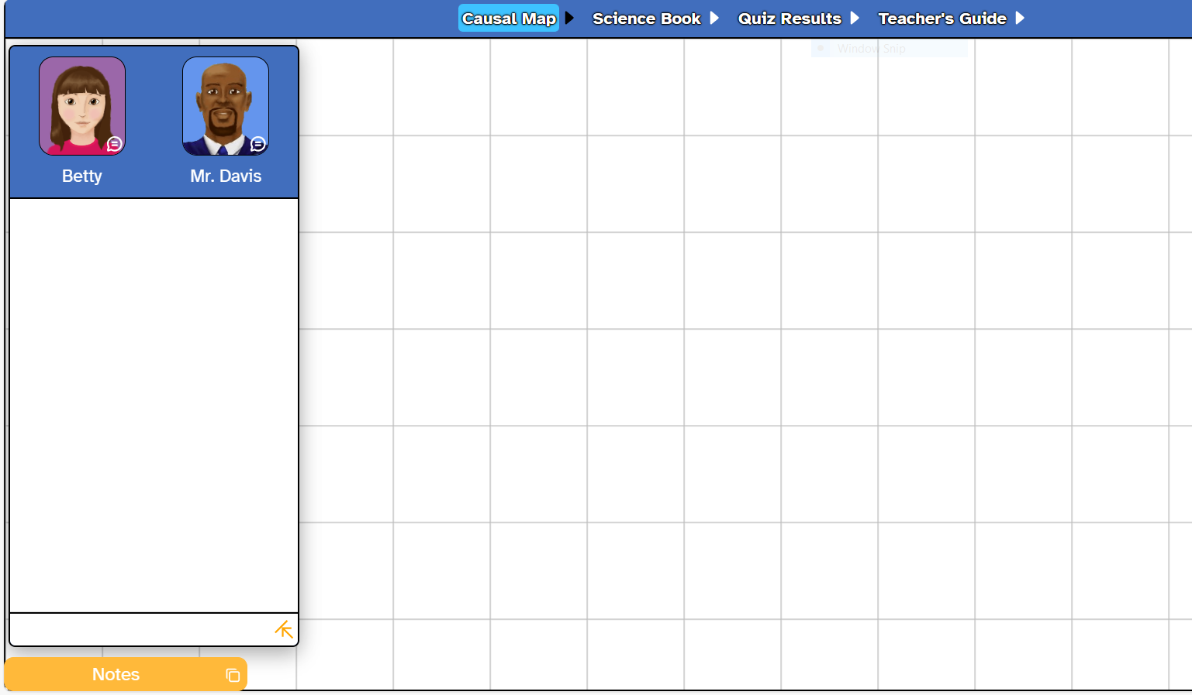
Key Elements Menu
The Betty’s Brain interface has 6 key elements.
Look at the 6 labels in this picture carefully. Then click on the numbers to know more.

Slide 15
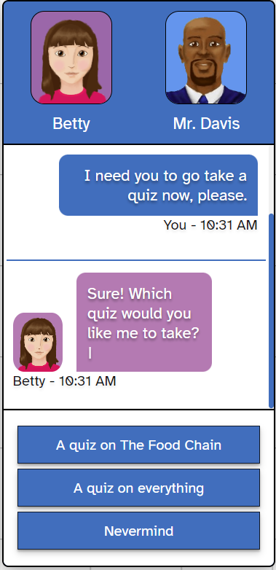
Virtual Agents
Virtual agents are characters students can interact with. In Betty’s Brain, there are two virtual agents – Betty and Mr. Davis.
Betty
Betty is the virtual agent who is the student’s ‘student’. The student teaches Betty through a visual representation that organises the reasoning structures in a domain.
The Betty’s Brain system depends on well-known teaching interactions to organise student activity – presenting, interacting, teach-by-telling, teach to model, checking and probing.
Betty provides detailed feedback on how well she has been taught by taking a quiz and providing explanations. This helps the student correct their map. A mutually beneficial relationship!

Slide 16
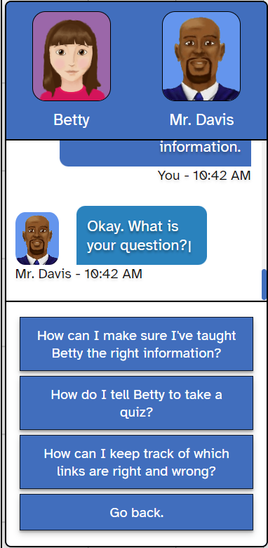
Virtual Agents
The other virtual agent in the interface is Mr. Davis, the mentor.
Mr. Davis
Students can also seek on-demand support from Mr. Davis, who is the student’s mentor in teaching Betty and navigating the interface.
Should the student have any difficulties building the causal map, or if the student is confused regarding how best to ensure that Betty makes fewer errors on her quizzes, they can chat with Mr. Davis.
An important aspect of Mr. Davis’ feedback is that it is personalised – he offers suggestions based on issues students have experienced in the past.

Slide 17
Casual Map Builder
In this tab, students build and modify the causal map that represents the phenomenon they learn in the unit. The causal map is made of two fundamental elements: concepts and links.
Causal Map Elements
Concepts
Links

Slide 18
Casual Map Builder
Concepts
A concept is any person, place, or thing that is a part of the topic (e.g., thermoregulation). A causal relationship shows how one concept causes another concept to change. In Betty’s Brain, students can define this relationship as positive (a concept causes another to increase) or negative (a concept causes another to decrease).
For example, people use up oxygen by breathing it in. When they do this, they decrease the amount of oxygen in the air. This is a causal relation between two concepts: people and oxygen. The relation is negative: people decrease oxygen in the environment by breathing.

Slide 19
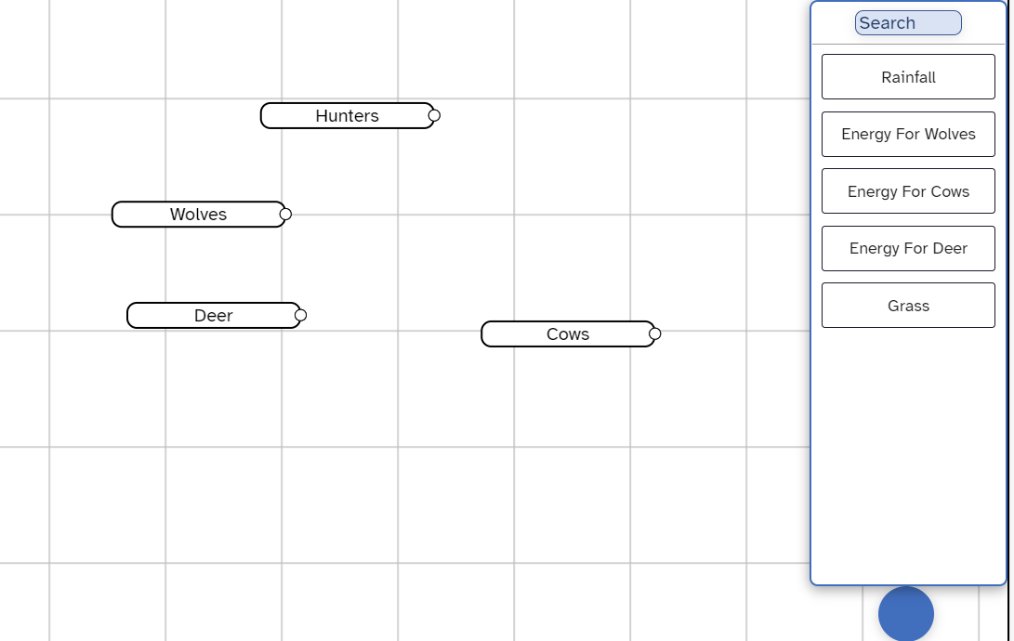
Casual Map Builder
How do I add a concept?
Students can add a concept by clicking on the icon at the bottom-right of the interface. This opens the menu of concepts. They can drag and drop concepts onto the causal map builder space.

Slide 20
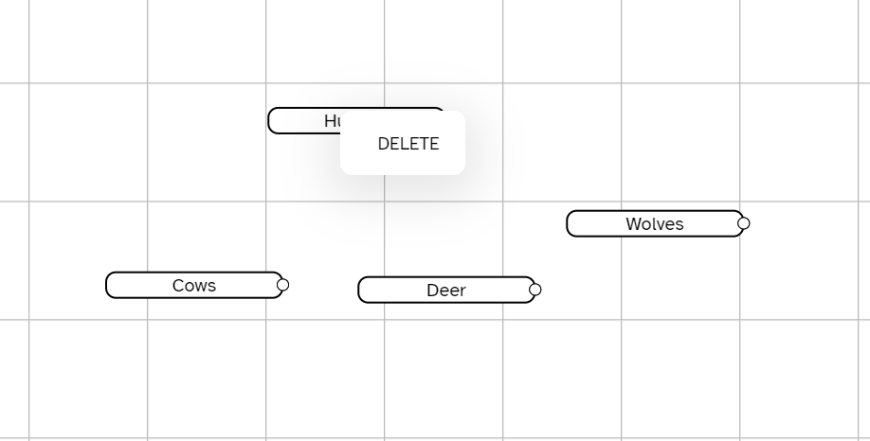
Casual Map Builder
How do I delete a concept?
Students can delete an added concept by right-clicking on it and clicking ‘DELETE’.

Slide 21
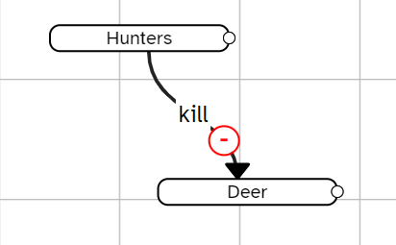
Casual Map Builder
Links
A link defines which two concepts are connected, in what direction they are connected (which concept causes the other) and the nature of the relationship (positive or negative).
For example: Hunters kill deer, which results in fewer deer. This is a negative relationship ( ) from hunter to deer.

Slide 22
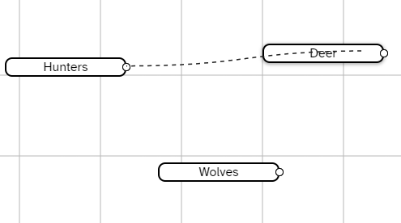
Casual Map Builder
How can I add and edit links?
Students can drag their mouse pointer from the circle on the right end of one concept to the other concept, in the direction of the causal relationship.

Slide 23
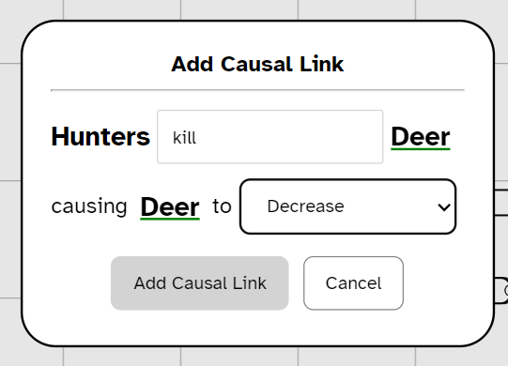
Casual Map Builder
How can I add and edit links?
Once a student adds a link, a pop-up window will appear. Students must type an appropriate verb for the relationship (e.g., kill) and select the nature of the relationship (increase or decrease). Then, click ‘Add Causal Link’.

Slide 24
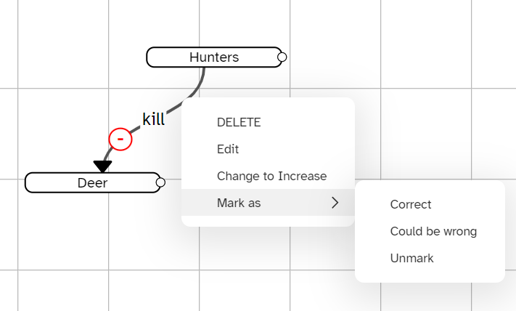
Casual Map Builder
How can I add and edit links?
Students can modify links by right clicking on them. They can also tag a link as ‘could be wrong’. The link will turn orange. This can serve as a reminder to quiz Betty or find more information for that relationship in the Science Book.

Slide 25
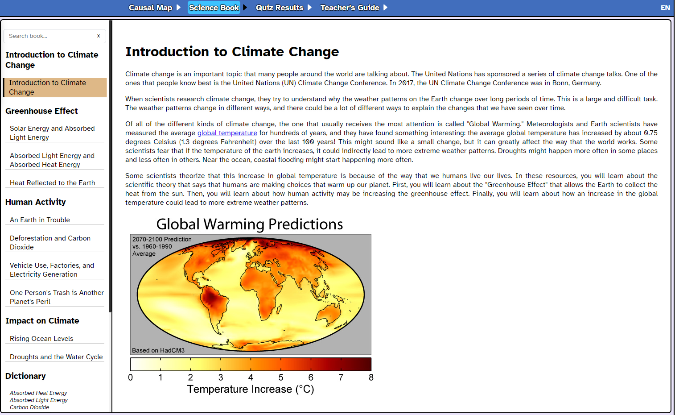
Science Book
The Science Book presents information on the topic. Students can browse it by typing key words in the ‘search’ bar and can use the Dictionary in the left-hand menu to look up terms they do not understand.

Slide 26
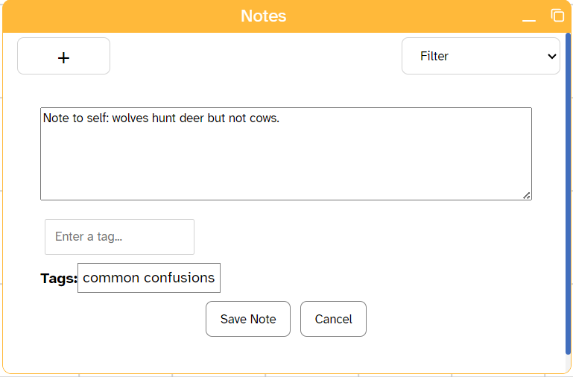
Notes
Students can use the Notes tool to keep track of key information and add ‘tags’ to make it easier for students to search through their previous notes (using the filter drop-down).

Slide 27
Quiz Results
In this tab, students can view the results of the quizzes taken by Betty. For each quiz taken, the student is provided the following information:
The topic of the quiz
The date and time of the quiz
The correctness of Betty’s answer to each question (grade)
The part of the causal map used by Betty to answer the questions

Slide 28
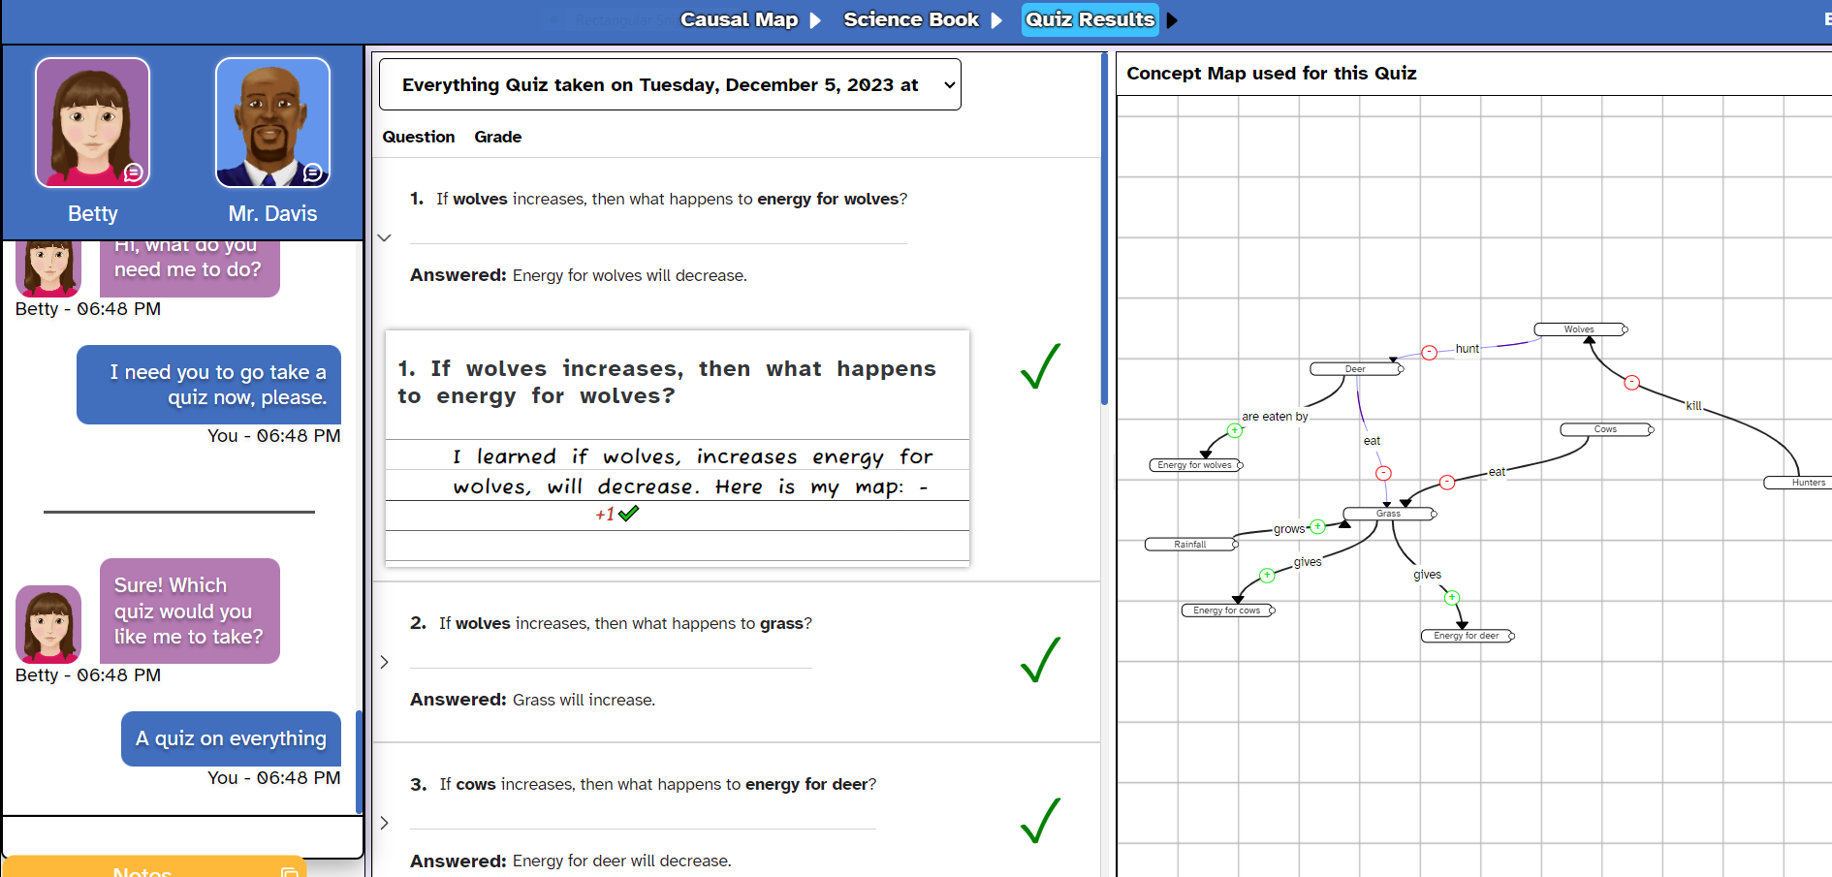
Quiz Results
This indicates which topic Betty took the quiz on, as well as the date and the time.

Slide 29
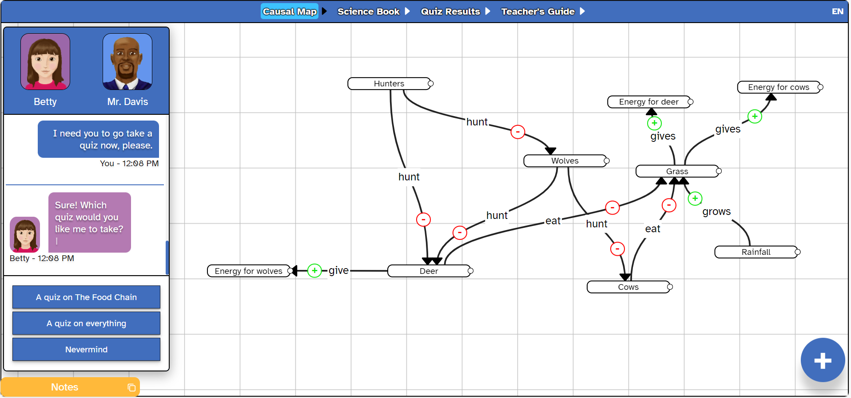
Quiz Results
Sometimes, each causal map can have subparts – here, Betty can take a quiz on the whole causal map or only on the subpart pertaining to the food chain.

Slide 30
Quiz Results
This shows the student’s causal map that was used by Betty to answer the quiz.

Slide 31
Quiz Results
The ‘grade’ refers to the correctness of Betty’s answer. It can be correct ( ), wrong ( ), right-so-far, or unknown ( ) which means Betty does not have enough information to work with because the map is incomplete.

Slide 32
Quiz Results
A student can click on a question to see which part of the concept map Betty used to answer (unless there is missing information). Betty also provides an explanation (e.g. “I learned…”)

Slide 33
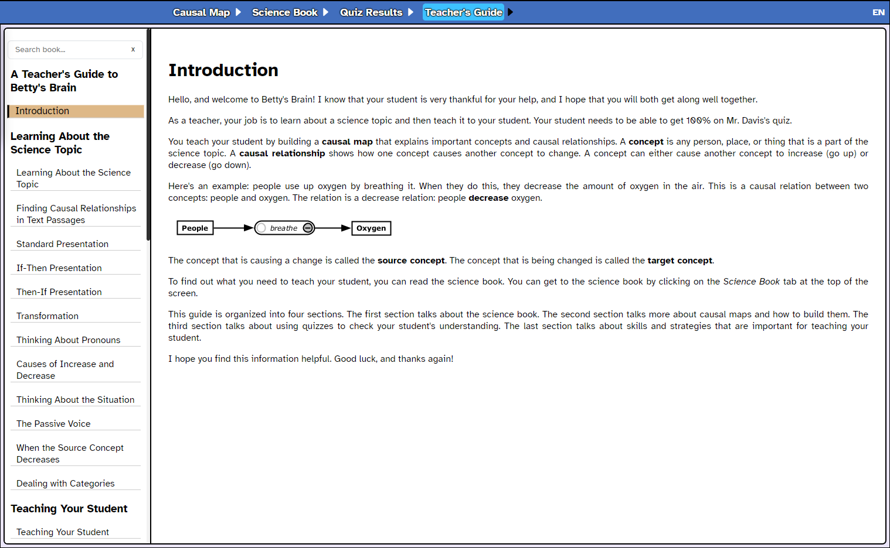
Teacher’s Guide
The Teacher’s Guide is a collection of tips that students (acting as Betty’s teacher) can use to build effective strategies to complete the units.

Slide 34
Quiz: Section 2
Which of the following is NOT an element of the digital environment of Betty’s Brain?
Discussion Forum
Notes
Teacher’s Guide
Science Book

Slide 35
Quiz: Section 2
Which of the following is NOT an element of the digital environment of Betty’s Brain?
Discussion Forum
Notes
Teacher’s Guide
Science Book

Slide 36
Quiz: Section 2
Which of the following is a virtual agent in Betty’s Brain?
Science Book
Causal Map Builder
Mr. Davis
Teacher’s Guide

Slide 37
Quiz: Section 2
Which of the following is a virtual agent in Betty’s Brain?
Science Book
Causal Map Builder
Mr. Davis
Teacher’s Guide

Slide 38
Congrats, you have finished Section 2!
Time for a quick break.

Slide 39
3
How can I use Betty’s Brain?
BACK TO MAIN MENU

Slide 40
How can I use Betty’s Brain?
In Betty’s Brain, you can use expert-designed units on different topics, such as climate change or thermoregulation. If you want to adapt any of the expert-designed units or develop a unit of your own from scratch, you can create custom units too!
Expert-made units
Unit Types
Custom units

Slide 41
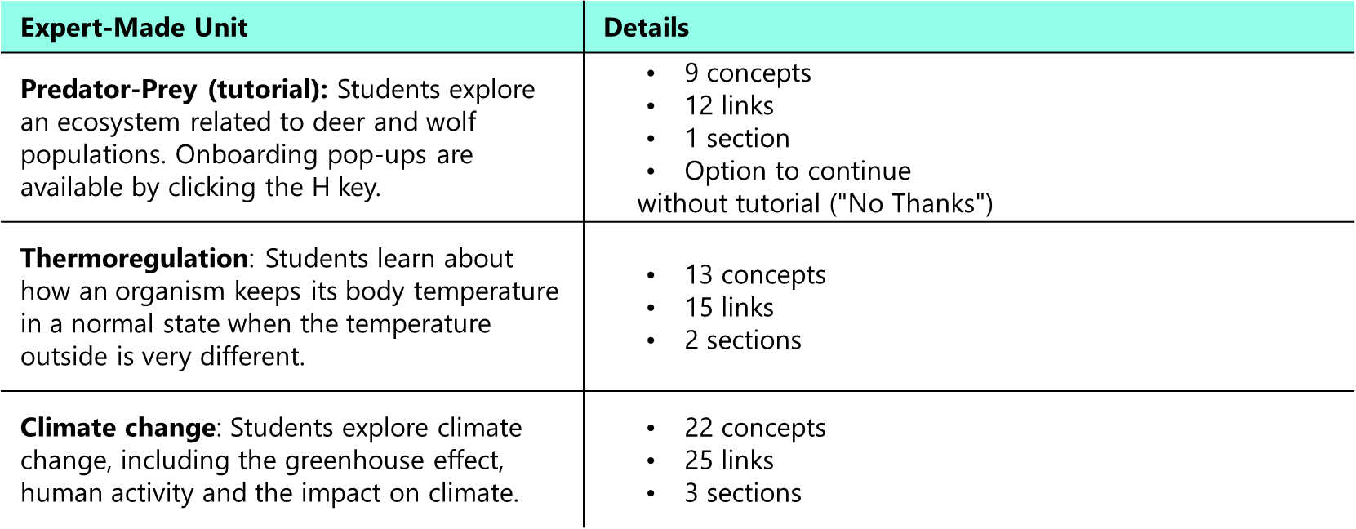
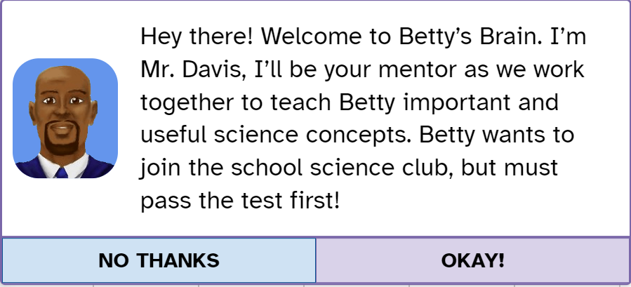
Expert-Designed Units
There are three expert-designed units for immediate use in the application.

Slide 42
Custom Units
Want to teach something else other than predator-prey, climate change or thermoregulation? You can create your own unit! Using the customiser tool, you can:
Build your own causal map
Automatically generate quizzes for Betty
Build the resources for the ‘resource’ book
Export the custom unit

Slide 43
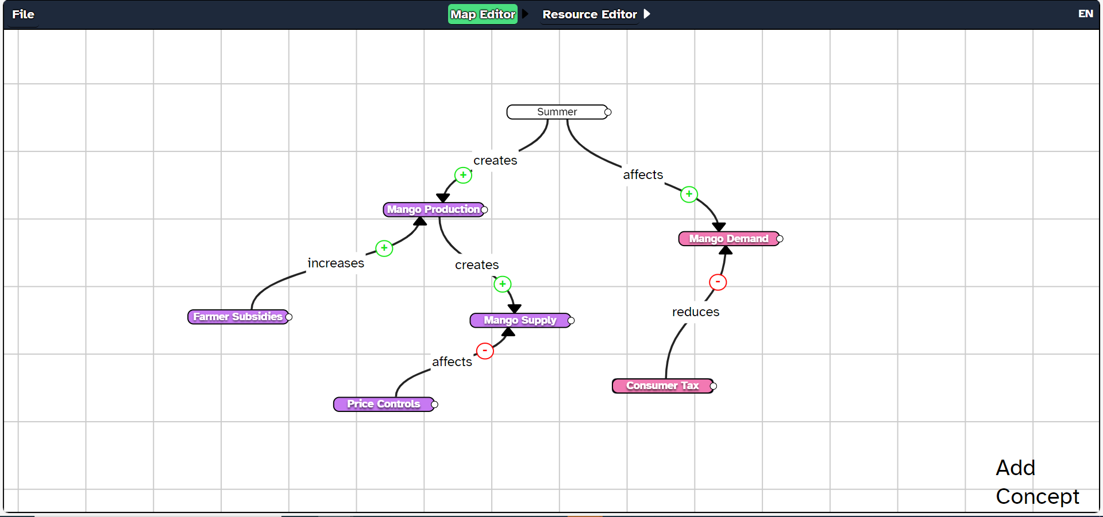
Custom Units
What subjects can I use the custom units for?
Any topic in which there is a system with different variables that are causally related can be represented using a causal map.
For instance, if you want your class to understand the dynamics behind the supply and demand of mangoes in the market, you could create a causal map to explain the factors that affect these variables. This would fall under the realm of economics.

Slide 44
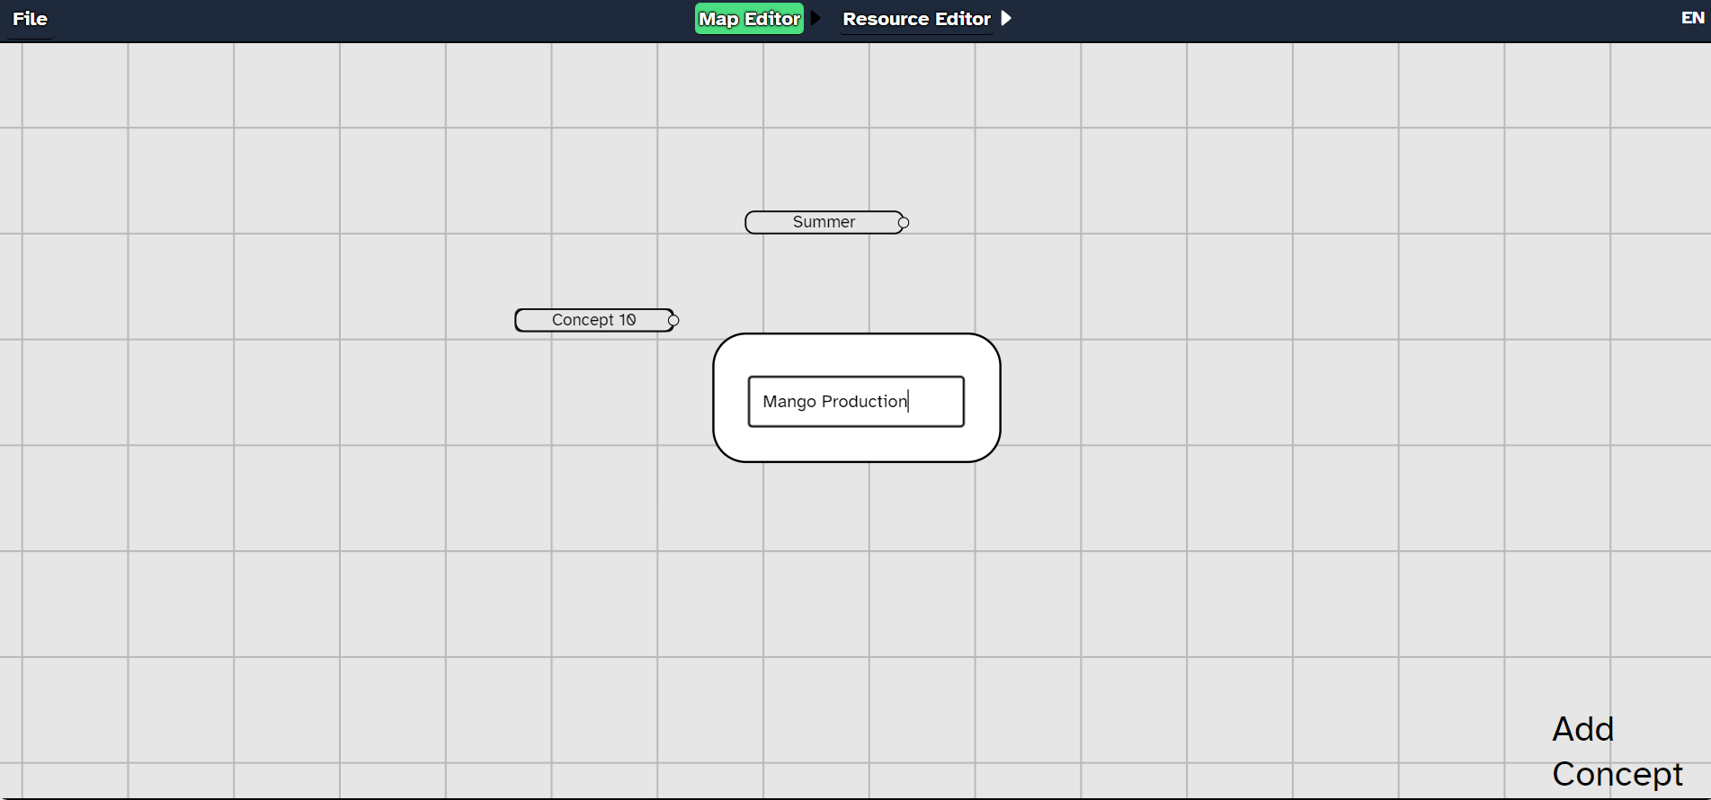
Custom Units
Build your own causal map
Add new concepts to the builder by clicking on the Add new concept button.

Slide 45
Custom Units
Build your own causal map
Rename concepts by right-clicking on them.

Slide 46
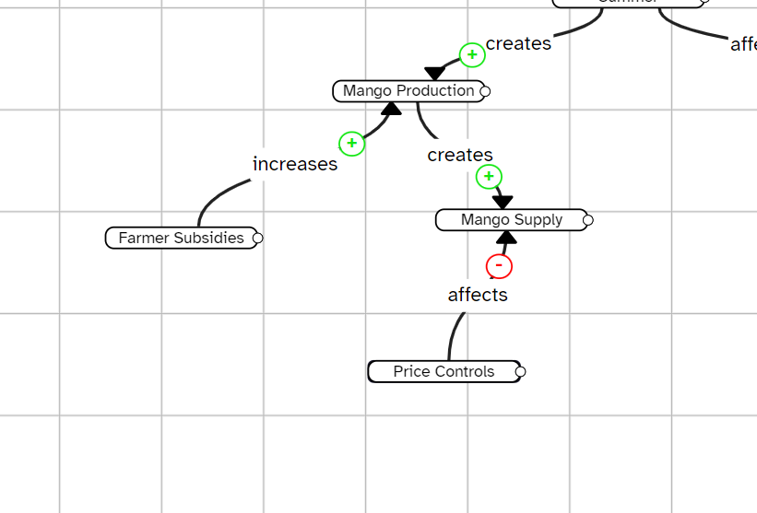
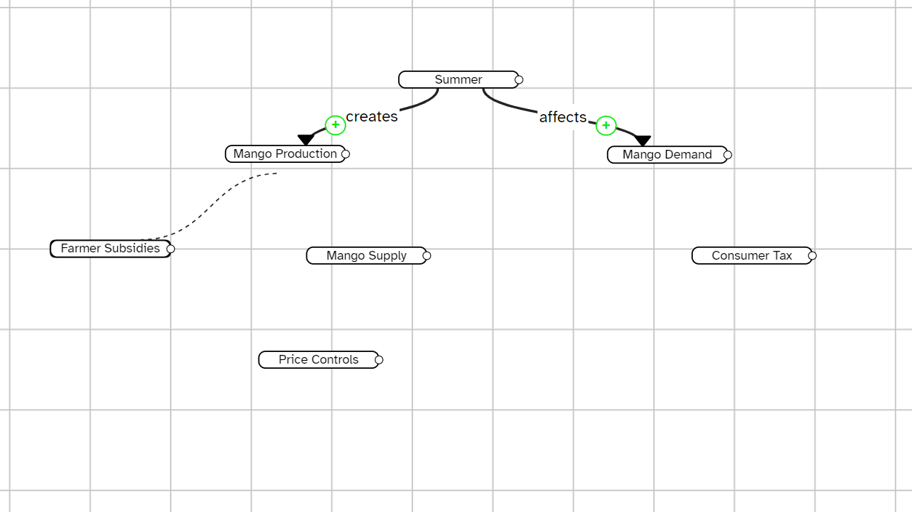
Custom Units
Build your own causal map
Create links between concepts by dragging your mouse pointer from one concept to another, in the direction of the causal relationship.
Change the nature of the link’s relation by clicking on the ‘+’ or ‘-’ sign on the link.

Slide 47
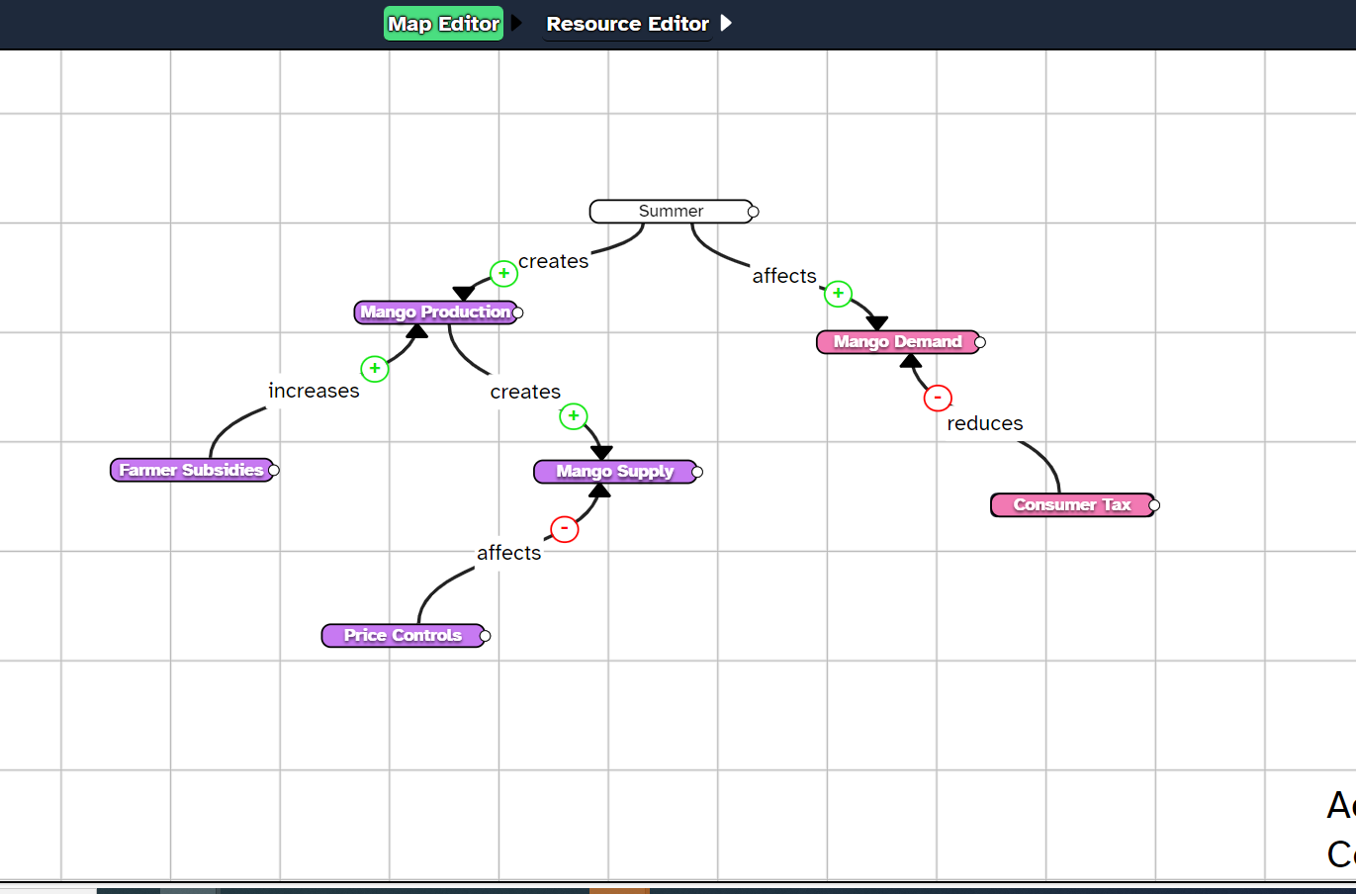
Custom Units
Automatically generate quizzes for Betty
Parts of the causal map can be separated to test Betty on different sections of the map.
This can be useful when the maps are complex and have multiple sub-parts.
Supply Side
Demand Side

Slide 48
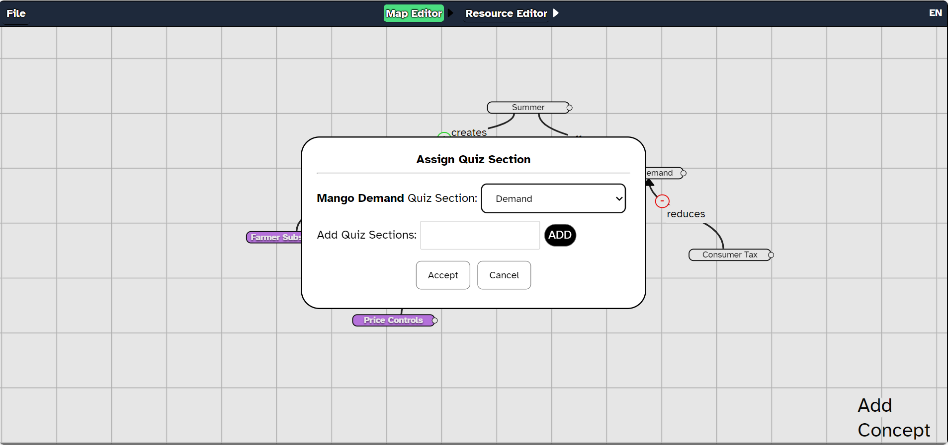
Custom Units
Automatically generate quizzes for Betty
Supply Side
Demand Side
To add a quiz section, right click on a concept and click on ‘Add quiz section.’ Do this for every concept that is supposed to be a part of a specific section.
You can choose to create a quiz on any section of the map, provided there are at least two links in that section.

Slide 49
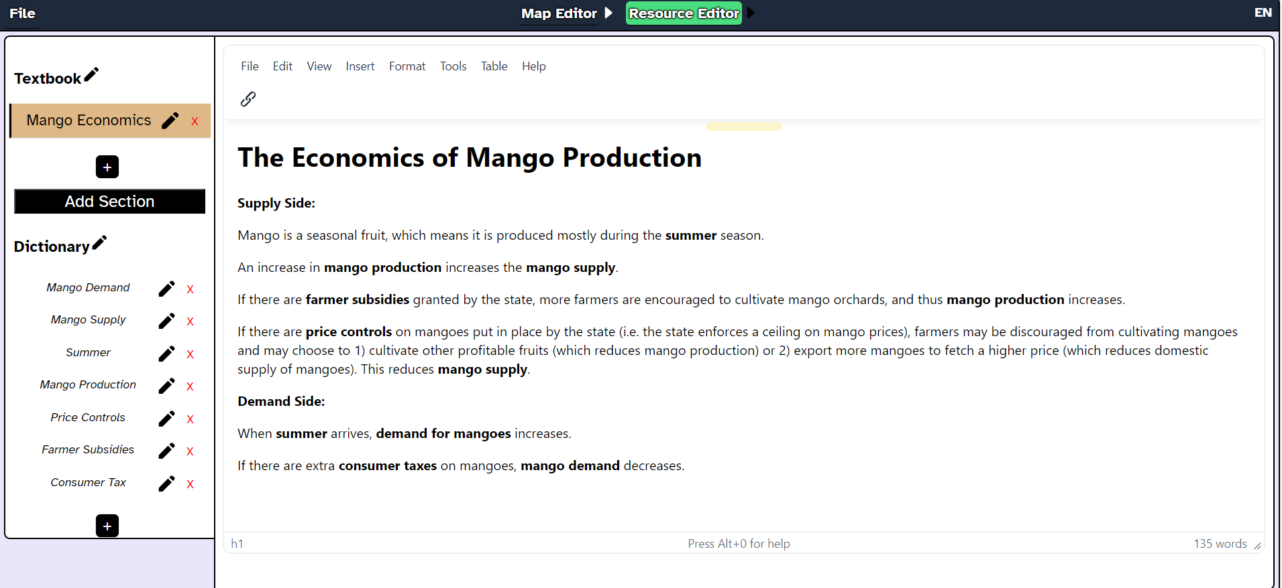
Custom Units
Remember to appropriately cite and reference any content you get from external sources!
Build resources for the science book
Go to the Resource Editor tab, and you will see that you can add relevant resources related to the causal map you want your students to build.

Slide 50
Custom Units
Build resources for the science book
You can also embed hyperlinks and videos should you wish to add external resources from the internet.

Slide 51
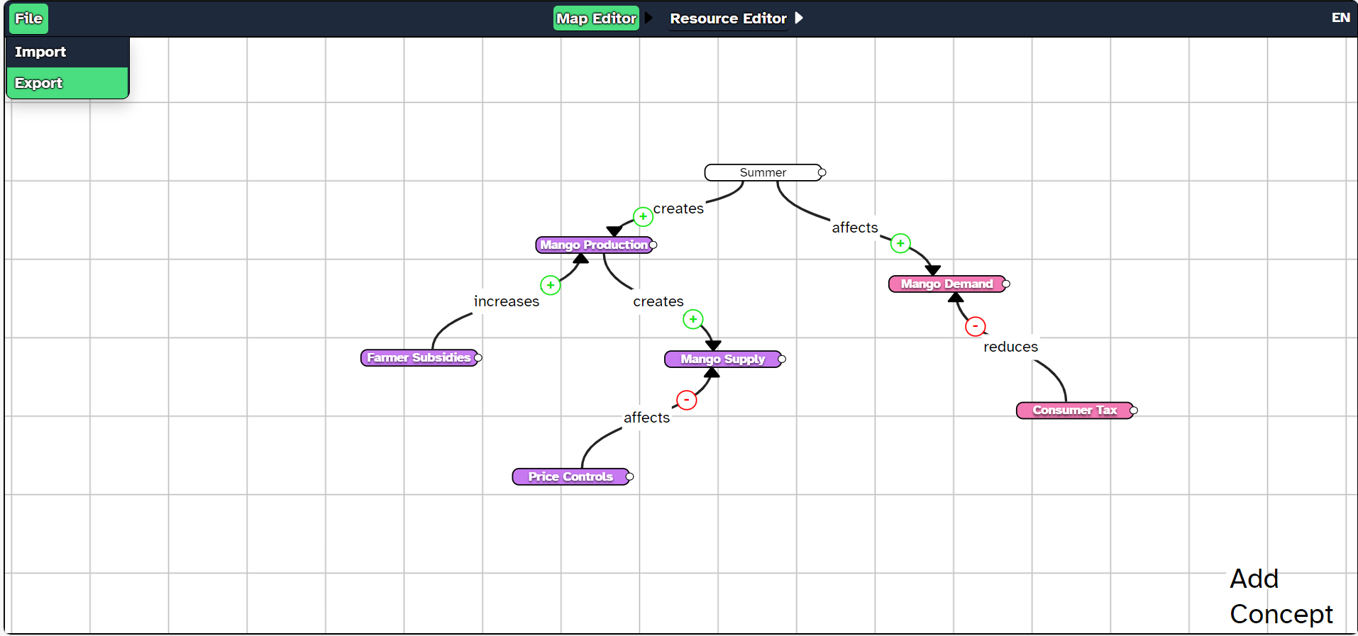
Custom Units
Export the custom units
Click on File then click on Export to export your custom units.

Slide 52
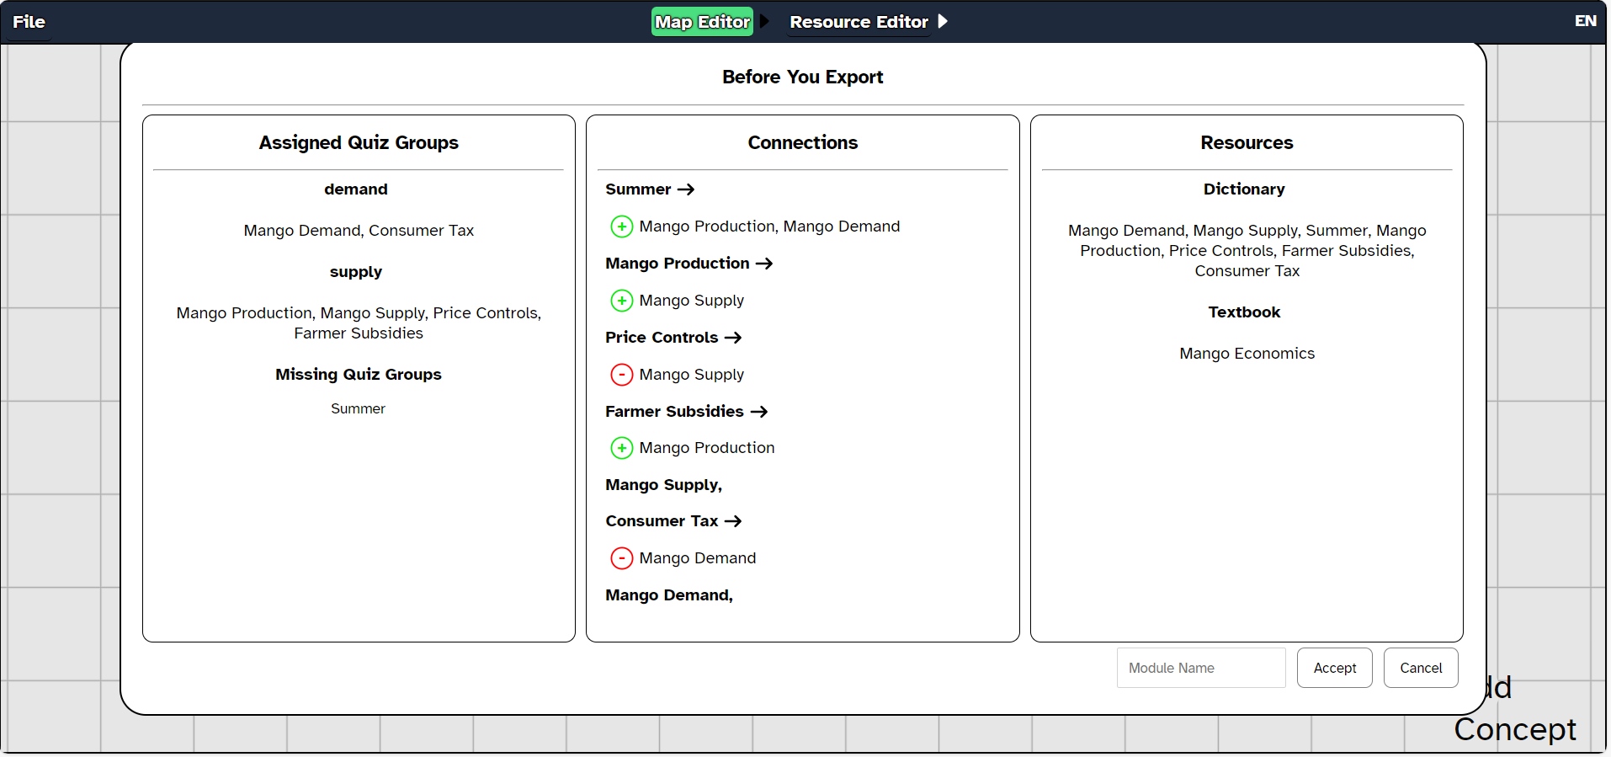
Custom Units
Export the custom units
Review your custom unit in this summary page, then give it a name. Click on Accept.

Slide 53
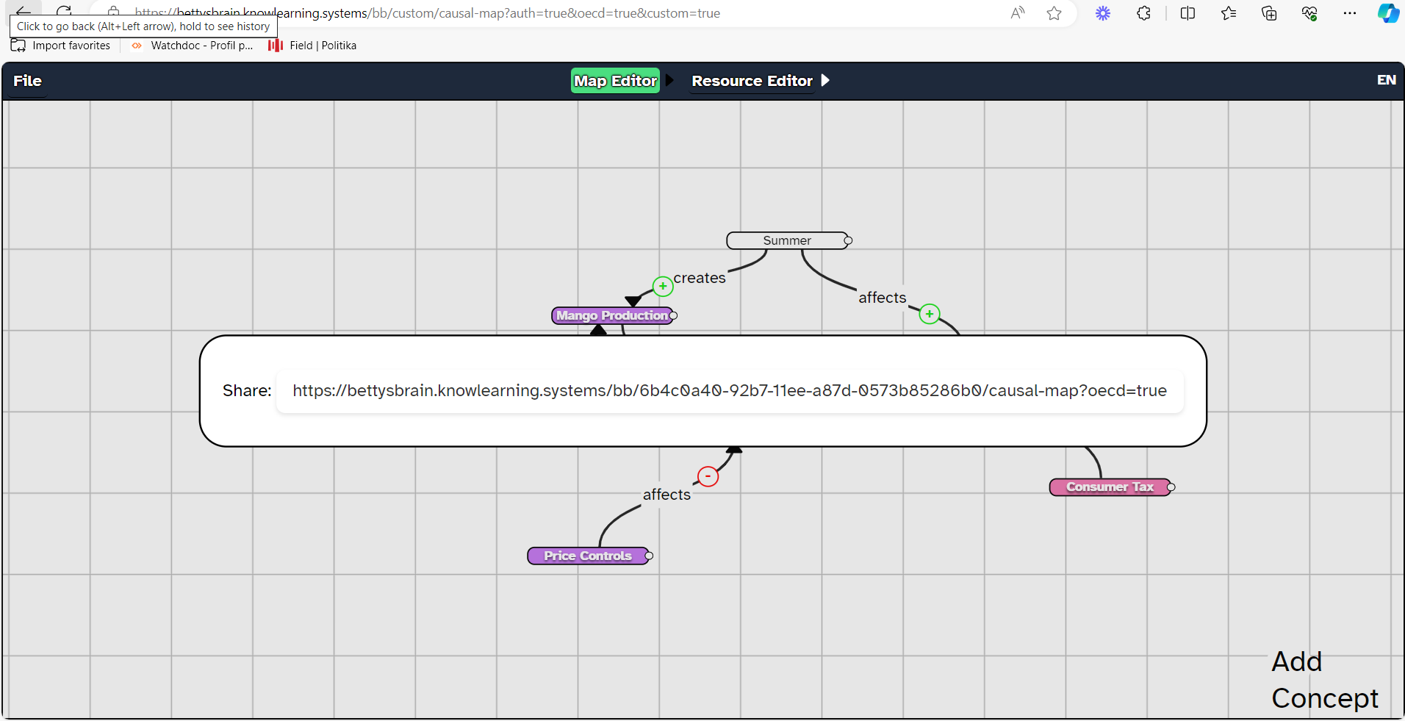
Custom Units
Export the custom units
Copy the code for your custom unit. You can add this to the item library in your teacher account.

Slide 54
Quiz: Section 3
You are a Grade 8 history teacher and you want to create a unit on the events that triggered the start of World War I. Which of the following would you use to create a new unit?
Science Book
Quiz Results
Virtual Agent
Customiser Tool

Slide 55
Quiz: Section 3
You are a Grade 8 history teacher and you want to create a unit on the events that triggered the start of World War I. Which of the following would you use to create a new unit?
Science Book
Quiz Results
Virtual Agent
Customiser Tool

Slide 56
Quiz: Section 3
You have built a causal map using the customiser tool on earthquakes. What would you do to add more information on the concept on the Betty’s Brain interface?
Add new content to the resource editor
Ask students to refer to their textbooks
Ask Mr. Davis to clarify students’ questions
Ask students to use the internet

Slide 57
Quiz: Section 3
You have built a causal map using the customiser tool on earthquakes. What would you do to add more information on the concept on the Betty’s Brain interface?
Add new content to the resource editor
Ask students to refer to their textbooks
Ask Mr. Davis to clarify students’ questions
Ask students to use the internet

Slide 58
Congrats, you have finished Section 3!
Time for a quick break.

Slide 59
4
How can I view students’ progress?
BACK TO MAIN MENU

Slide 60
How can I view students' progress?
There are three ways for you to view your students' progress: using the expert map view, the log view, or the links view. The following slides explain each of the three views in more detail.
Dashboard Views
Expert Map View
Links View
Log View

Slide 61
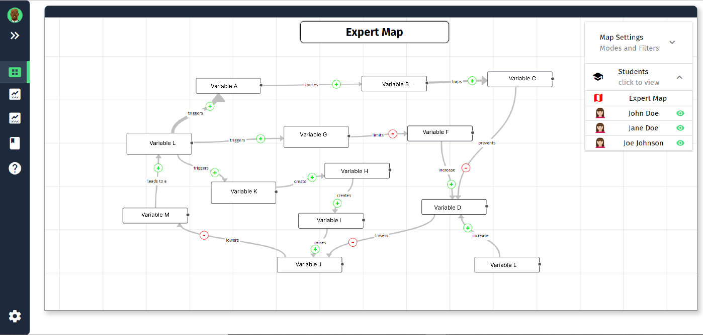
Expert View
This is the default mode called the ‘expert view’, in which you can view the correct and complete map of a specific unit. You can personalise it to see what you want by using the ‘Map Settings’ menu.

Slide 62
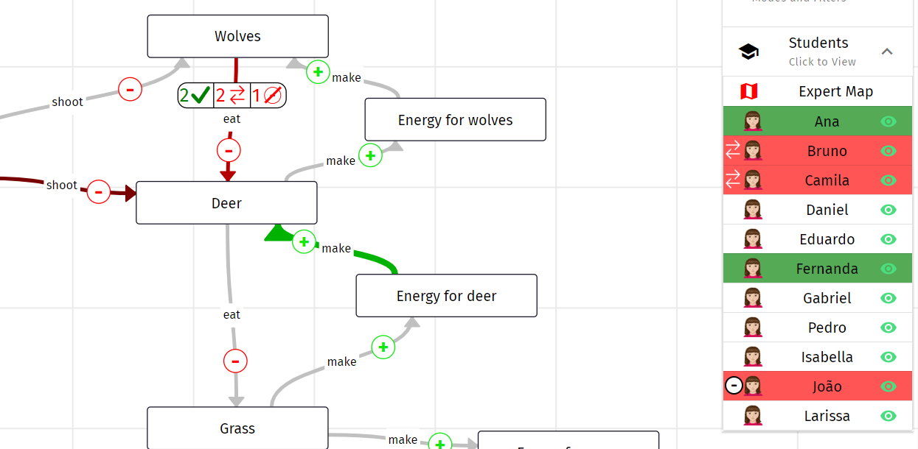
Expert View
In this view, you can hover over each link and see how many students got that link right, how many got it reversed (e.g., B→A instead of A→B), and how many got it wrong (e.g. incorrectly marked a link as a link).
When you hover a link in the Expert View, you can see on the right which students have got the link wrong, reversed, correct, or missing.

Slide 63
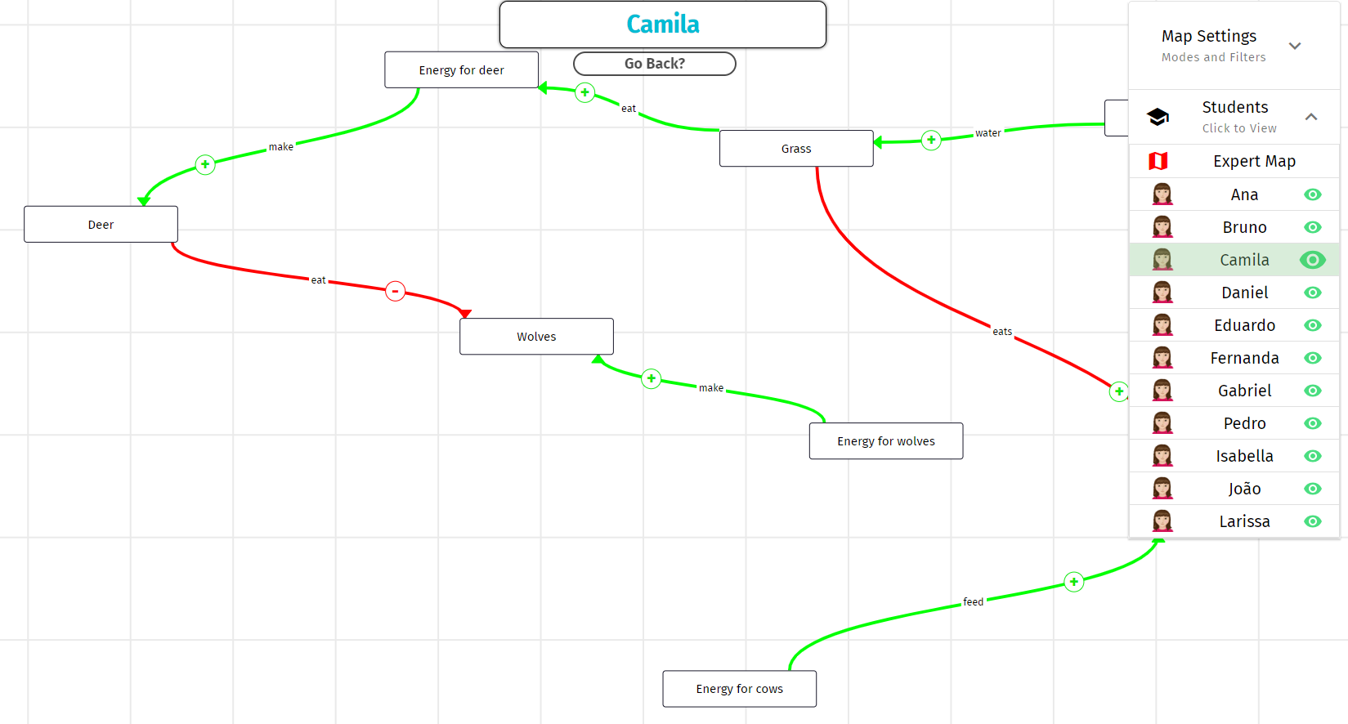
Expert View
You can also click on the eye button next to the student’s name to see their screen in real-time.

Slide 64
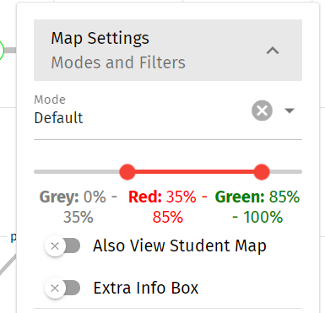
Expert View
Using the sliders in the ‘Map Settings’ menu, you can set thresholds that modify the appearance of the main expert map according to the percentage of students who get each link right or wrong.
For example, you could decide that if 85% or more students get a link right, that link should be colored green on the map, while if between 35% to 85% get it wrong, it should be colored red.

Slide 65
Log View Dashboard
The log view dashboard is where you can see the progress of each individual student. This view gives you information on missing nodes, missing links, reversed links, extra links, shortcut links, and the overall map completion rate of each student.
The slides that follow explain each of these terms in more detail.

Slide 66
Log View Dashboard
‘Missing nodes’ refer to the concepts that are not yet included in the map

Slide 67
Log View Dashboard
‘Missing links’ refer to the links that the student did not include in their map but could be made because the concepts are already in their causal map.

Slide 68
Log View Dashboard
‘Extra links’ are links that the student has drawn but are not included in the expert map

Slide 69
Log View Dashboard
‘Reversed links’ are links that go from concept B → concept A instead of the correct A → B direction.

Slide 70
Log View Dashboard
‘Shortcut links’ are links in which the student connected two concepts A and B directly, skipping a necessary mediating concept C

Slide 71
Log View Dashboard
This refers to the student’s completion rate of the map (i.e., the extent to which the student has replicated the underlying expert map)

Slide 72
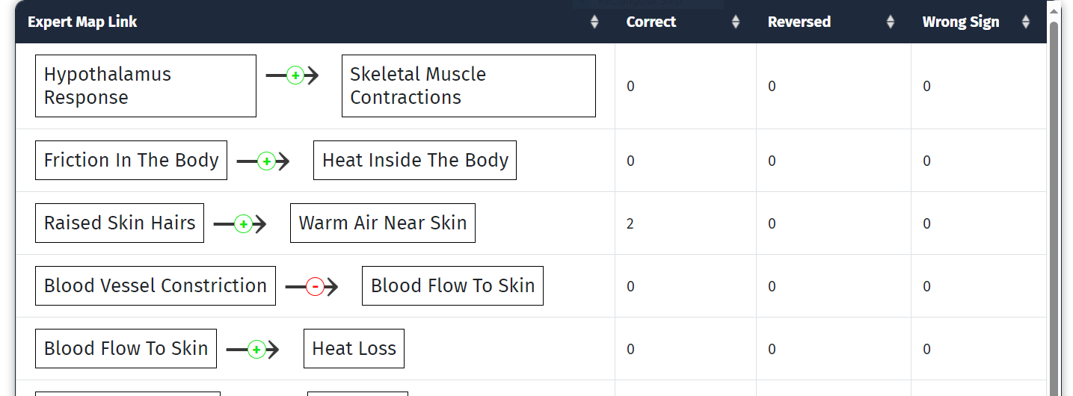
Links View Dashboard
The ‘links view’ provides information on which sections of the map – and in turn, which concepts within the scientific phenomenon – are proving to be more challenging for students to understand.

Slide 73
Links View Dashboard
The number of students who correctly included the link in their own map

Slide 74
Links View Dashboard
The number of students who reversed the link

Slide 75
Links View Dashboard
The number of students who labelled it with the wrong sign

Slide 76
Quiz: Section 4
Which of the following views shows you the full and correct map?
Expert View
Log View
Links View
Dashboard View

Slide 77
Quiz: Section 4
Which of the following views shows you the full and correct map?
Expert View
Log View
Links View
Dashboard View

Slide 78
Quiz: Section 4
Greenhouse gas emissions (A) increase global temperatures (B) which in turn increase sea levels (C). One of your students creates a positive link A → C in their causal map (forgetting B). What kind of a link is this?
Reversed Link
Missing Link
Missing Node
Shortcut Link

Slide 79
Quiz: Section 4
Greenhouse gas emissions (A) increase global temperatures (B) which in turn increase sea levels (C). One of your students creates a positive link A → C in their causal map (forgetting B). What kind of a link is this?
Reversed Link
Missing Link
Missing Node
Shortcut Link

Slide 80
Congratulations, you’re all done! Take a few moments to look at a quick recap in the next slide.
Notes:
One dense slide here

Slide 81
What is Betty’s Brain?
Causal map building
Elements of Betty’s Brain
Virtual Agents
Science Book
Using Betty’s Brain
Expert-made units
Viewing student progress
Target skills:
Causal Reasoning
Learning by teaching
Concepts
Links
Causal Map Builder
Betty
Quiz Results
Teacher Guide
Notes
Systems Thinking
Self-regulated Learning
Custom units
Expert view
Log view
Links view
Predator-prey
Thermoregulation
Climate change
Mr. Davis

Slide 82
Well-done! You’re ready to use Betty’s Brain with your students.

