Slide 1
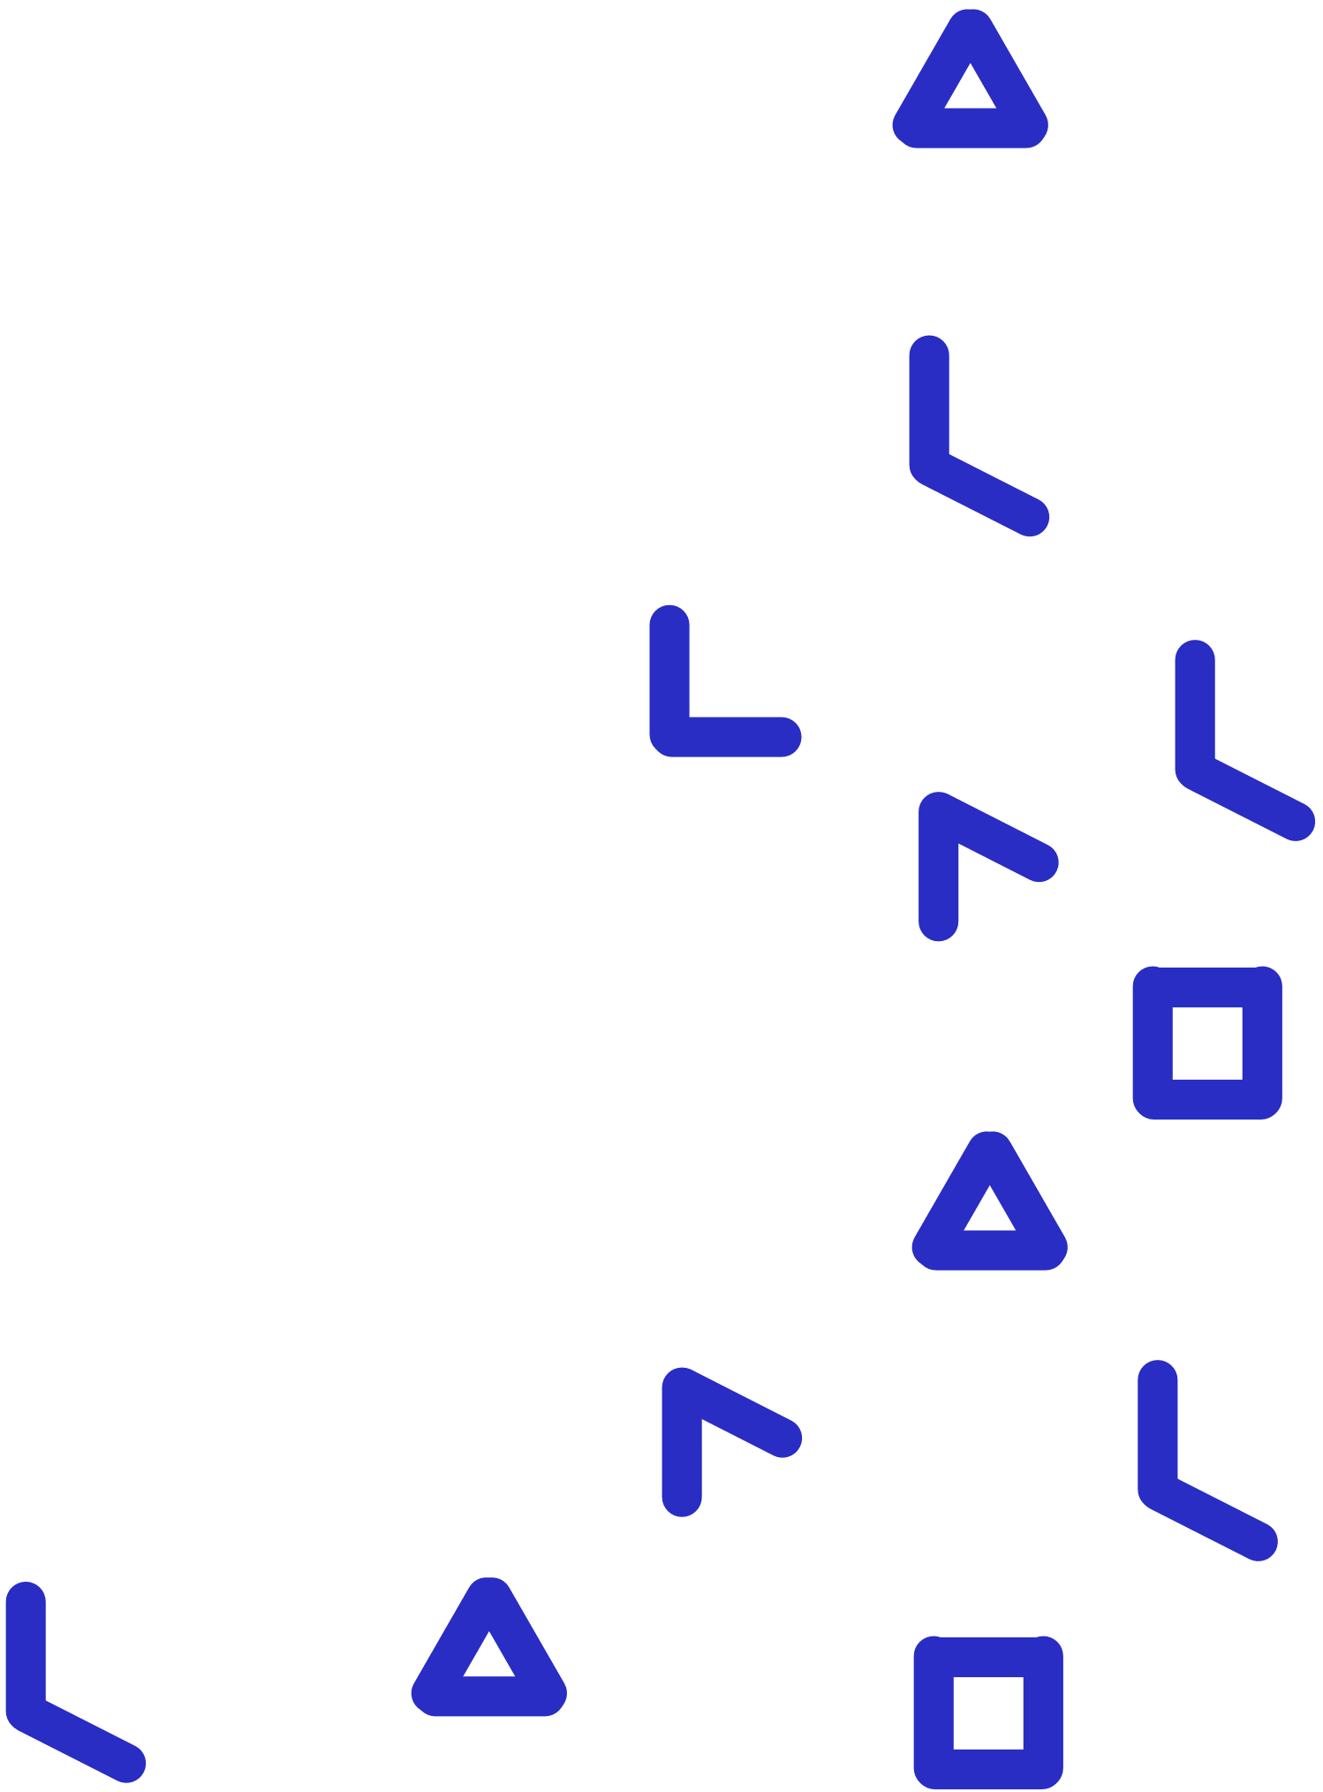
PILA Game Creator
Powered by Cand.li
Teacher’s Guide

Slide 2
Overview of Sections
1. What is the PILA Game Creator?
2. What are the key elements of the digital environment in the PILA Game Creator?
3. How can I use and customise the PILA Game Creator?
4. How can I view student progress on the PILA Game Creator?
Notes:
Link these as well

Slide 3
1
What is the PILA Game Creator?
BACK TO MAIN MENU

Slide 4
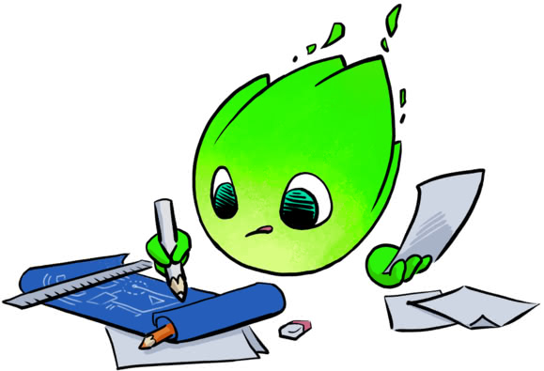
Introduction to PILA Game Creator
What is the PILA Game Creator?
The PILA Game Creator powered by Cand.li is a PILA application in which students learn how to design, programme and test their own digital game.
The PILA Game Creator aims to develop and assess students’ computational problem solving, creative thinking and self-regulated learning skills.

Slide 5
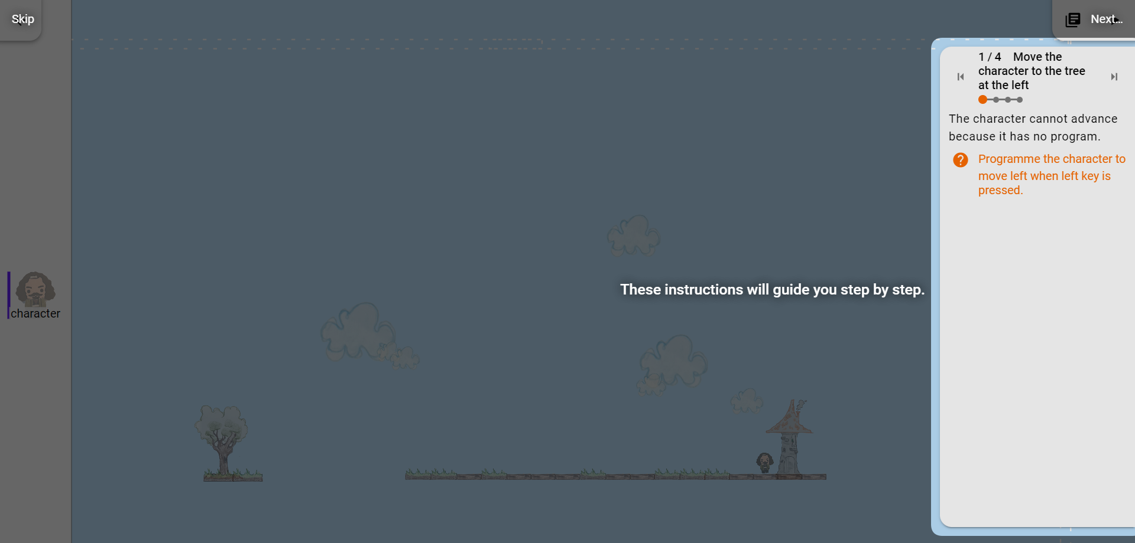
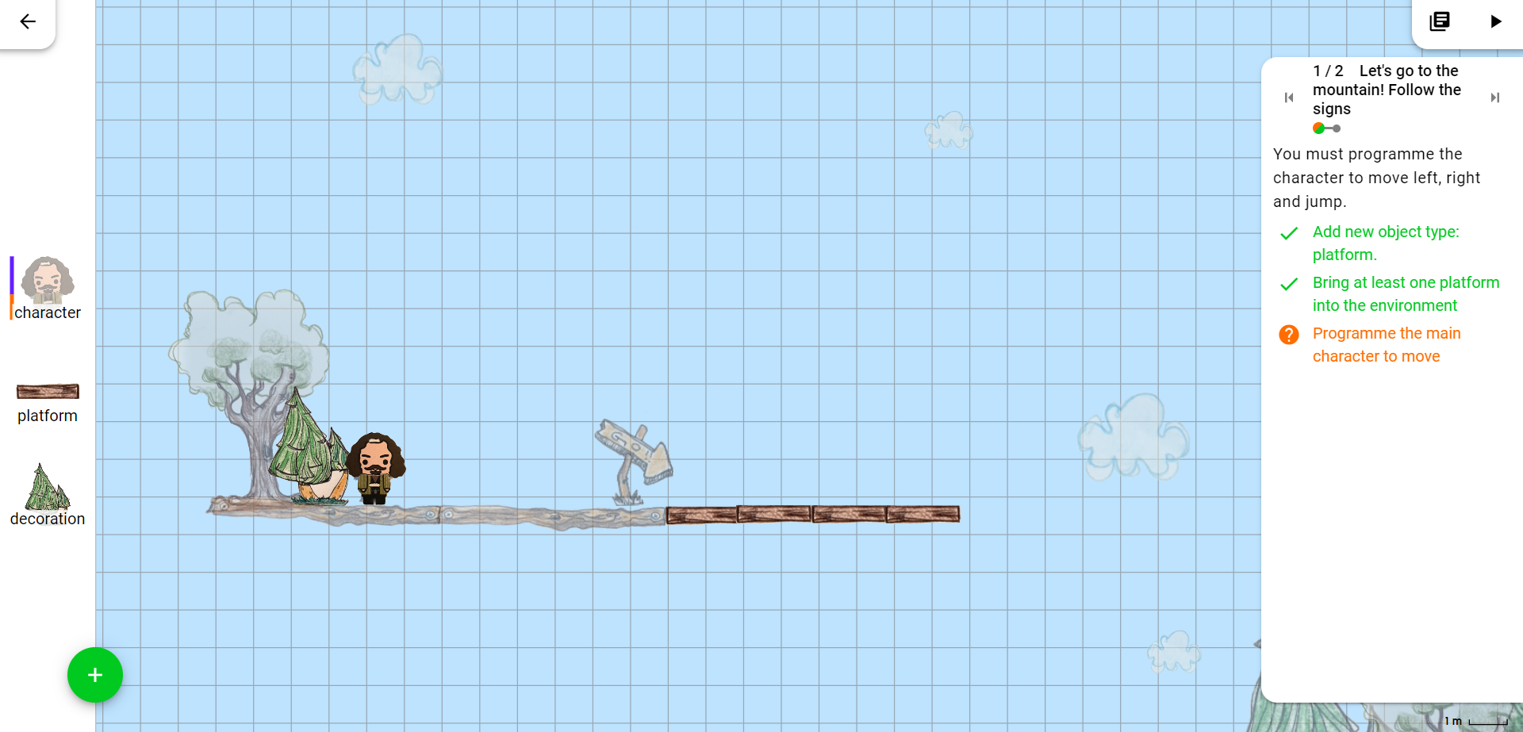
Introduction to PILA Game Creator
How does it work?
First, students are guided through the interface and tools.
They then begin to design their own game world by adding game objects to the middle area.

Slide 6
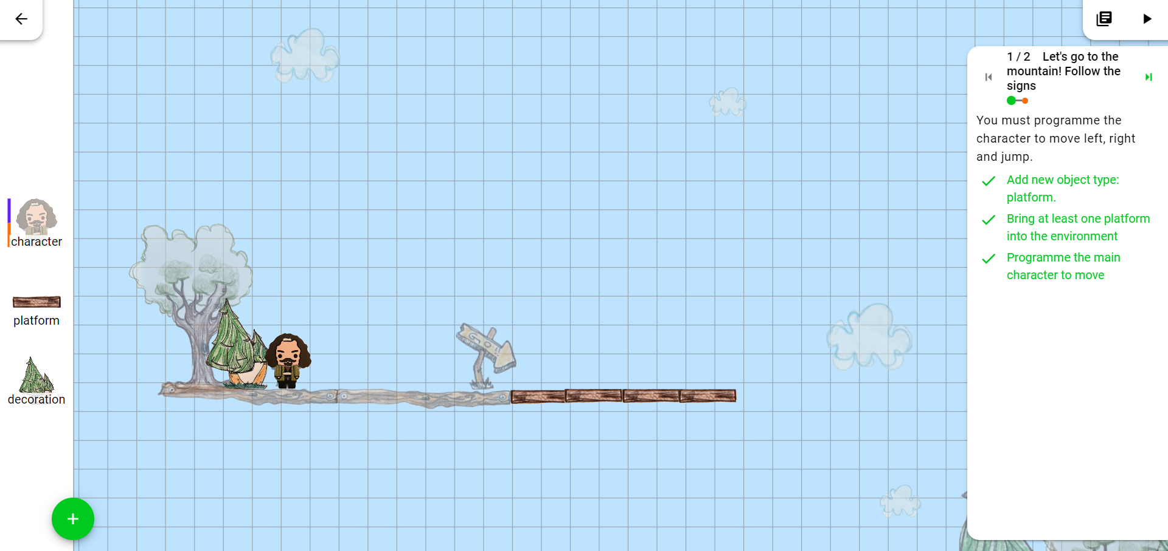
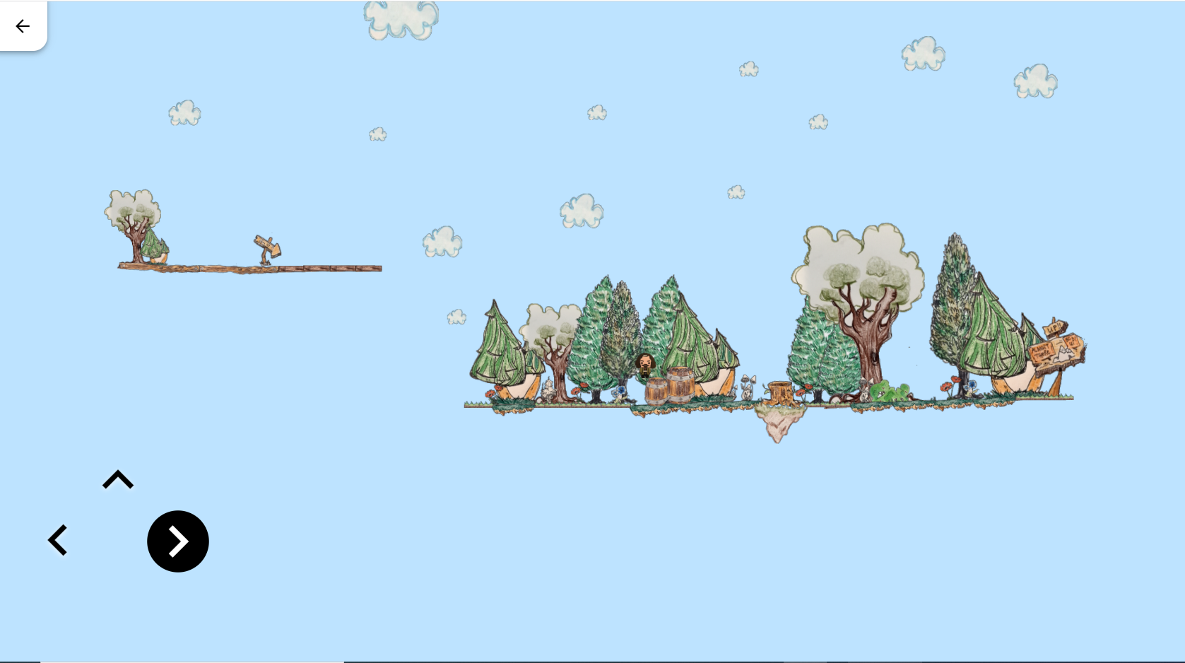
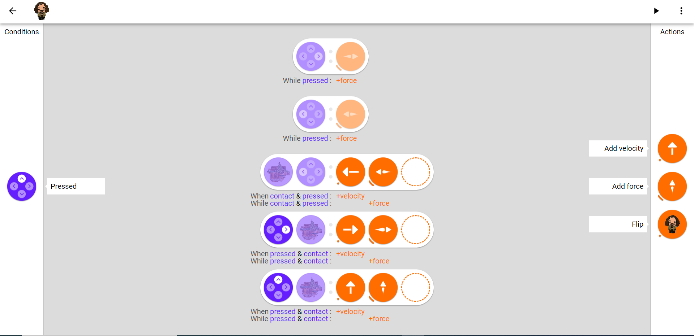
Introduction to PILA Game Creator
How does it work?
Students must programme each object to be interactive using a visual event-based language. This means, when certain conditions are met (player pressing the left arrow), the object performs certain actions (move left).
As they build, students can play the game to check that their programme is working properly.

Slide 7
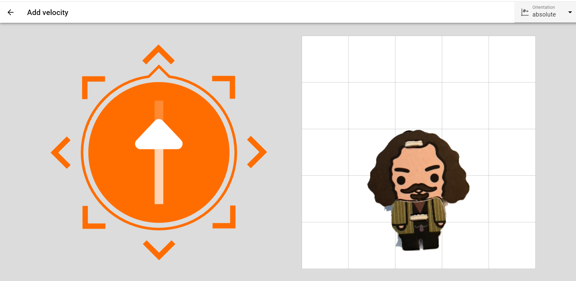
Introduction to PILA Game Creator
How does it work?
Based on the playing experience, students can continue programming or adjust what they had programmed, in addition to adding objects (e.g. platform) to the game world.

Slide 8
Introduction to PILA Game Creator
a
What are the target skills?
PILA Game Creator aims for students to learn and demonstrate…
Computational Thinking
Self-regulated Learning
…how to manage and make decisions about one’s own learning processes. This includes setting goals, planning strategies, and monitoring progress.
…how to develop solutions to problems that can be executed by a computer. This involves breaking problems down into smaller, more manageable parts, recognising patterns and other skills.
Creative Thinking
…how to think innovatively, generate new ideas, and produce new and original solutions to problems.

Slide 9
Introduction to PILA Game Creator
Introduction Video
On the right is a short video that introduces the idea of making an interactive game

Slide 10
Quiz: Section 1
Which of the following skills does Cand.li aim to develop and assess? (Select all that apply)
Computational Thinking
Systems Thinking
Mathematical Reasoning
Creative Thinking

Slide 11
Quiz: Section 1
Which of the following skills does Cand.li aim to develop and assess? (Select all that apply)
Computational Thinking
Systems Thinking
Mathematical Reasoning
Creative Thinking

Slide 12
Quiz: Section 1
Which of the following tasks does a student do when working with the PILA Game Creator? (Select all that apply)
Design the game world
Programme game world objects
Test the game
Write C++ code

Slide 13
Quiz: Section 1
Which of the following tasks does a student do when working with the PILA Game Creator? (Select all that apply)
Design the game world
Programme game world objects
Test the game
Write C++ code

Slide 14
Congrats, you have finished Section 1!
Time for a quick break.

Slide 15
2
What are the elements of the digital environment of the PILA Game Creator?
BACK TO MAIN MENU

Slide 16
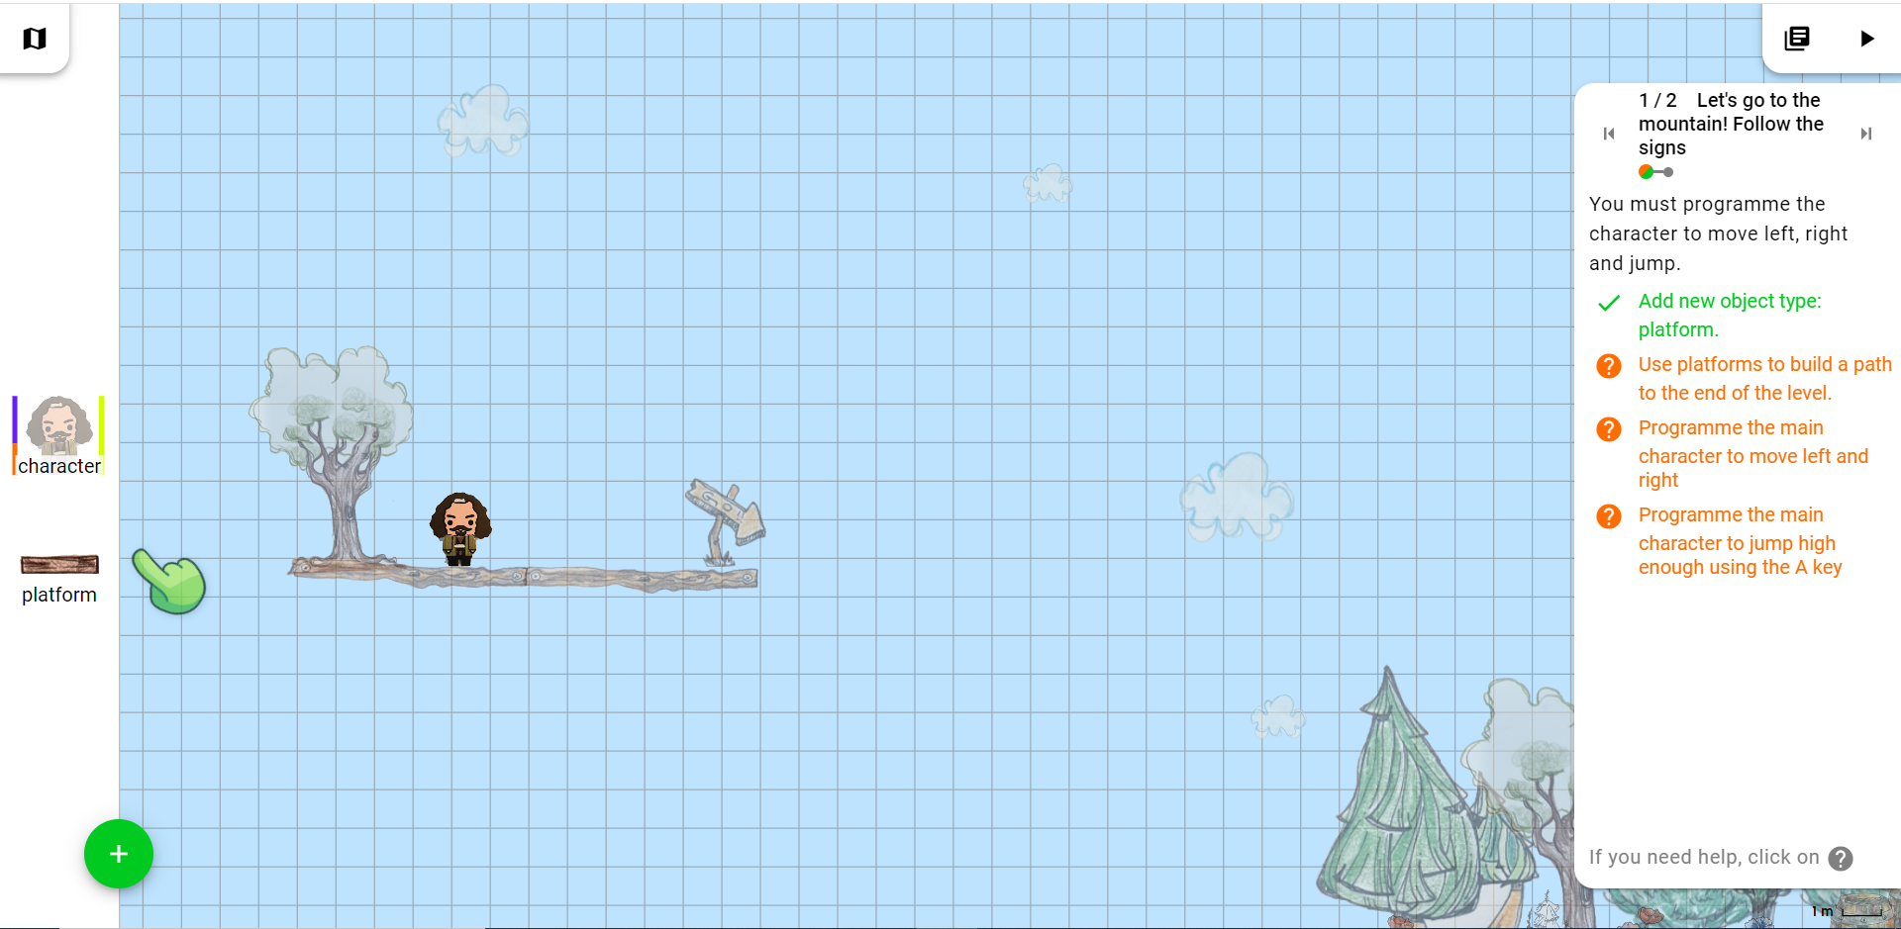
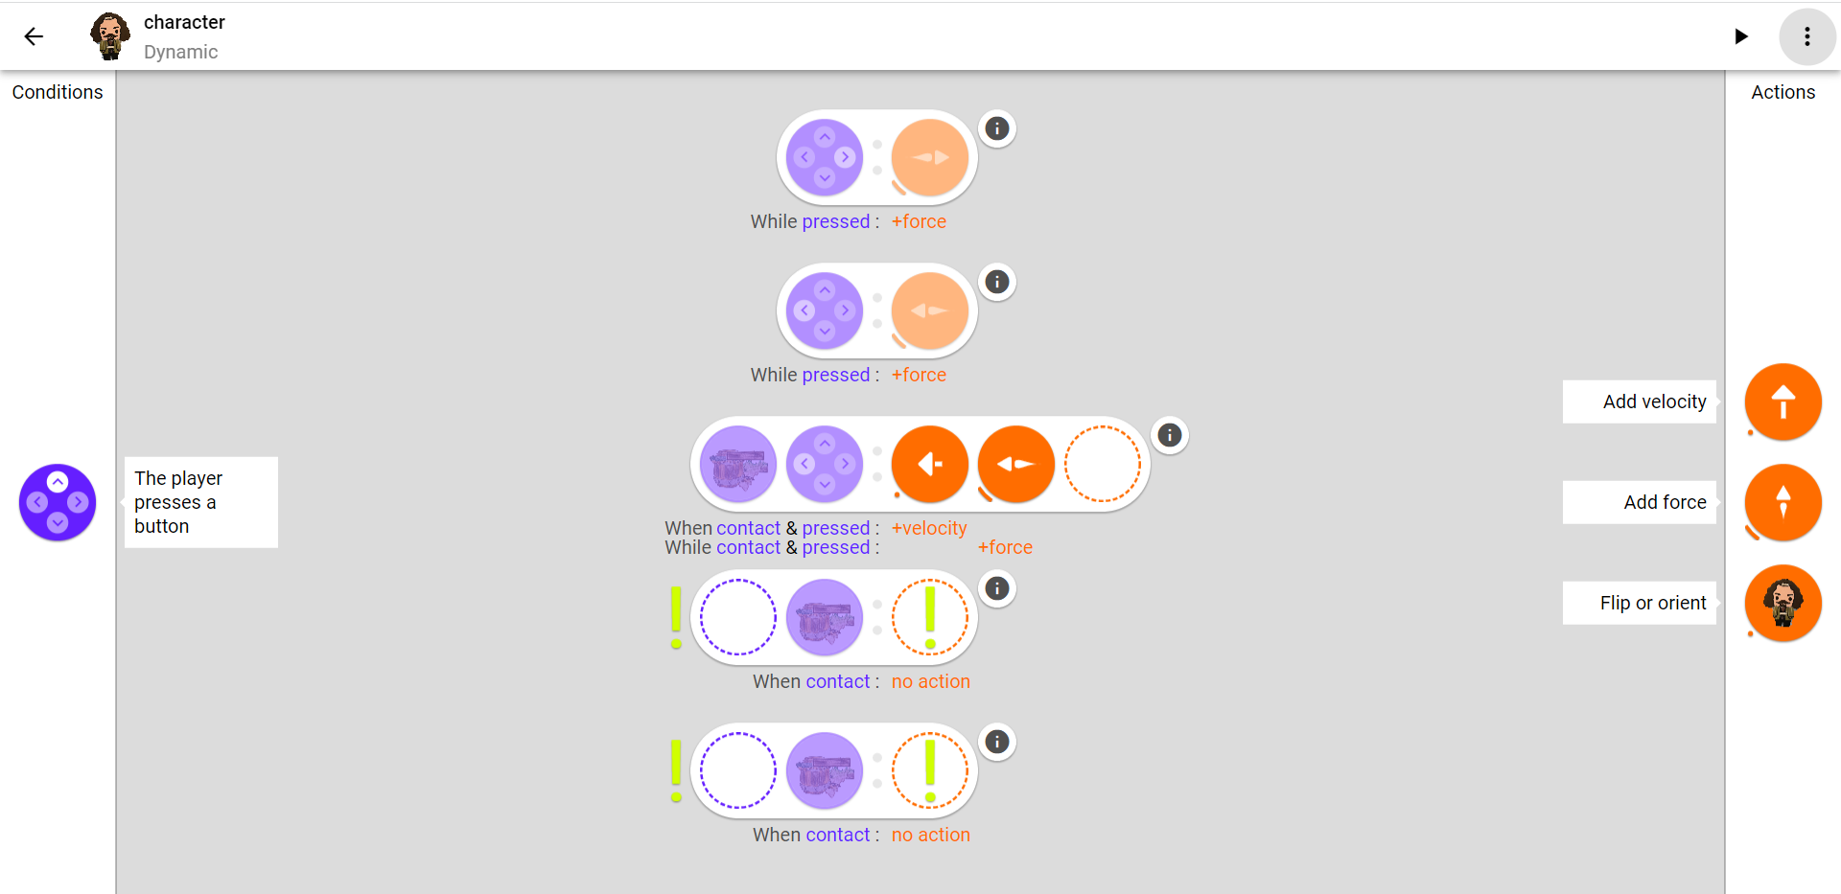
Key Elements
The PILA Game Creator interface has seven main elements. Take a look at each element in these visuals. Then, click on each number to know more.

Slide 17
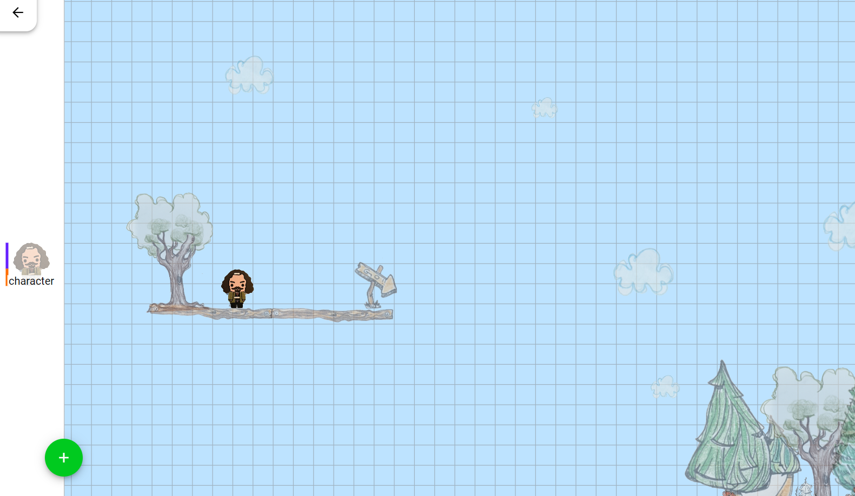
Level Editor
The level editor is the canvas on which the game is designed.
The ‘object palette’ contains the objects that can be used to design the game world. Objects can be the main character, platforms on which the character moves around, decorative items like trees, etc.
Students can drag and drop, as well as rotate and scale objects in the ‘level area’. The combination of objects creates the game world.
Object Palette
Level Area

Slide 18
Level Editor
Object Palette
To add an object to the object palette, click on the ‘+’ button and click on the desired object.
Play the video to see how it works!

Slide 19
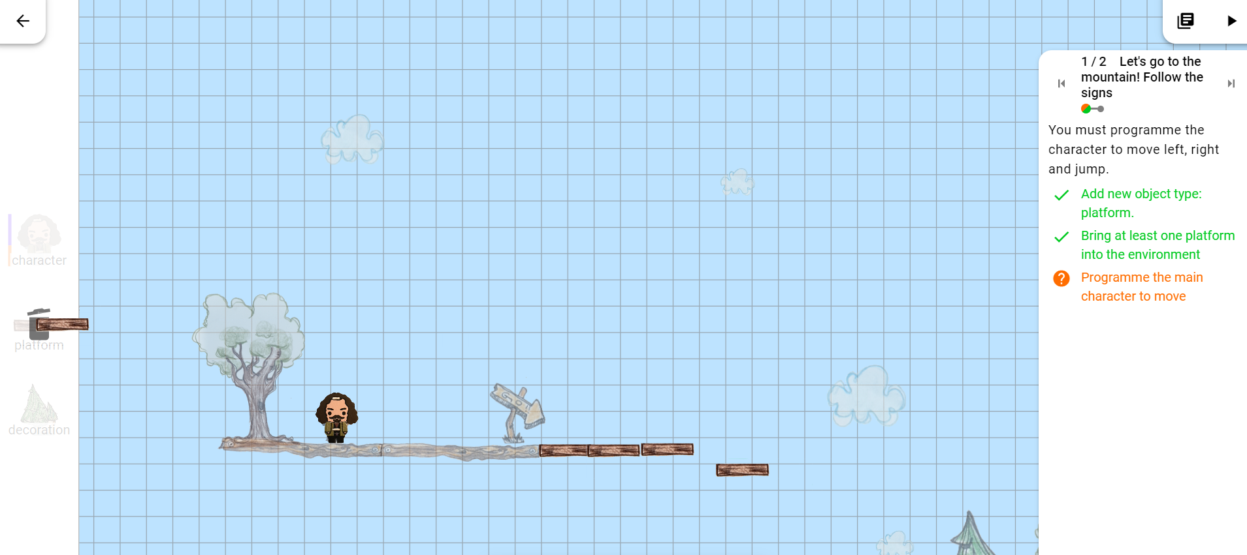
Level Editor
Object Palette
To remove an object from the level area, drag and drop it back into the object palette.

Slide 20
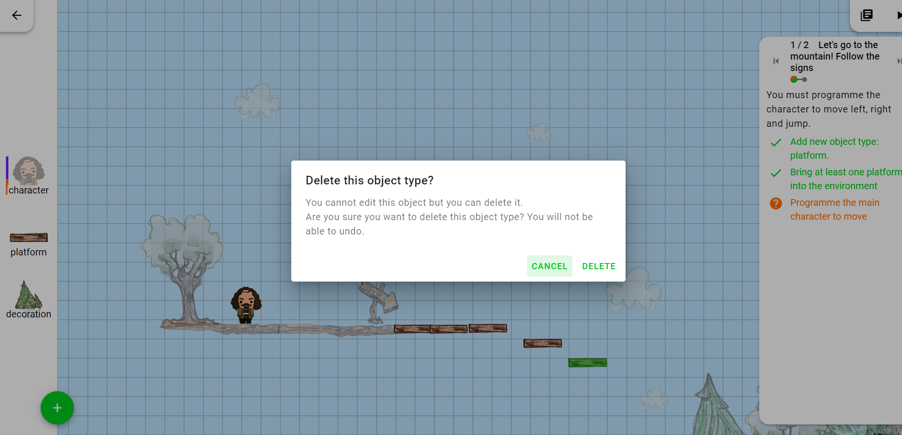
Level Editor
Object Palette
To remove an object from the object palette, click on it and choose ‘DELETE’

Slide 21
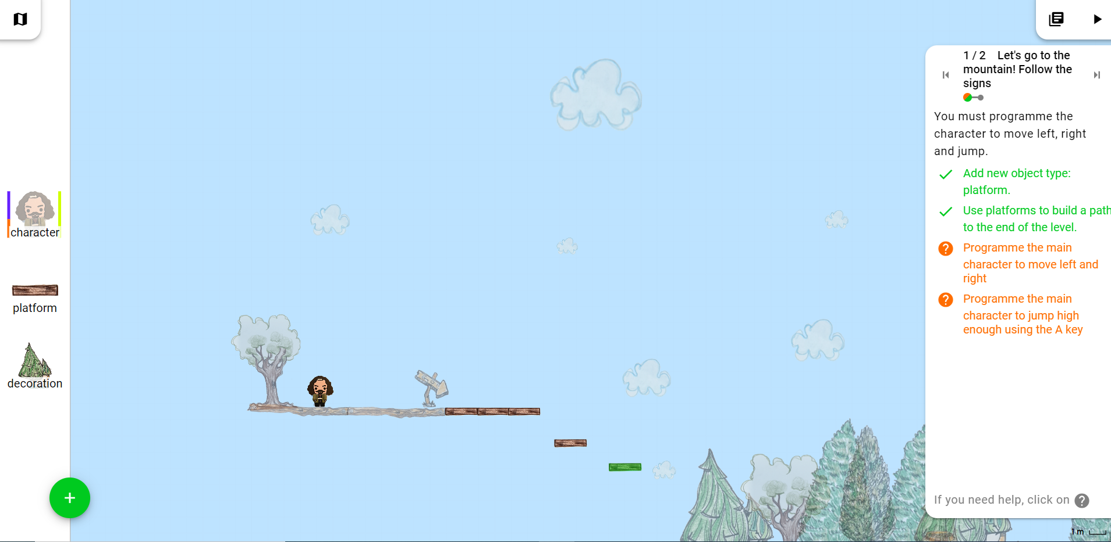
Instruction Panel
Instructions
The instruction panel offers step-by-step instructions on what students must do.
Each instruction window is a step to completing the game level. For example, there are 2 steps in this level.
Within a step, there are sub-goals. For example, there are 4 sub-goals in this level.

Slide 22
Instruction Panel
Hint System
If students need help achieving the sub-goals, they can ask for hints. These hints adapt to what they have done up to that point.
Students can click on the button of a sub-goal to get a hint.
Play the video to see how it works!
The button appears 30 seconds after the game begins, so students must try to find a solution first.

Slide 23
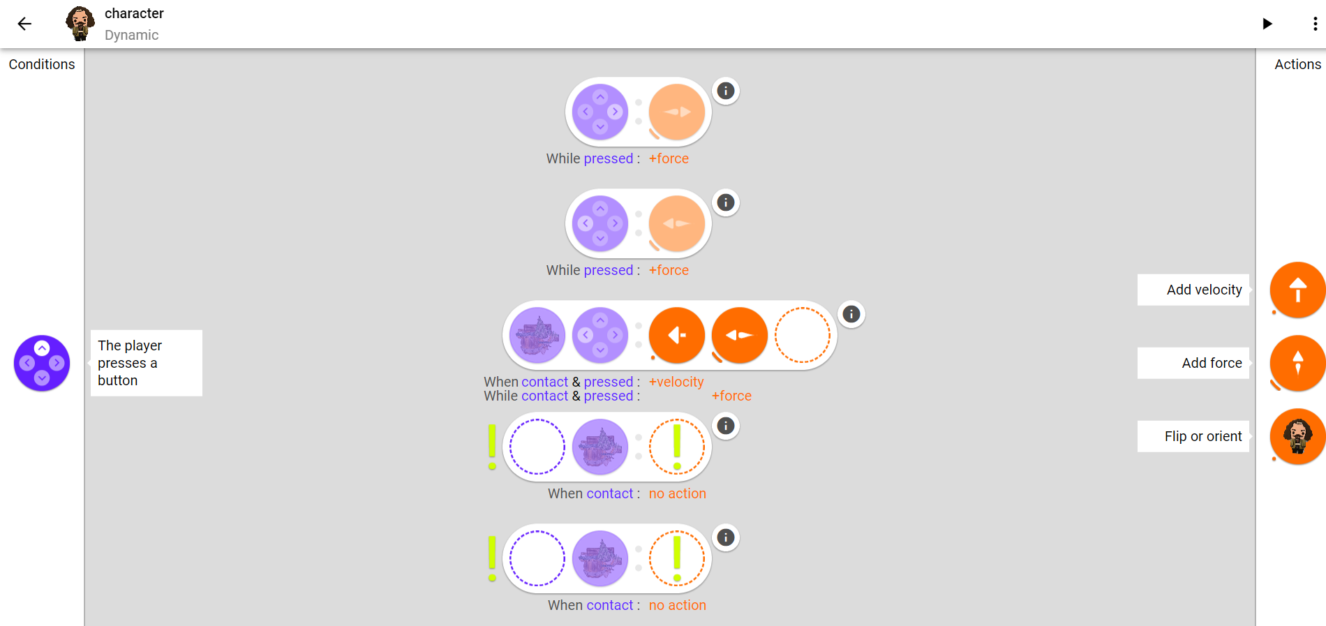
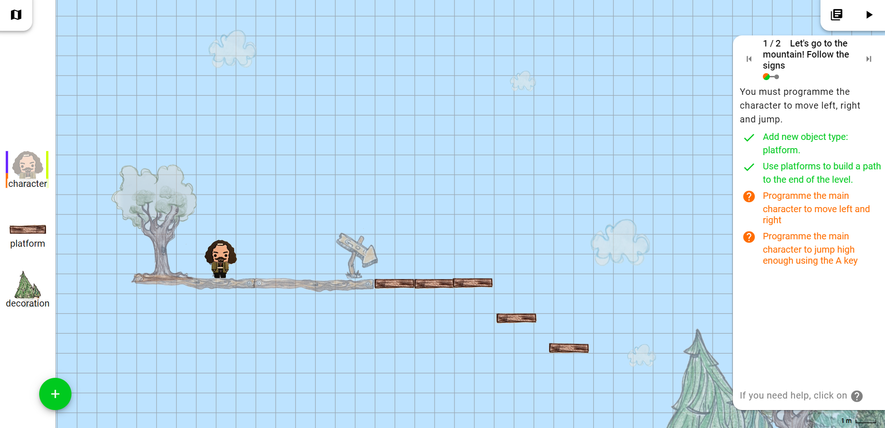
Programme Editor
Here, students can program the rules that determine how objects behave in their game.
To programme objects to be interactive in ‘play’ mode, students must click on the object. This opens the programme editor.

Slide 24
Programme Editor
Conditions & Actions
The programme editor houses two building blocks which can be used to build your programmes: conditions and actions.
Conditions are what need to be fulfilled for the object to carry out the actions.
Actions are what the object does when the conditions are met.

Slide 25
Programme Editor
Conditions & Actions
For this rule, if the conditions are met (the character is touching the ground and a player presses the left arrow key on their keyboard), then the character will move to the left (thanks to the addition of velocity and force to the left).

Slide 26
Programme Editor
Adding a new condition and action
To add a condition, drag and drop a condition to any empty dotted circle (in purple).
To add a corresponding action to the condition, drag and drop the desired action to empty dotted circle (in orange).
Play the video to see how it works!

Slide 27
Programme Editor
Creating conditionals
You have now programmed your character to move right when the button > is pressed – you have created a conditional.

Slide 28
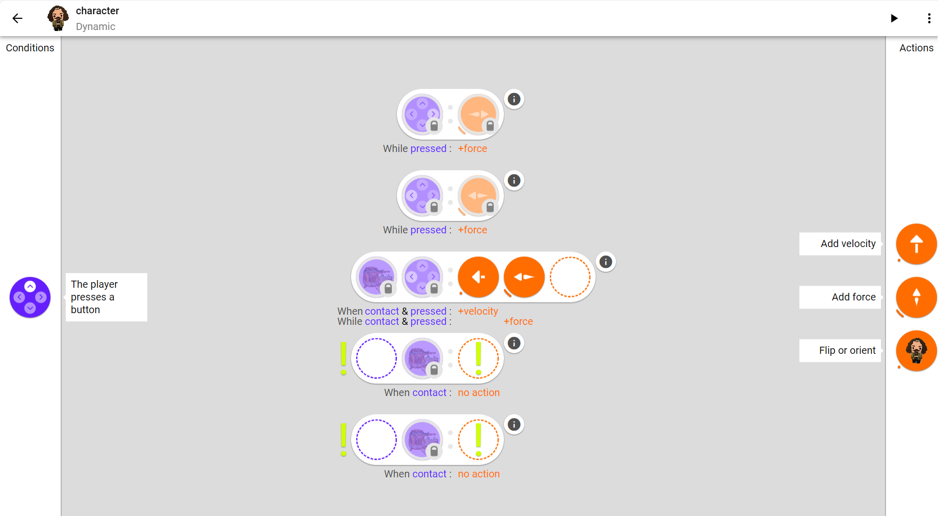
Programme Editor
Conditions and Actions
Note that some conditionals are pre-programmed – they are greyed out with a lock symbol to show they cannot be edited.
The pre-programmed elements are present so that students understand why some objects can already perform certain actions. It also scaffolds students’ learning.

Slide 29
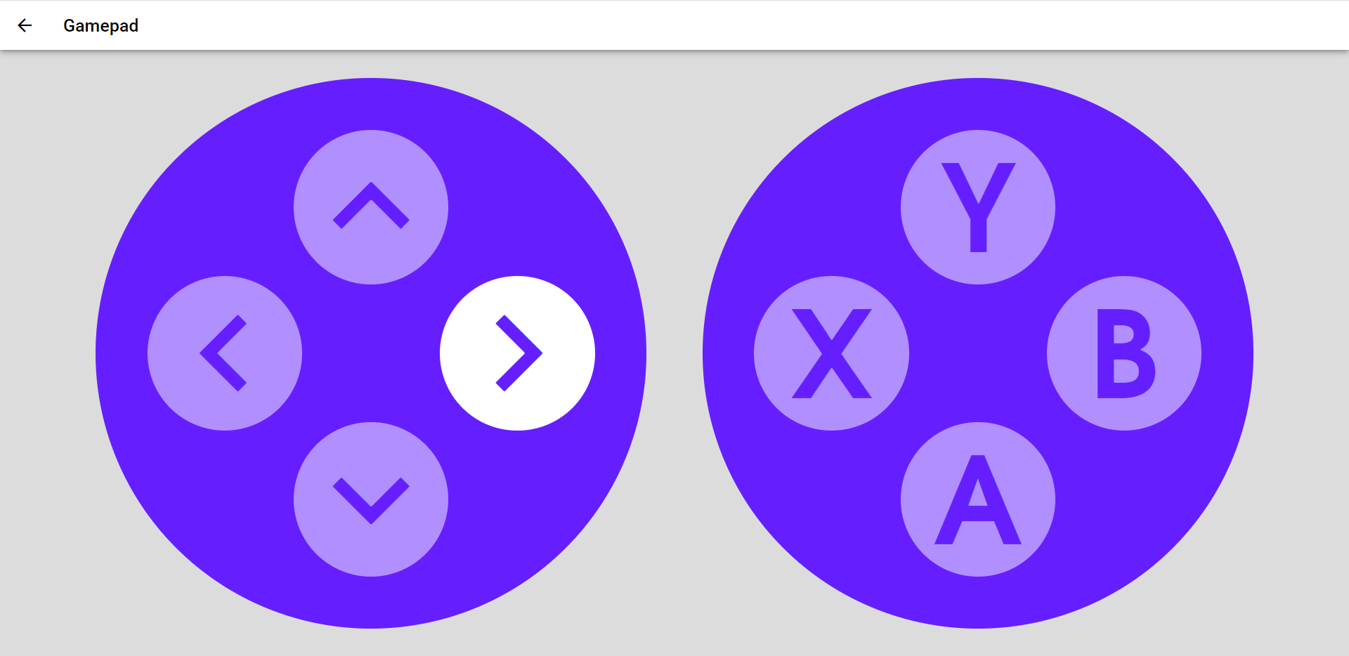
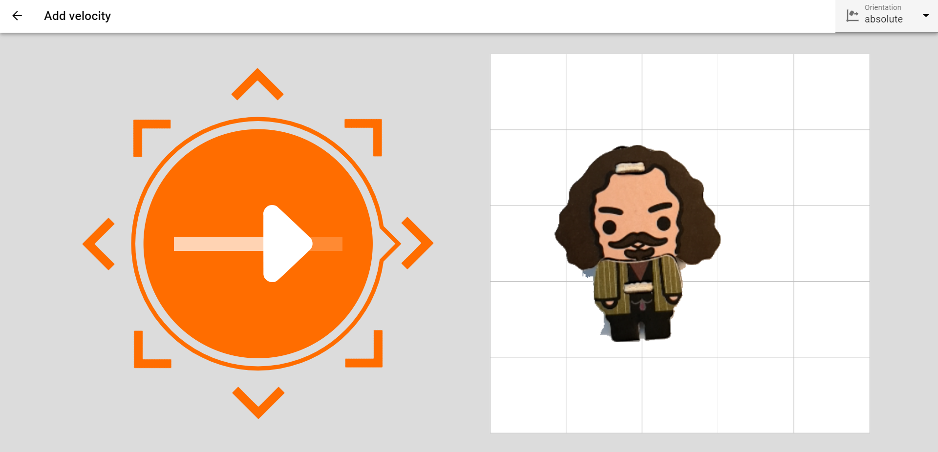
Programme Editor
Editing conditions and actions
Note that when you click on the condition or action after it has been added to the dotted circle, you can adjust their parameters – like changing the button’s direction or increasing the velocity.

Slide 30
Programme Editor
Editing conditions and actions
The icon indicates that something is missing in the programme. It could be that students need to modify a block by clicking on the circle, or something still needs to be added.

Slide 31
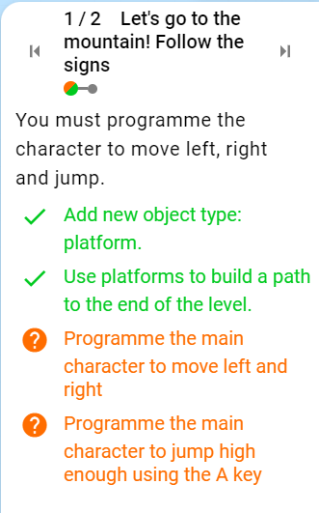
Programme Editor
Example: This sub-goal asks students to programme the character to jump when the ‘A’ key is pressed.
Play the video to see an example solution!

Slide 32
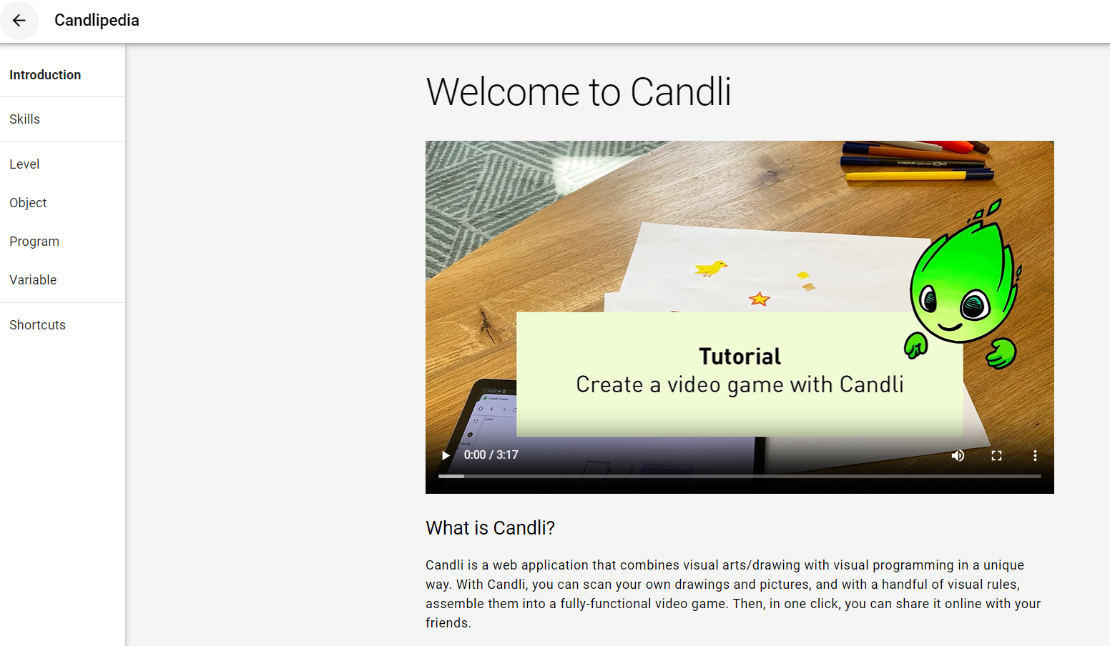
Candlipedia
Candlipedia
‘Candlipedia’, represented by the icon, is documentation in which all the different elements (level, object, program, variable) of the Candli application are clearly explained for teachers and students to understand the platform better.

Slide 33
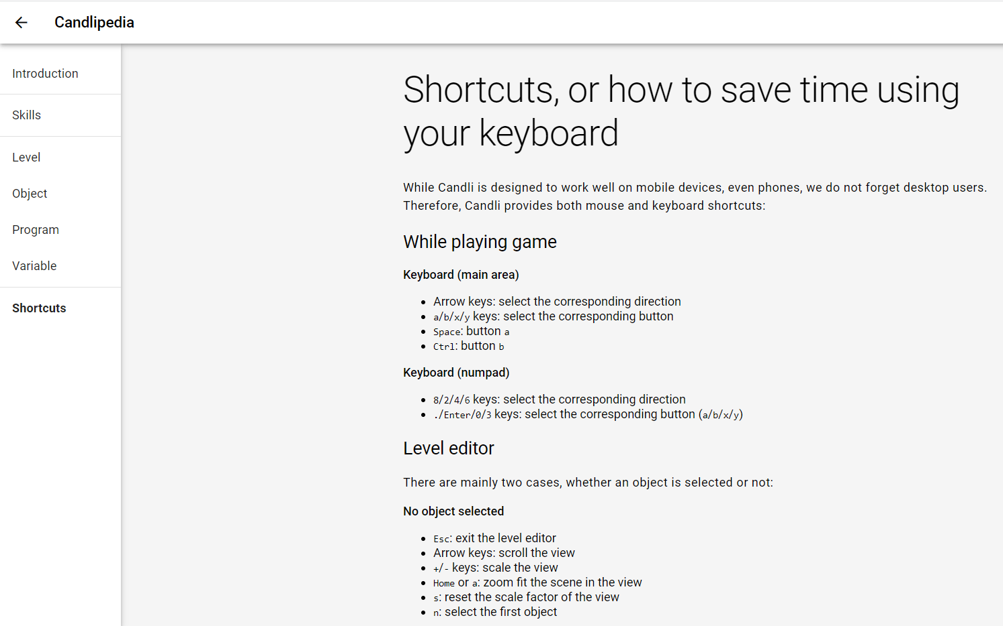
Candlipedia
Candlipedia: Shortcuts
Shortcuts that can help you create the games are also explained.
These can be both mouse and keyboard shortcuts.

Slide 34
Candlipedia
Candlipedia: Skills Framework
You already know that Game Creator aims to develop game design and computational thinking skills among students.
In this video, you can see the various sub-skills, as well as the levels of “mastery”. As students achieve sub-goals in the levels, they will receive feedback on what they can do.
Teachers and students can access this information in Candlipedia in the Skills tab and the teacher dashboard.

Slide 35
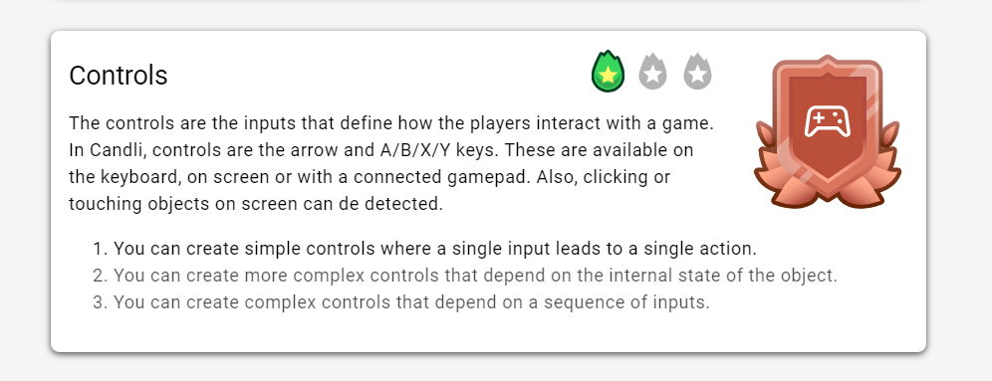
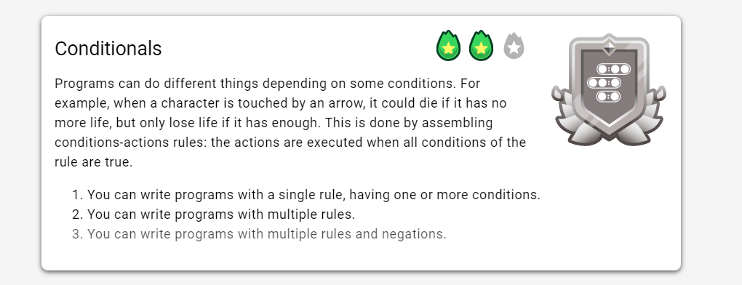
Candlipedia
Candlipedia: Skills Framework
When a student achieves level 1 within a sub-skill, they will “earn” a bronze badge.
When a student achieves level 2 within a sub-skill, they will earn a silver badge.
When a student achieves level 3, they will earn a gold shield.
The small icon is a reminder of their progress.

Slide 36
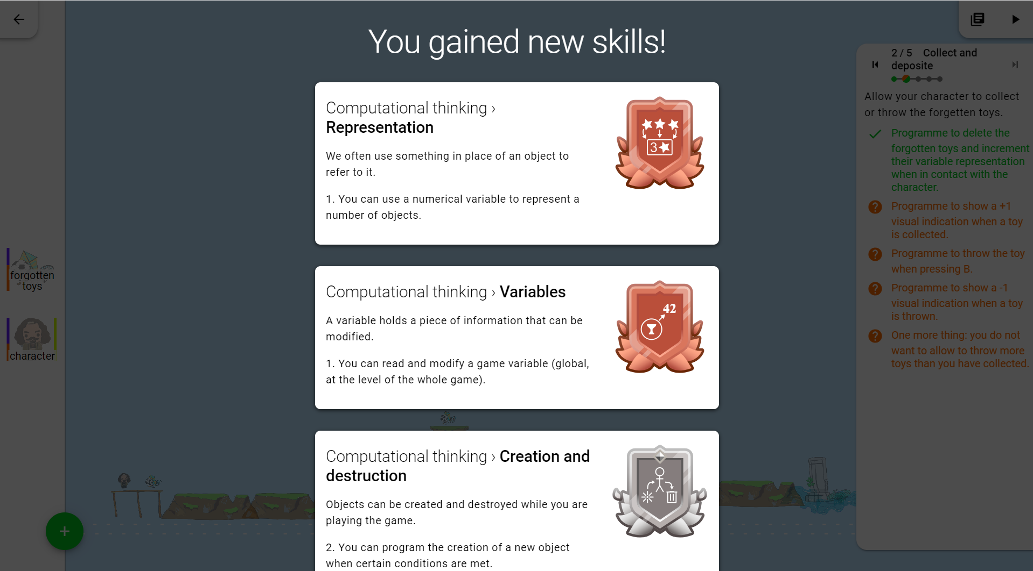
Feedback System
Pop-Up Notifications
The fifth element of Game Creator is its feedback system.
Based on the skills framework available in Candlipedia, students will receive information on the progress of achieving skills through pop-up notifications.

Slide 37
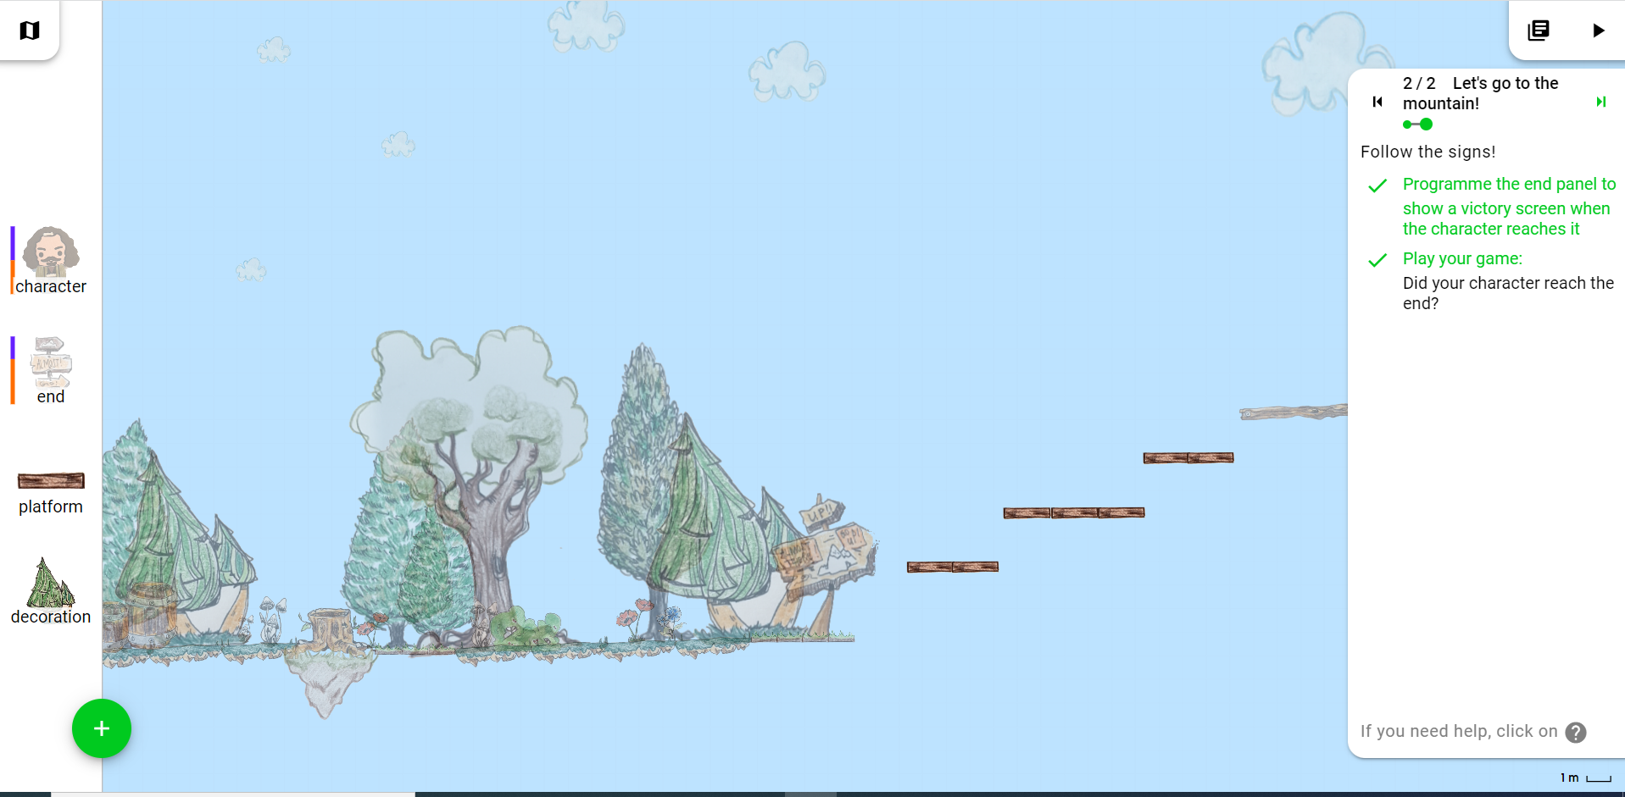
Game Play
Game Play Button
Click on this button to test the game that you have designed and programmed.

Slide 38
Game Creator Map
Map Button
Click on this icon to go back to the map in which the other levels of the experience are present.

Slide 39
Quiz: Section 2
You want to know what skills you have gained after completing a level in the PILA Game Creator. Which of the following can give you that information?
Candlipedia
Programme Editor
Level Editor
Pop-Up Notifications

Slide 40
Quiz: Section 2
You want to know what skills you have gained after completing a level in the PILA Game Creator. Which of the following can give you that information?
Candlipedia
Programme Editor
Level Editor
Pop-Up Notifications

Slide 41
Quiz: Section 2
You need to make a character in the PILA Game Creator jump when the A button is pressed. Which of the following elements would you need to go to?
Game Creator Map
Programme Editor
Level Area
Object Palette

Slide 42
Quiz: Section 2
You need to make a character in the PILA Game Creator jump when the A button is pressed. Which of the following elements would you need to go to?
Game Creator Map
Programme Editor
Level Area
Object Palette

Slide 43
Congrats, you have finished Section 2!
Time for a quick break.

Slide 44
3
How can I use and customise the PILA Game Creator?
BACK TO MAIN MENU

Slide 45
How can I use PILA Game Creator?
The PILA Game Creator has content that is designed either by experts (expert maps and levels), or custom content that you can design and assign as a teacher.
PILA Game Creator
Expert Maps
Custom Maps
Expert Levels
Custom Levels

Slide 46
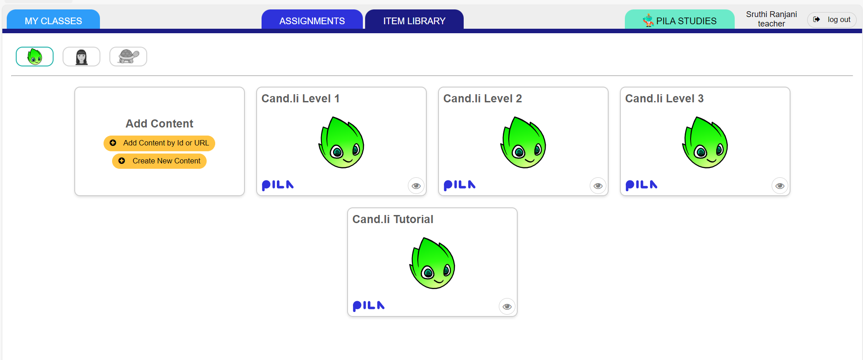
Expert Maps
Expert maps are designed by PILA experts according to evidence-based learning progressions. In your teacher account, you can find maps that meet your needs by filtering by concepts (e.g. repetition), difficulty level, etc. You can immediately assign an expert map as classwork or homework.
Expert maps are tagged with the PILA logo.

Slide 47
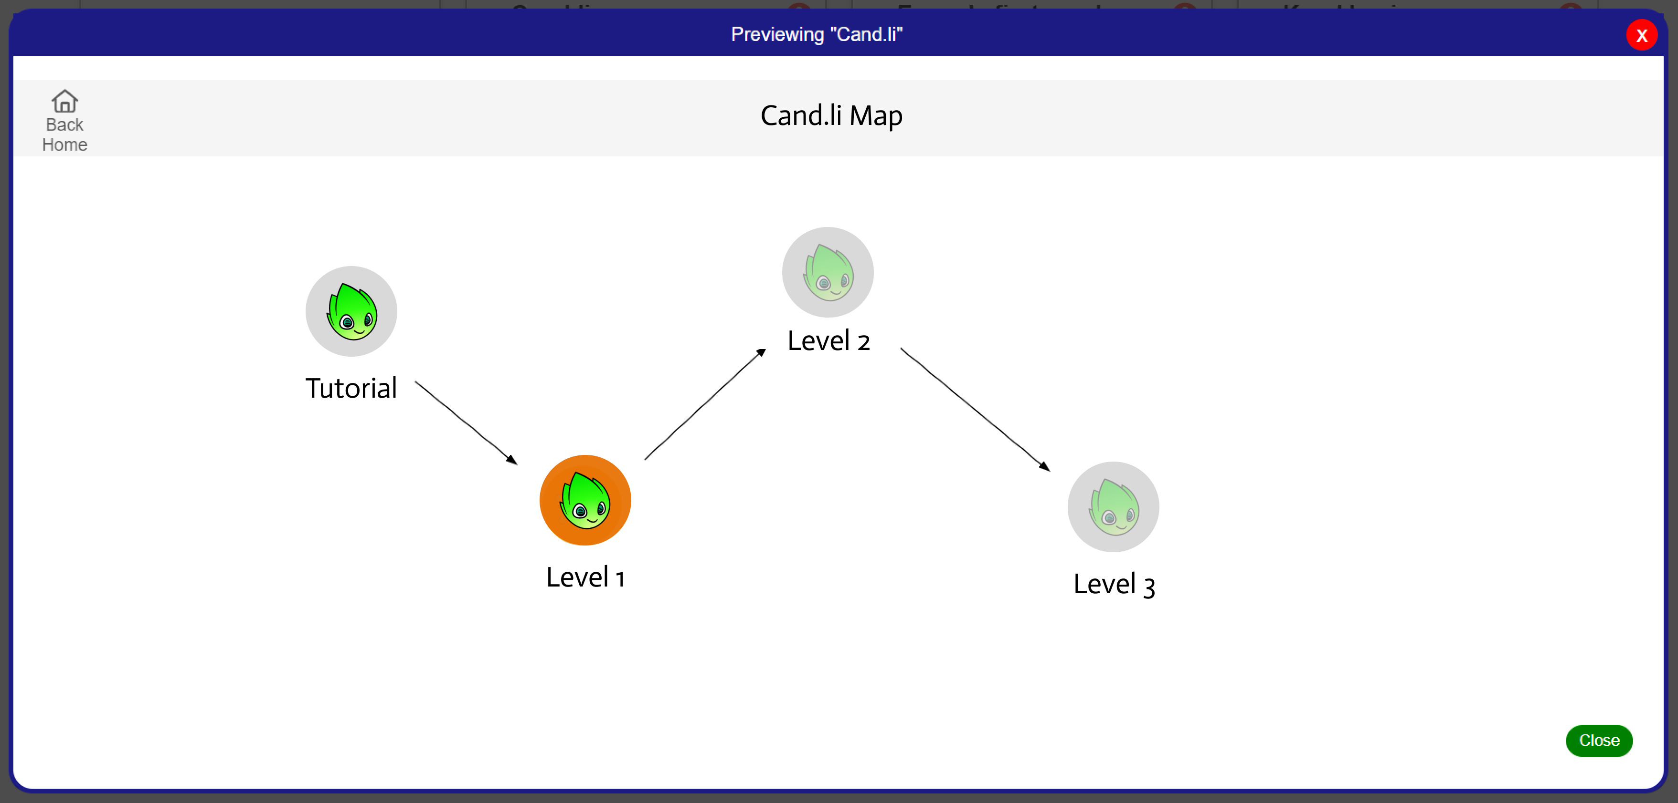
Custom Maps
Custom maps are maps that you can make yourself, by combining either custom levels or expert levels. Custom maps can be created by ordering various game levels in a sequence of your choice.

Slide 48
Custom Maps: Custom Levels
Custom levels can be of different types – depending on the mode of the game world.
Custom levels are levels that you can design and assign to students to work through. You can create a basic level editor and add step-by-step instructions on what the students need to achieve. The students can then begin their design, programming, and testing process.
Custom levels can be of different types – depending on the mode of the game world.
Custom Level Types
Platformer
Maze
Racer
As of now, the expert levels are all only platformer levels on Game Creator.

Slide 49
Custom Maps: Customiser tool
Level Customiser Tool
…
Teachers can use a level customiser tool to develop new levels. They will be able to first select a type of game (platformer, racer or maze). Teachers can build the games using sprites available for this game type. Then, they must write instructions for the teachers.
Rather than automated scoring, students must signal how they achieved different sub-goals. They can explain to teachers in natural language, as well as by pointing to specific elements in the interface to do so.
This tool is currently under development. Expected in Q2 of 2024.

Slide 50
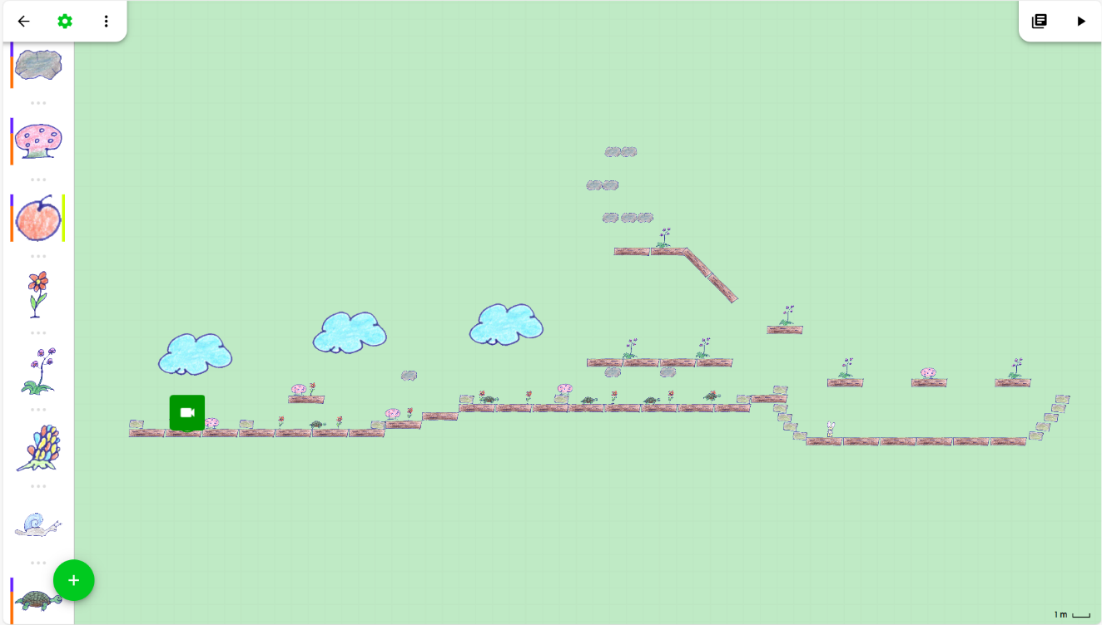
Custom Maps: Custom Levels
Platformer
In platformer-based levels, students typically move their main character horizontally and vertically.
For instance, in the examples you have seen so far, the character is programmed to move left, right, and jump.
To win the game, the character moves on the platform to reach a specified end, while picking up objects and avoiding obstacles.

Slide 51
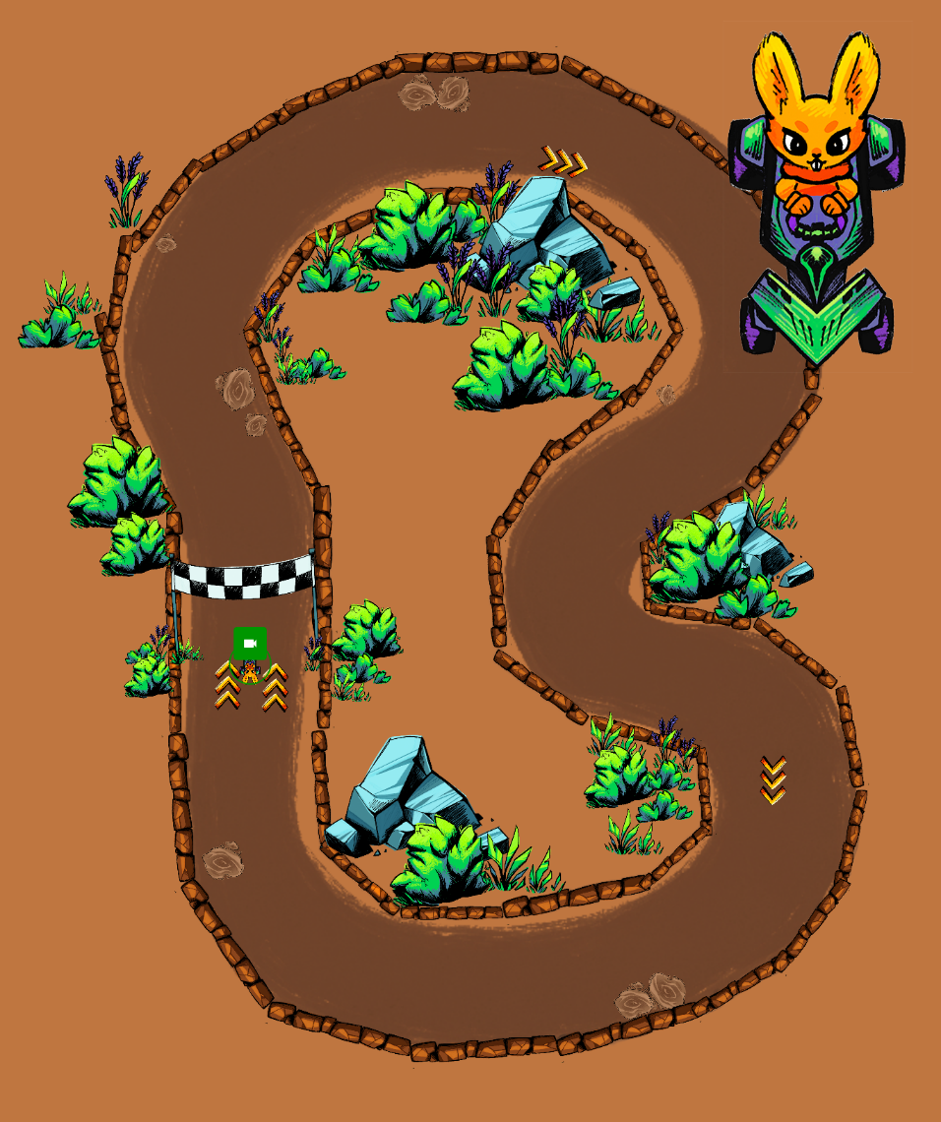
Custom Maps: Custom Levels
Racer
In racer-based levels, students can programme different objects to race.
The levels are set in a top-down view.
In this example, the user must drive the car around the track.

Slide 52
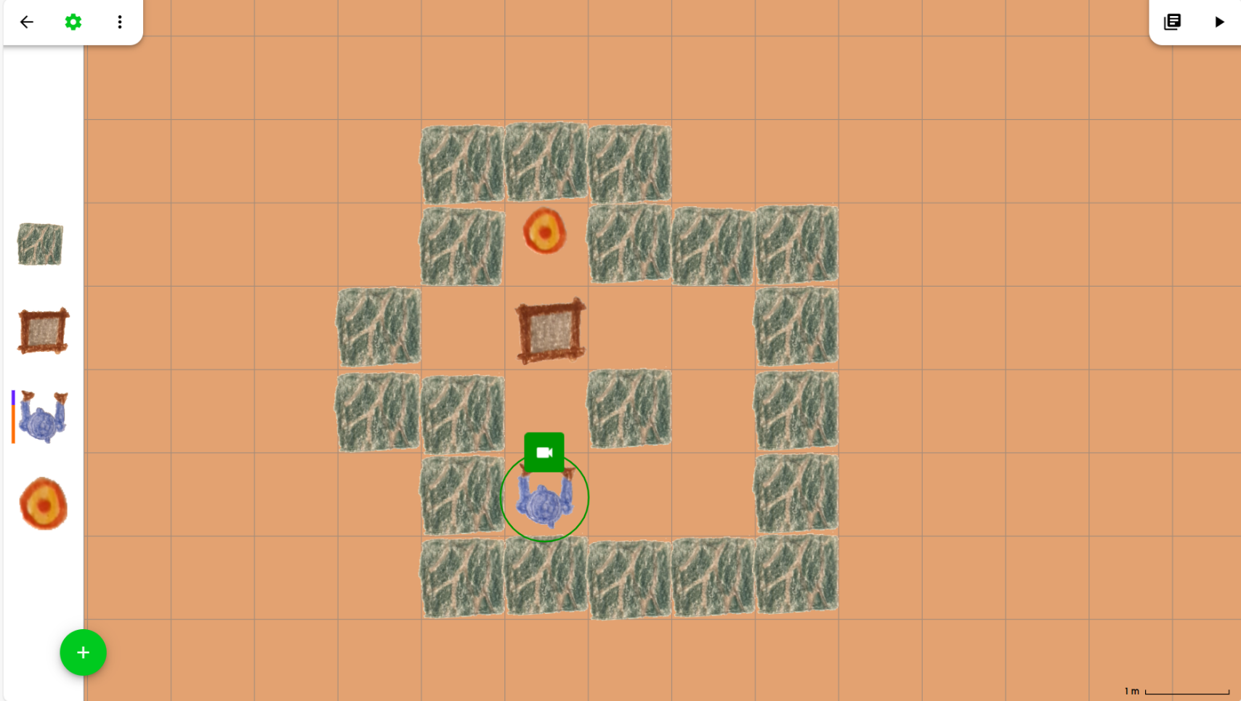
Custom Maps: Custom Levels
Maze
In a maze-based game, the player navigates through a complex network of paths or passages to reach a goal or solve a puzzle.
In this example, the player needs to make the character push the block out of the way from in front of the target. To win the game, the character must touch the target!
…

Slide 53
Quiz: Section 3
Which of the following options is correct about customising maps and levels in Game Creator?
You can create custom racer games
The customiser tool will be available in 2024
Custom levels can be automatically scored
You cannot combine custom levels with expert levels in a custom map

Slide 54
Quiz: Section 3
Which of the following options is correct about customising maps and levels in Game Creator?
You can create custom racer games
The customiser tool will be available in 2024
Custom levels can be automatically scored
You cannot combine custom levels with expert levels in a custom map

Slide 55
Congrats, you have finished Section 3!
Time for a quick break.

Slide 56
4
How can I view students’ progress on the PILA Game Creator?
BACK TO MAIN MENU

Slide 57
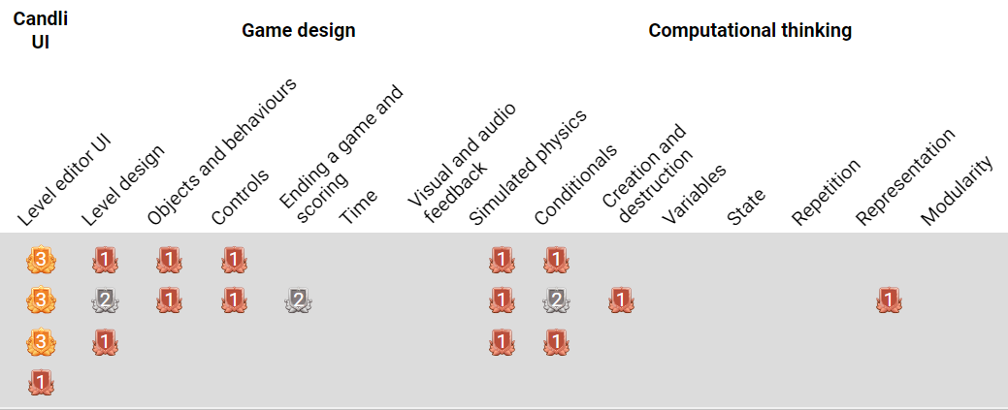
Live Monitoring View
The PILA Game Creator dashboard shows a real-time view of students’ progress. You can see how long they take to finish programming each sub-goal in a level, how many hints they used and what skills they have practised.

Slide 58
Live Monitoring View
These are the different games/game levels.

Slide 59
Live Monitoring View
The boxes in green show how long the student took to complete a specific sub-goal.
The boxes in yellow refer to the tasks that the student completed with the help of a hint.

Slide 60
Live Monitoring View
This column shows the total time the student took to finish a specific level.
This column shows how many hints were used in this level overall.

Slide 61
Live Monitoring View
These are the skills and sub-skills that the PILA Game Creator promotes.
The badges – bronze, silver, and gold – show the progress students have made in a sub-skill.

Slide 62
Quiz: Section 4
Which icon in the PILA Game Creator dashboard tells you how many hints a student has used?
The icon
The icon
The icon
The icon

Slide 63
Quiz: Section 4
Which icon in the PILA Game Creator dashboard tells you how many hints a student has used?
The icon
The icon
The icon
The icon

Slide 64
Congratulations, you’re all done! Take a few moments to look at a quick recap in the next slide.
Notes:
One dense slide here

Slide 65
Introduction to Game Creator
Game design & programming
Elements of the Task Interface
Level Editor
Using and Customising Karel
Expert maps
Viewing student progress
Live-monitoring view
Expert levels
Custom maps
Custom levels
Instruction Panel
Programme Editor
Introduction Video
Candlipedia
Game Play Button
Game Creator Map
Object Palette
Level Area
Conditions
Actions
Shortcuts
Skills Framework
Instructions
Hints
Tutorial
Levels 1-5
Platformer
Racer
Maze
Time taken
Hints used
Skills gained
Sub-skills gained
Badges for levels
Skills: Computational thinking, game design and creative thinking
Levels completed

Slide 66
Well-done! You’re ready to use PILA Game Creator with your students.

